Slide 1
REUNIFICATION - THE PRIMARY PERMANENCY PLANNING GOAL
FACILITATOR CLASSROOM GUIDE
Modified January 2022
Notes:
REUNIFICATION - THE PRIMARY PERMANENCY PLANNING GOAL
FACILITATOR CLASSROOM GUIDE
Modified January 2022

Slide 2
To prepare for the Class
See Notes view
Notes:
To prepare for this class, you should:
Review the facilitator preparation information included in this Guide along with the handouts.
Review the Resources for this theme found on CapLEARN (https://learn.childwelfare.gov/) or NTDC website (https://ntdcportal.org/).
Develop an agenda that includes this theme and any other themes you will be conducting along with it during the class.
Ensure that participants have a copy of the Participant Resource Manual and that it is accessible to them. This Manual will be used during all themes and will have handouts needed by participants. Facilitators should have copies of the handouts for the theme available in case participants do not bring their Manual to class. If the theme is being taught on a remote platform, facilitators should have the handouts available so that they can share in the chat and/or email to participants who do not have their Manual.
Bring any materials you need for the activities.
Review any videos or other electronic media used in this theme, if any, and plan the mechanics of how you will present them. Media for this theme are listed in the Materials and Handouts slide. Review the instructions for each media clip (e.g., to pause or stop at a particular time stamp). The videos can be played in different ways, including:
Play them from a flash drive or the computer’s hard drive using a media player app
Link to them from CapLEARN or the NTDC website.
Practice playing the media for the theme. Ensure that you have the files and apps you need, that your links and connections work, and that you know when to pause or stop the media clip if appropriate.
If training on a remote platform, make sure all participants have the link available to access the class and that you have all videos, PPT’s and handouts ready for use.
If training in person, ensure that a room is available and set up, with the following:
Enough tables and chairs for all participants
Projector and screen (check that it works with the computer you will be using)
Classroom activities have been adapted so that they can be done on a remote platform. Adaptations will be marked as follows so that they can be easily spotted throughout the Facilitator Classroom Guide: Adaptation for Remote Platform
TO PREPARE FOR THE CLASS

Slide 3
MATERIALS AND HANDOUTS
See Notes view
Notes:
FACILITATOR'S NOTE
Participants are expected to have the Participant Resource Manual available for every session.
MATERIALS NEEDED
You will need the following if conducting the session in the classroom:
A screen and projector. Test before the session with the computer and cables you will use.
A flipchart or whiteboard and markers for several of the activities. A flipchart with a sticky backing on each sheet may be useful and will allow you to post completed flipchart sheets on the wall for reference.
Name tent cards (use the name tent cards made during the Introduction and Welcome theme)
You will need the following if conducting the session via a remote platform:
Access to a strong internet connection
A back-up plan in the event your internet and/or computer do not work
A computer that has the ability to connect to a remote platform- Zoom is recommended
HANDOUTS
Have the following handouts accessible. Participants will have all handouts listed below in their Participant Resource Manual:
Handout #1: Permanency Options
Handout #2: Case Study: Chandra
Handout #3: Supporting a Child Through the Reunification Process.
VIDEOS AND PODCASTS
Before the day you facilitate this class, decide how you will show/play the media items, review any specific instructions for the theme, and do a test drive. You may wish to set up the media to the start point. Unless indicated otherwise below, all videos and podcasts can be obtained on CapLEARN (https://learn.childwelfare.gov/) or NTDC website (https://ntdcportal.org/).
The following media will be used in this theme:
Creating a Successful Reunification (8:32 minutes)
EVALUATION
There is a pre- and post-survey available for every theme. If the facilitator wants to use these evaluation tools, they will need to be downloaded from the NTDC website or CapLEARN and provided to participants. Participants will need to complete the pre-survey prior to the theme and the post-survey upon completion of the theme. If conducting the class on a remote platform, the facilitator will need to put the surveys into an online format such as survey monkey.
MATERIALS AND HANDOUTS

Slide 4
Theme and competencies
See Notes view
Notes:
FACILITATOR'S NOTE
Before beginning, review the theme and competencies. You will not read these aloud to participants. Participants can access all competencies in their Participant Resource Manual.
THEME AND COMPETENCIES
4

Slide 5
Suggested agenda
See Notes view
Notes:
FACILITATOR'S NOTE
This notes page shows a suggested agenda and timing for this theme. Before the theme, please review this agenda and incorporate it into your overall agenda for this and any other themes you are conducting along with it.
AGENDA
This theme is divided into four sections. This content is based on approximately 1.5 hour of classroom material.
BEFORE YOU BEGIN THE CLASS
Before discussing the Color Wheel of Emotions and covering the content of this theme, you should do the following:
Make any announcements that are needed regarding the training, timing of training, or process to become a foster or adoptive parent.
Take out the Participant Resource Manual and direct participants to this theme in their Manual. Remind participants that the Competencies for today’s theme are in their Manual.
Review the agenda for the theme. Facilitators should add a slide to the PPT deck that includes the agenda so that they can review it with participants. Make sure to include start and end times and any breaks that will be taken during the session.
Encourage participants to be engaged and active learners.
Encourage participants to contact you in between classes with any questions and/or concerns. (Prior to class, list the name(s) of the facilitators on the board with contact information.)
Remind participants to put out their name tents (these can either be made by the participants during the first class or the agency can print out name tents and provide them to the participants at the first class). If conducting the class on a remote platform, remind participants to type their first and last names in their screen box.
SUGGESTED AGENDA

Slide 6
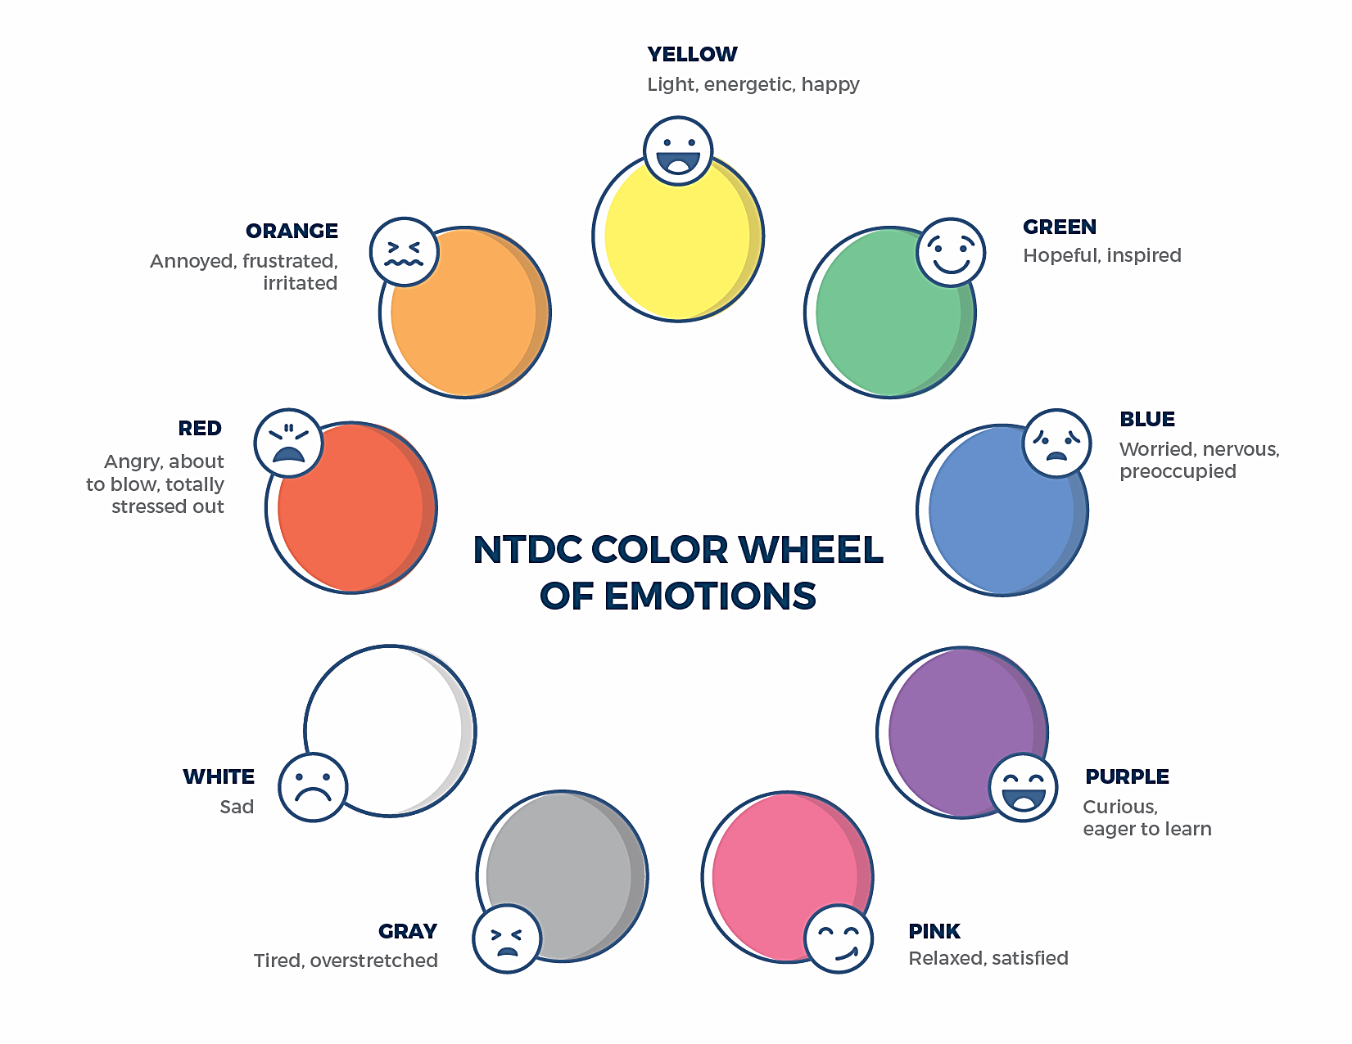
Welcome to the national training and Development Curriculum for foster and adoptive parents
Notes:
FACILITATOR'S NOTE
Have this slide showing onscreen as participants assemble for the first class of the day. As participants come in, welcome them back and ask them to take a few minutes to do a self-check using the Color Wheel. NOTE: The Color Wheel should only be done one time per day; before the first theme of the day. If combining several themes together on one day, facilitate the Color Wheel at the beginning of the first class of the day as participants are coming into the room.
SAY
Welcome back. We are so glad that you have taken time out of your day to join us for another exciting learning opportunity. As you recall, tuning in to how you’re doing on a daily basis may not be something everyone here is used to, but this type of regular self-check is critical for parents who are adopting or fostering children who may have experienced trauma, separation, or loss, as it will be helpful to become and stay aware of your own state of mind. It may seem like a simple exercise but be assured that knowing how we’re doing on any given day strengthens our ability to know when and how we need to get support and/or need a different balance. Doing this type of check in will also help us to teach and/or model this skill for children! Please take a moment to look at the color wheel and jot down on paper the color(s) that you are currently feeling.
DO
Wait a little while to give participants time to complete the Color Wheel.
SAY
Now that everybody has had the opportunity to do a quick check in, would someone like to share what color(s) they landed on today for the Color Wheel?
DO
Call on someone who volunteers to share their color(s). If a challenging emotion or feeling is shared, thank the person and acknowledge their courage in sharing, pause for a moment, encourage everyone to take a deep breath, and transition to beginning the theme.

Slide 7
REUNIFICATION - THE PRIMARY PERMANENCY PLANNING GOAL
Modified January 2022
Notes:
FACILITATOR'S NOTE
Show this slide briefly just before you start the class.
SAY
Let’s get started! Welcome to the Reunification theme.
7

Slide 8
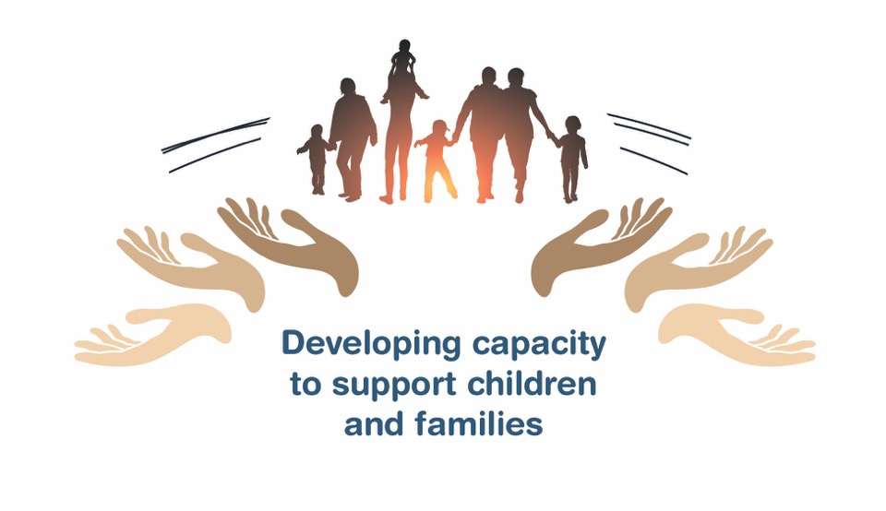
Place holder for slide with opening Quote
Notes:
FACILITATOR'S NOTE
The opening quote slide should only be used for the first theme of the day. If combining several themes together on one day, the opening quote slide would only be shown after the Color Wheel at the beginning of the first theme. It is important to always emphasize with this slide that this type of parenting involves lifelong learning and that it will be critical for families to be invested in their own learning before and after a child is placed in their home.
PARAPHRASE
We are excited to share this lesson with all of you today. We are going to start with the Reunification theme. As the slide states, this information will help to develop your capacity to support children and families. This type of parenting will require continuous learning. So, let’s dive in and see what important information we have to share with you today.
8

Slide 9
SECTION 1:
INTRODUCTION: REUNIFICATION-THE PRIMARY PERMANENCY PLANNING GOAL
Notes:
PARAPHRASE
We will be covering the following in this theme:
Reunification is the primary goal for children in foster care, and approximately half of all children return to their family of origin through a reunification plan. Reunification is the primary goal because most children want to return to their parent, familiar surroundings, and relationships.
Most parents love and care for their children and, often with additional supports, they can provide safe and loving care. Reunification allows a child to maintain important connections with their parent, extended family, and community.
The process of reunification can be complex and is usually controlled by a court with advice from caseworkers and attorneys. The child’s parents are given a case plan that includes the steps they must take in order for their children to be reunited with them.
The reunification process is likely to be stressful for the child, the child’s parents, and the family that is fostering.
As a parent who is fostering, your role will be to protect the child’s physical and emotional safety, and support the child and the parents through the reunification process.
When reunification is not possible, the child welfare agency will start to consider other permanency options for the child. In your Participant Resource Manual, Handout 1: Permanency Options, has been included as a resource that gives more information on permanency options that will be considered for the child.

Slide 10
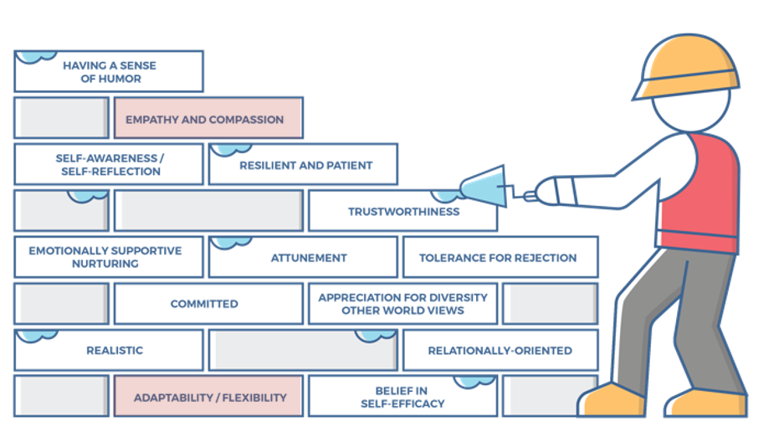
Characteristics of successful foster and adoptive parents
10
Notes:
FACILITATOR'S NOTE
This slide is shown at the start of each theme. Although the graphic will remain the same, the bricks that are colored in red will change based on the characteristics that will be touched upon in this theme. The characteristics were obtained from review of literature, stakeholder interviews, and review of existing curricula. We want families to become very acquainted with these characteristics throughout the training. It is important to note that in addition to the characteristics that are highlighted in red, there may be additional characteristics that are touched upon during the theme. Facilitators should try to connect these characteristics to the content they are sharing throughout the training. Remind participants that their Participant Resource Manual contains the definitions for these characteristics.
SAY
Before we get into the content lets look at the 14 characteristics of successful foster and adoptive parents. When you took your self-assessment, you were asked about these characteristics.

Slide 11
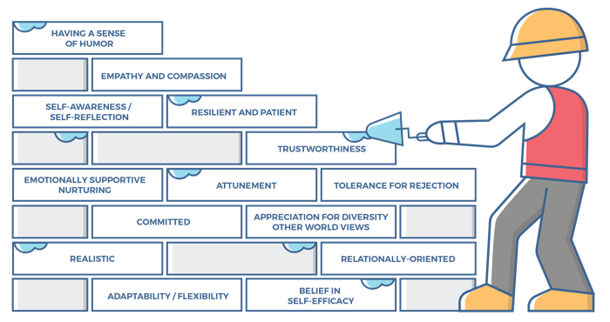
Characteristics for Reunification
Empathy and Compassion:
Parents can perceive/feel others’ emotions, particularly others disappointment or sadness.
Parents can look past the current behavior and find the core distress related to the child’s response.
Parents know they cannot shield the child from pain but must allow the child to experience and express pain and grief.
Adaptability/Flexibility:
Parents are willing and able to make changes in their parenting style/responses in order to be accommodating, encouraging, and supportive to the physical, emotional, and cognitive needs of the child.
Parents share the responsibility of caring for the child and are not restricted by stereotypical or societal roles/expectations.
Parents can acknowledge when something is not working and are able to try a different approach or modify their expectations for the child.
Notes:
SAY
The Reunification theme will cover the following characteristics:
Empathy and Compassion
Adaptability/Flexibility
Take a moment to think back to how you assessed yourself with these characteristics. It is important as you start this journey to assess your characteristics as they are qualities that can strengthen your ability to successfully parent a child who is in foster care or has been adopted.
ASK
Now that we have reviewed the definitions, why do you think these specific characteristics are important to reunification?
Reinforce the following:
Empathy and Compassion
Being separated from their parents is emotionally difficult and the child will need your empathy and compassion as they deal with their worry and feelings of loss.
For the parent, being separated from the child is also emotionally difficult. The empathy and compassion that you have and that you show for the child’s parents will go a long way in developing a positive partnership with the parents to best meet the child’s needs. The child will also benefit from seeing this partnership.
Adaptability/Flexibility
Supporting the child’s visitations with parents often requires a willingness to be adaptable and flexible. If a plan does not seem to be working well, be willing to work with the child’s parents and caseworker to develop a plan that can work better.

Slide 12
SECTION 2:
REUNIFICATION PROCESS
Notes:
FACILITATOR'S NOTE
Allow 20 minutes for this section.
PARAPHRASE
We’ll start by talking about the process of reunification.

Slide 13
What are Your Thoughts?
REUNIFICATION
Notes:
FACILITATOR’S NOTE
This is a 5-minute large-group brainstorming exercise to capture participants’ thoughts on reunification.
Note: There is a Kinship Caregiver adaptation for this slide in the addendum of this theme.
DO
Write “REUNIFICATION” in large letters at the top of a flipchart or whiteboard.
Adaptation for Remote Platform: Instead of a flipchart, add a new blank slide and then use Zoom annotate feature (text) to reflect participant responses. If not using Zoom, you can use Jamboard like a whiteboard. (You need a Google account to access Jamboard.)
PARAPHRASE
We will start this section with a quick brainstorming activity to capture your thoughts about reunification. Write down whatever comes to mind -positive or negative when thinking about reunification. This is brainstorming, so the goal is to create a lot of ideas and not worry about whether they are “right.”
You’ll have a few minutes to brainstorm, and then ask for people to share what they wrote down.
DO
Ask the class to write down what they think about reunification.
Ask participants to share their thoughts with the entire class.
Facilitate the discussion by writing key words, thoughts, and ideas on the flipchart or whiteboard.
PARAPHRASE
Often, there are a lot of feelings about reunification. Reunification can be difficult for parents who are fostering because they get attached to the child. It is not uncommon for parents and families who are fostering to feel some sadness when a child that has lived with them is reunified. For some families this can be the most challenging part of fostering. It is important to know that about half of the children that come into care will be reunified which means it is highly likely that a child you foster will go home. As a result, parents who foster need to be prepared and ready to support the child through this transition so that it can be as smooth as possible.
Let’s start by walking through the process for reunification.

Slide 14
The REUNIFICATION Process, 1 of 5
Enter the
Child Welfare System
Reunification Plan
Achieve Plan Goals
Reunification
Details vary with from state to state.
Notes:
PARAPHRASE
While every state and tribal nation has different processes for bringing a child into the child welfare system and for determining the criteria for reunification with their family, some elements of the process are similar.
We’ll look at these three major steps.
FACILITATOR’S NOTE
The online theme, Overview of Child Welfare, covers in more depth how children come to the attention of the child welfare system and the process they go through in leaving the system. It is recommended that participants do this theme prior to Reunification- The Primary Permanency Planning Goal.

Slide 15
The REUNIFICATION Process. 2 of 5
Enter the
Child Welfare System
Reunification Plan
Achieve Plan Goals
Reunification
Why do children enter?
Parental abuse, neglect, abandonment or incapacity
Possibly other reasons
Where are they placed?
With relatives
With nonrelated foster parents
Notes:
PARAPHRASE
Children generally enter the child welfare system due to abuse, neglect, or abandonment. Sometimes, the parent’s mental health, drug use, or incarceration, results in the parent’s inability to care for the child and endangers the child’s safety. When possible, children are placed with relatives. When relative placement is not an option, children may be placed with nonrelative foster parents.

Slide 16
The REUNIFICATION Process, 3 of 5
Enter the
Child Welfare System
Reunification Plan
Achieve Plan Goals
Reunification
Reunification is the primary plan
Tailored to the needs of the child and parents
Timeline usually established by the court
Notes:
PARAPHRASE
Because typically the primary goal is reunification, there is a plan developed for the parent to follow that addresses the reasons the child was removed. Most often the plan has a timeline established by the court, with the hope that within a reasonable amount of time, the parent(s) will be able to have their child returned to them.
Reunification plans are tailored to the specific needs of the child and the child’s parent. They may include parenting classes, substance abuse rehabilitation, release from incarceration, anger management classes, therapy, and other requirements to address the parent behavior or circumstances that led to the child’s removal. Reunification plans include visitation, so that the child and parent can maintain a positive relationship, and often, the child’s parent can receive guidance in relating to the child in a positive way. Visitation might be supervised or unsupervised, depending on the risk to child safety.

Slide 17
The REUNIFICATION Process, 4 of 5
Enter the
Child Welfare System
Reunification Plan
Achieve Plan Goals
Reunification
Parent is responsible for achieving goals.
Caseworker assists, guides the process, and makes recommendation to the court.
Notes:
PARAPHRASE
The child’s parent is responsible for achieving the goals set for them to work toward reunification with their child, usually within a specified time frame. They have a caseworker assigned to help them achieve those goals, and in some cases, they also have a peer mentor who can encourage them and share their experience with a successful outcome. The caseworker and the court are responsible for guiding the reunification process, and usually the caseworker makes the recommendation to the court to determine whether the parent has achieved the goals necessary for reunification.
Parents who are fostering are also critical in the reunification process in that they can help to facilitate visits, ensure the child stays connected with their parents, and even support the parents as they work toward completing the goals necessary for reunification.
The timeline set by the court (state or tribal) can be modified, extended, or shortened, depending on the progress or lack of progress that is being made by the parent.

Slide 18
The REUNIFICATION Process, 5 of 5
Enter the
Child Welfare System
Reunification Plan
Achieve Plan Goals
Reunification
If the plan is going well:
Visits increase in frequency and duration
Ongoing caseworker support
If the plan is not going well:
Other permanency goals may be considered.
Notes:
PARAPHRASE
When the reunification process is going well, and the caseworker recommends to the court that the child should return to the parent, a plan is made for when and how the child will be reintegrated into the home. As reunification gets closer, the frequency and duration of visits will increase.
If the parent is not able to complete the tasks necessary for reunification, the child welfare agency will explore other permanency options such as adoption and guardianship. It is possible that the child can remain in their current foster home and move toward adoption or guardianship. If the parent who is fostering the child does not want to consider adoption or guardianship, then the child welfare system will look for another family that is able and willing to be a permanent family for the child. This will allow the child to have stability as they grow into adulthood.

Slide 19
SECTION 3:
PARTICIPATION IN REUNIFICATION PLANS
Notes:
FACILITATOR’S NOTE
Allow 60 minutes for this section.
PARAPHRASE
Parents who are fostering participate in the reunification process as part of the support system to both the child and the child’s parent.
19

Slide 20

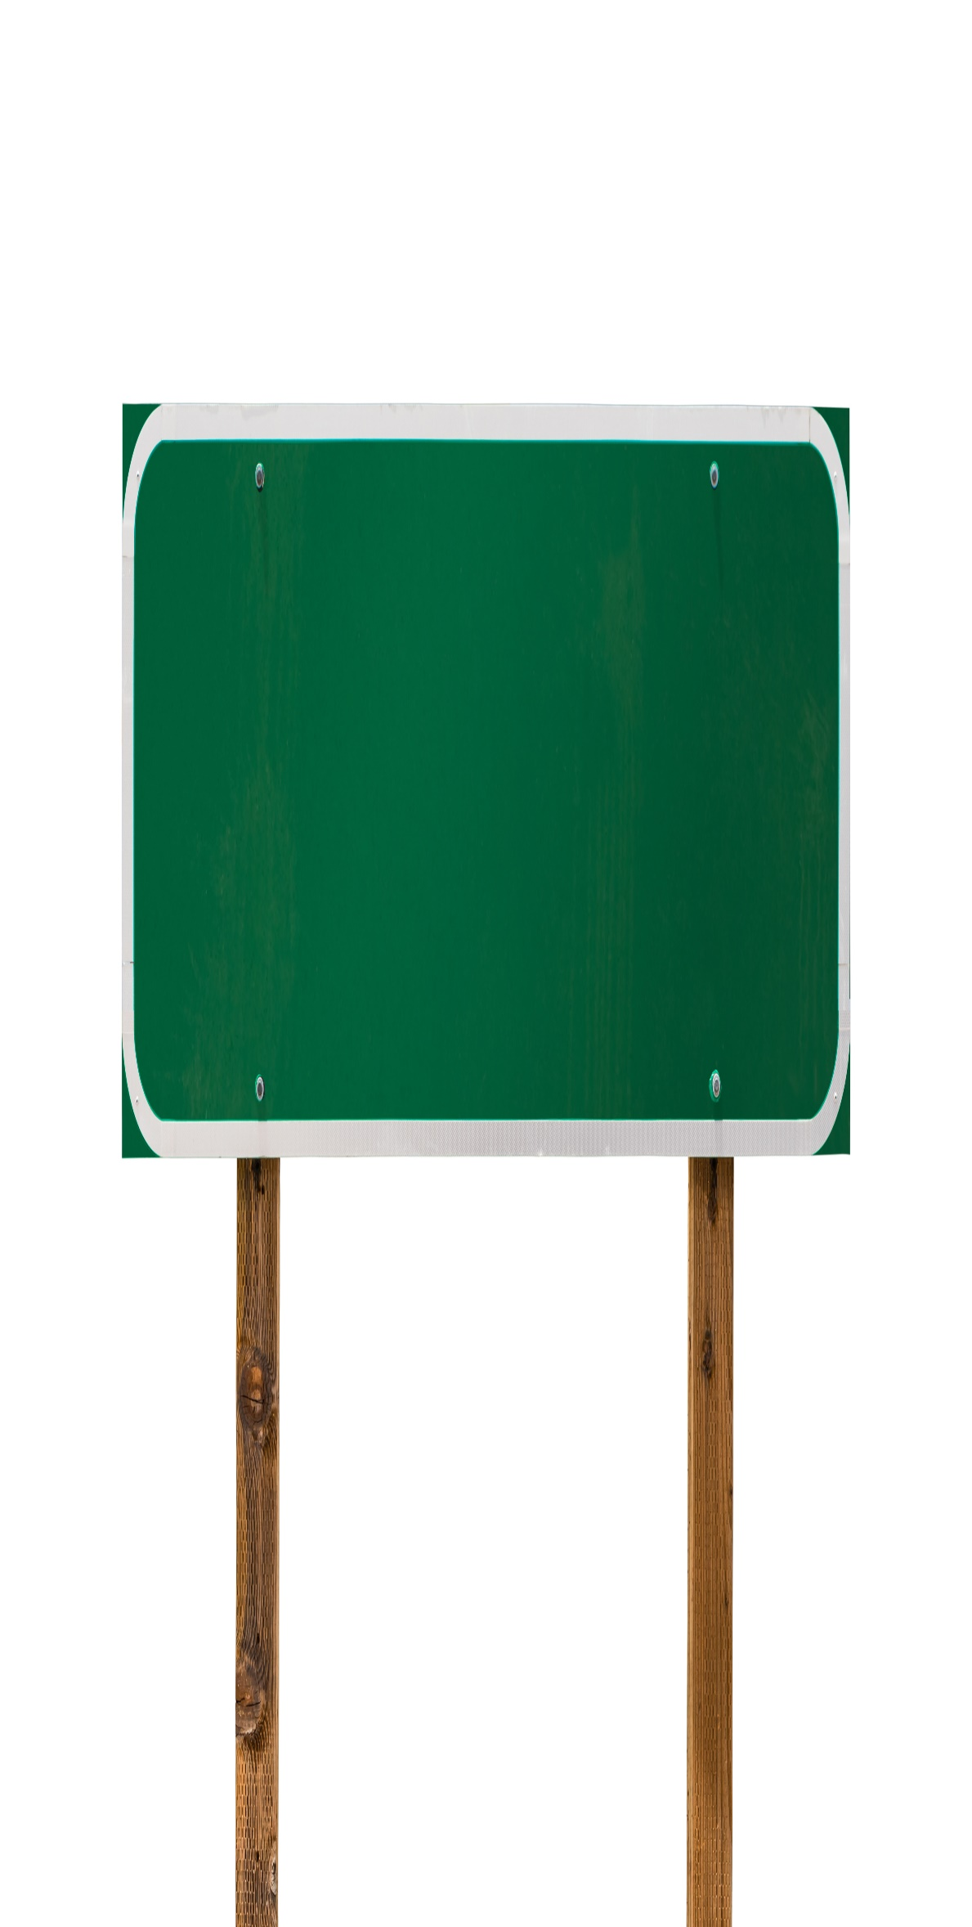
Concurrent Planning, 1 of 3
REUNIFICATION
Primary plan
PLAN A
Notes:
PARAPHRASE
As discussed, the primary goal is reunification.
But reunification is not always possible. When parents don’t complete the work necessary to be reunited with their children, the child welfare agency will work towards achieving another permanency goal and plan.

Slide 21
Concurrent Planning, 2 of 3
REUNIFICATION
Primary permanency plan
PLAN A
CONCURRENT PLANNING
Other permanency options
PLAN B
Notes:
PARAPHRASE
Concurrent Planning allows the system to develop a Plan B in case reunification is not possible. The Child Welfare Information Gateway describes Concurrent Planning as follows:
READ this definition:
Concurrent planning, required by the Adoption and Safe Families Act of 1997, is an approach that seeks to eliminate delays in attaining permanent families for children and youth in foster care. Effective implementation requires comprehensive and early assessment. It involves identifying and working toward a child's primary permanency goal (such as reunification with the child’s family), while simultaneously identifying and working on a secondary goal (such as guardianship with a relative). This practice can shorten the time to achieve permanency if efforts toward the primary goal prove unsuccessful because progress has already been made toward the secondary goal.

Slide 22
Concurrent Planning, 3 of 3
GOALS OF
CONCURRENT PLANNING
Consider other permanency options if reunification is not possible.
Minimize moves for the child.
Respect existing relationships.
PLAN B
Notes:
PARAPHRASE
Let’s take a closer look at concurrent planning.
In concurrent planning, while the reunification plan is being worked on, a simultaneous Plan B is being considered if reunification does not work. If the child is placed with a relative, there should be exploration of the possibility that the relative will consider guardianship or adoption. If the child is placed in a nonrelative foster home, the parent who is fostering should be considered for guardianship or adoption as well. Most states and some tribal nations now require that parents who are fostering go through the same front-end training and process as parents who want to adopt, so that there is an option for the child to remain with the foster family if reunification does not work out. This does not mean that every parent who is fostering will want to become a guardian or adoptive parent. The ultimate goals of concurrent planning are to:
Minimize the number of moves for the child
Reduce the time for the child to achieve permanency
Respect the relationships the child has established.
However, it is important to remember that reunification is the primary goal when they enter the system and will be fully pursued in hopes of reuniting the child with their family.
The concurrent planning process can be challenging for parents who are fostering as the change in a permanency goal can change the path that they initially thought they were on, change their role with the child, and add uncertainty regarding what the permanency plan will ultimately be for the child. This requires the parent who is fostering to have a great deal of flexibility (characteristic).

Slide 23

Creating a Successful reunification
Notes:
PARAPHRASE
The parent who is fostering plays an important role in setting the tone for the child, listening to the child’s feelings and concerns, helping the child understand what is happening with the reunification plan, and making sure that communication with the child’s parent is consistent with the reunification plan.
Now let’s watch a video of Kim Batiste, a parent, and Dennis Volk, who fostered her children, talking about their partnership in reunifying Kim’s two sons with her, and the support that followed. Dennis has been fostering for over 40 years and is an adoptive parent. He had casually known Kim from the community, and he provided care for Kim’s children while she was becoming clean and sober, to successfully reunify with them. In this scenario, the mother (Kim) was able to work very well with the parent who was fostering (Dennis). This will not always be the case, so after watching this video, we will do a case scenario where the relationship between the child’s parent and the parent who is fostering is not as strong or positive.
DO
Play the video, Creating a Successful Reunification (8 minutes and 32 seconds) found on the NTDC website or CapLEARN. After the video stops, facilitate a brief discussion.
PARAPHRASE
When a child is ready to return home, the parent who is fostering plays an important role in setting the stage for a successful transition, providing encouragement to both the child and the parent. It is important that the child understands the plan, the timing of visitation, and when the anticipated move home is expected. Children should not be left to wonder what will happen. If old enough, they should be given a part in planning the return home. Often transitional visits and overnights precede the actual move, and you need to maintain a positive attitude that reunification will be successful. Offering support such as respite from time to time, advice by phone, or just a listening ear, can ease the transition for the child and their parent.
ASK
Thinking back on Kim’s and Dennis’s relationship, and the support Dennis provided to Kim after reunification:
Consider what you might be comfortable with and willing to do.
Consider what you might find difficult to do.

Slide 24

Supporting reunification: visitation
Notes:
PARAPHRASE
Visitation is critical for reunification, and parents who are fostering play a key role in the visitations. It is important that you discuss visitation with their caseworker, so that a plan can be developed that works for all parties. Parents who are fostering can choose to not have the visits in their home, but instead in a neutral place, such as the agency office, McDonalds, local park, zoo, etc. Parents who are fostering are also key in helping the child find ways to maintain contact and connection with their parents when they are not visiting, such as phone calls, letters, facetime, texting, etc.
Even if the reunification is not be possible, the child’s connection to their parents is still important. Opportunities to maintain connection should be discussed with the caseworker.

Slide 25

CASE STUDY:
Chandra
Notes:
FACILITATOR’S NOTE
In this case study exercise, you will distribute Handout #2: Chandra Case Study. Break the class into several groups of 4 to 5 participants. Participants will read the handout and think about what they could say or do to support Chandra. In each group, participants will discuss what they would do or say to support Chandra if they were fostering her. (Allow 10 minutes for the case study and discussion that follows on the slide labeled- Chandra: Suggested Responses.)
PARAPHRASE
I’m going to hand out a copy of the case study about Chandra, a 15-year-old girl whose mother is having difficulty with the reunification plan. Please read it and think about what you would say or do to support Chandra.
DO
Distribute Handout #1: Chandra Case Study.
If you wish, you can read the case study aloud to the group or ask a volunteer to do so (see text below or in the handout).
Break the participants into small groups.
Allow participants a couple of minutes to write down their ideas on what they can do or say to support Chandra and then discuss within their small group.
Reconvene the large group to go over the next slide.
FACILITATOR’S NOTE
The case study text is:
Chandra is 15 years old and has been in your home for 8 months. She was removed from her mother’s care when her mother, Diandra, was arrested for stealing money from her employer and taken to jail. She used the money to buy drugs, as she had a longtime drug habit. Her employer declined to press charges and hoped that she would get treatment for her drug use. Chandra was aware of her mother’s drug use, but they had managed to barely get along before her mother was arrested. Diandra had a reunification plan she was to follow to have Chandra returned to her care. The plan included a 90-day drug treatment facility in lieu of prison time, visitation with Chandra at the rehab facility, staying clean, and getting a job after she completed the program, going to NA meetings, and regular visitation with Chandra at the County Department after drug treatment.
For the past 4 months, Diandra has missed 50% of the visits with Chandra. Diandra lost her job, and she has not been attending regular NA meetings. Her caseworker has told her that the judge will not extend her reunification if she does not start to meet the reunification plan requirements, and Chandra will not be returned to her. Chandra is angry at her mother for not following through, and every time she misses a visit, Chandra cries and says she does not understand why her mother doesn’t love her.

Slide 26
Chandra: Suggested Responses
I know this is hard for you, and you are disappointed.
Your mother has some struggles that she is not managing well right now, but that does not mean that she does not love you.
I am here to talk with you about your feelings whenever you want to talk.
Would you like to start writing in a journal so that you can put your feelings down on paper?”
Would you like to write a letter to your mother and tell her how you feel? You can keep the letter or send it to her-your choice.
Let’s call your caseworker/therapist and make an appointment to talk with them about what the plan is for you and your mother.
Notes:
PARAPHRASE
Was it difficult to think of helpful and supportive things to say or do in this situation? Here are additional things you could say to Chandra.
DO
Ask a volunteer to read the bullets on the slide.
PARAPHRASE
We’ve learned a lot about reunification, the reunification process, and ways we can support the child through the process. In the next section, we’ll reflect on what we’ve learned. You can also find other helpful tips on how to support and talk to a child about the process of reunification on Handout 3: Supporting a Child Through the Reunification Process.

Slide 27

Working With the Support Team
Notes:
PARAPHRASE
Parents who are fostering must be open to working with caseworkers, Court Appointed Special Advocates (CASAs) or Guardian Ad Litem (attorney), therapists, and other stakeholders to support the child. You are responsible for taking the child to therapy and participating as appropriate; attending school meetings; medical appointments; and supporting the child in activities that normalize their stay in foster care, such as sports, after school activities, and such.

Slide 28

Your Role in the Support Team
Communicate and coordinate with the caseworker.
Report safety issues and concerns as well as positive aspects of a visit
Notes:
PARAPHRASE
While the caseworker and the court have the decision-making role in reunification, your input is valuable to the process and should be reported on a regular basis. Most important, you must report any safety issues or concerns that you have, both regarding the child’s behavior, and any perceived safety issues when the child and parent are together.
Using effective communication skills, the parent who is fostering should encourage the child to talk about their visit with their parent and reinforce the positive aspects of the visit, as well as noting and reporting both the positive and negative to the caseworker. It is important to remember that it is not unusual for the child to have some trouble transitioning back into the foster home and this is not necessarily an indication of something negative regarding the visitation. Understandably, visits may stir up feelings such as grief and sadness, anger and frustration, and we often see children express these feelings in behaviors. Patience, empathy, and support can help a child with these transitions (characteristic).

Slide 29

Supporting the Child
Most children have a strong bond with their parent.
Notes:
PARAPHRASE
Every child has a unique experience that brought them into foster care. For many children, their bond with their parent is strong, and their wish to return home is foremost in their minds. Even if they have lived with deprivation or abuse, they hope for a better outcome and reunification with their parent. The work that the child’s parents need to do to regain their child’s trust takes time and determination.
Some children in foster care who have experienced extreme deprivation may experience safety, plenty of food, clean clothes, attention to hygiene, birthday celebrations, and other benefits for the first time. That does not mean that they won’t miss their parents and hope for a better future with them. There is a bond that exists between children and their families even if their families are not able to meet their basic needs. It is critical for parents who are fostering to recognize this bond and to find ways to help support the bond whenever possible.

Slide 30

Supporting the Child, continued
A few children do not wish to return.
Notes:
PARAPHRASE
Despite the supports offered, some parents cannot meet the requirements for reunification. When reunification efforts fail, children need a great deal of support. When the child’s parents don’t show up for visits or show up drunk or high; make promises they cannot keep; don’t follow through with their responsibility to meet reunification timelines; children need support from their fostering parent to manage big feelings of disappointment, sadness, and sometimes anger. You must be able to sit with the child and listen to their pain and disappointment, acknowledge their feelings, and be supportive and empathetic. (characteristic).

Slide 31

Reflection/ Relevance
Think about a child you know and care about, and imagine the child is in foster care living in your home.
Answer the following questions:
How will you participate in reunification activities ?
How will you support parents and other family members?
How will you support the child after they return home?
Notes:
FACILITATOR'S NOTE
If time is tight, you can ask participants to complete the reflection/relevance activity at home. This will save about 5 minutes of class time.
Note: There is a Kinship Caregiver Adaptation for this exercise listed in the Addendum Section of this theme.
PARAPHRASE
Please open your Participant Resource Manual to theme. Think about a child you know and care about, and imagine the child is in foster care living in your home. Imagine you are telling the child how you plan to help them return to their parents by answering the following questions:
How you hope to participate in reunification activities (visitation, court appearances, reporting, etc.).
What you hope to be able to do to support parents and other family members.
What you are willing to do after the child returns home to help the reunification be successful.
31

Slide 32
SECTION 4:
WRAP-UP
Notes:
FACILITATOR'S NOTE
Allow 5 minutes for this section.
PARAPHRASE
Now, it’s time to wrap up. Before we do, I want to briefly highlight the key points from this theme:
There are different permanency options, but reunification is the primary goal for children in foster care.
Parents who are fostering have an important role in permanency planning- especially with reunification.
Permanence is important for all children.
Supporting a child’s parents and other family members is essential to achieving a successful reunification.
Parenting, supporting, and loving children while supporting reunification is difficult but rewarding.
Kinship caregivers and families who are fostering already have relationships with the child’s parents may need some additional support during the reunification process to manage relationships with the child’s parents that are complicated. This will be further discussed in the kinship parenting theme.
32

Slide 33

LIFE-LONG Learning
Notes:
SAY
It is critical that as you go through this journey, you continue to enhance your knowledge and skills. This theme has numerous resources that will help you continue to learn more about this Important topic. For example, the podcast, Understanding Reunification as the Primary Permanency Plan by Alice Talavera, was created for this theme and offers tips on how you can successfully promote reunification. You can find the resources on the NTDC website or in CapLEARN.

Slide 34
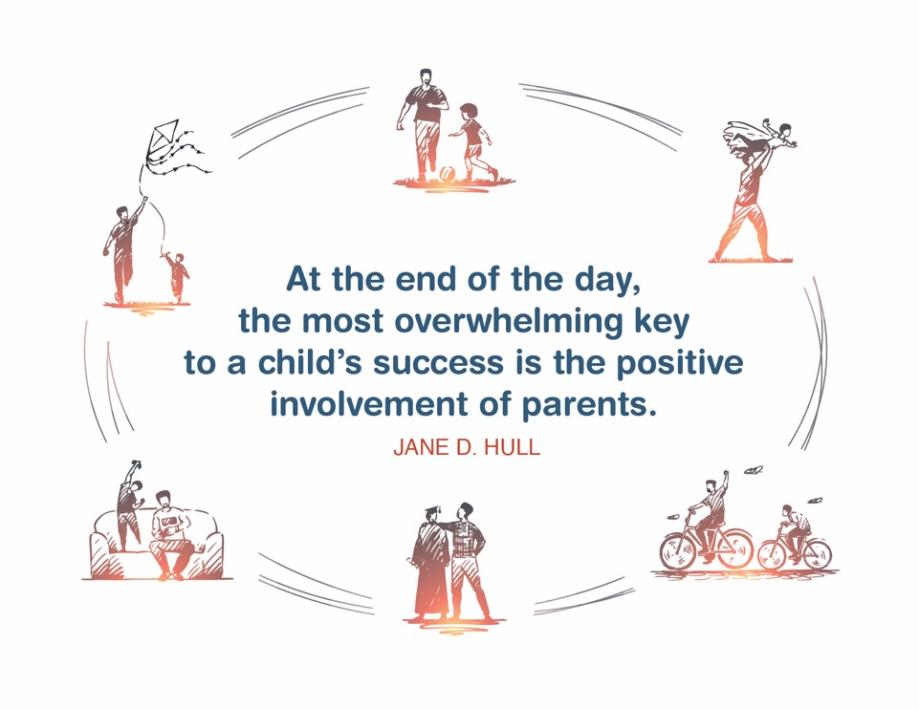
Place holder for slide with Closing Quote
Notes:
FACILITATOR'S NOTE
The closing quote above and the paraphrase section below will be done only once per day, after the last theme presented. If you are moving on to another theme, invite them to take a break, stretch, or breathe, before moving on to the next theme.
If closing for the day:
Thank everyone for attending and for their thoughtful participation and attention. Remind the participants that although this training may seem long, it is critical for them to gather the knowledge, attitude, and skills that are needed as they embark on this journey because they ultimately will play a huge role in the lives of children and families.
If in person, collect the name tents or have them tuck them into their Participant Resource Manual to bring back to the next class.
PARAPHRASE
Close out the day by covering the below topics:
Remind participants of the date/time for the next class and let participants know if there are any changes to the location.
Encourage participants to contact you (or other facilitators) if they have any questions or concerns.
Review the themes that will be covered during the next class.
If in person, remind participants to take their Participant Resource Manual with them and to bring them to the next session. If using a remote platform, remind participants to have the Participant Resource Manual available for the next class.
34

Slide 35
For more information, visit:
Notes:
35

Slide 36
This curriculum was funded by the Children’s Bureau, Administration on Children, Youth, and Families, Administration for Children and Families, US Department of Health and Human Services, under grant #90CO1132. The contents of this curriculum are solely the responsibility of the authors and do not necessarily represent the official views of the Children’s Bureau.

Slide 37
Addendum for kinship caregivers
There is addendum material for this theme for kinship caregivers.
Notes:
Section Two: Reunification Process
On slide 13, change the wording for the 2nd PARAPHRASE section to the following:
There are a lot of misconceptions and feelings about reunifications, so hopefully this was helpful. As we talk about the reunification process, it is important to remember that you play a very important role in this process. Your experience may feel different depending on if you are a new foster parent, a foster parent who is related to the child or you have another pre-existing relationship with the child and their family. Regardless of your fostering relationship with the child, it is important that you understand the steps of reunification and how you can support the child through this process.
Section Four: Self Reflection
Instead of using slide 32 (Reflection/Relevance), use the slide that follows which is specific to kinship caregivers.

Slide 38
Reflection/ Relevance
Think about a child you know and care about, and imagine the child is living in your home. If you are already caring for a related child, think about this child during the activity.
Answer the following questions:
How will you participate in reunification activities ?
How will you support parents and other family members?
How will you support the child after they return home?
Notes:
FACILITATOR'S NOTE
If time is tight, you can ask participants to complete the reflection/relevance activity at home. This will save about 5 minutes of class time. This reflection/relevance is specific to kinship care and there is a reflection/relevance section in the Manual that is specific to kinship.
The instruction for this activity varies for kinship caregivers, although the questions on the PPT slide are the same.
Kinship caregivers who are participating in class likely have preexisting relationship with one or both of the child’s parents and may need to process this information differently. For example, they may have strong feelings one way or the other about whether it is healthy or safe for the child to reunify to live with a parent and they may also have complicated relationships with the parent that can interfere with reunification. Inform kinship caregivers that there will be opportunity during the kinship parenting class to talk about the child’s parents, visitation issues, and other unique aspects of kinship care.
PARAPHRASE
Please open your Participant Resource Manual to theme. Think about a child you know and care about, and imagine the child is in foster care living in your home. Imagine you are telling the child how you plan to help them return to their parents by answering the following questions:
How you hope to participate in reunification activities (visitation, court appearances, reporting, etc.).
What you hope to be able to do to support parents and other family members.
What professionals you intend to collaborate with in this effort.
What you are willing to do after the child returns home to help the reunification be successful.
DO
Circulate to provide advice and answer questions as needed.
Keep track of time.
At 4 minutes, give participants a 1-minute warning.
At 5 minutes, move on to the next slide.
38

