Slide 1


Comparing Performance:
Managed Care and Fee-For-Service
June 16, 2015

Slide 2
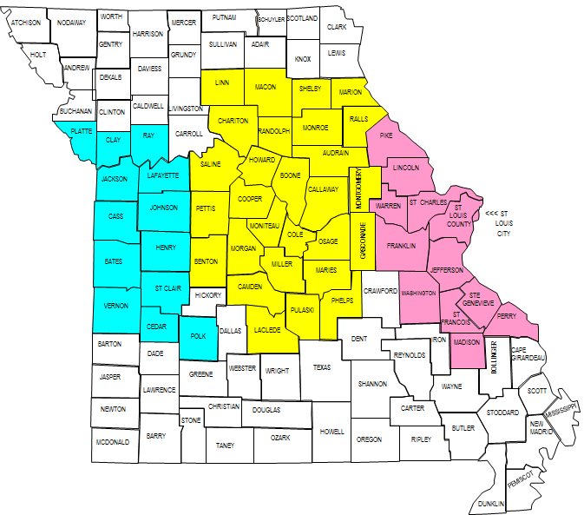
Managed care in Missouri
 |  | Number of Counties
 |  |  | Eastern Region (13)
 |  |  | Central Region (28)
 |  |  | Western Region (13)
 |  | Current Health Plans
 |  |  | HealthCare USA
 |  |  | Home State Health Plan
 |  |  | Missouri Care Health Plan
Size of Populations
MC | 458,338 | 49%
MC–like FFS | 238,165 | 25%
ABD FFS | 240,320 | 26%

Slide 3
Comparing Managed Care and Fee- for -Service
Comparing Similar Populations
  Include MC eligibility groups with the same eligibility groups in FFS
    All currently in MC (TANF, CHIP, and Pregnant women)
    TANF, CHIP, and Pregnant women in non-MC areas of the state currently in FFS
  Exclude the ABDs
Three Areas of Comparison
  Cost
  Utilization of Services
  Quality Performance

Slide 4

Comparing Performance:
Cost

Slide 5
Retrospective Cost Comparison by Mercer
Review last done by Mercer for SFY 2009 found MC saved 2.7% ($38 million) compared to FFS
Compared MC and FFS costs with adjustments
  MC total cost = capitation payments + FFS services carved out + MHD admin costs of managing contracts
  FFS total costs = FFS costs + MHD admin costs for operating FFS
Compared MC eligibility groups with the same eligibility groups in FFS.

Slide 6
Categories of Services Reviewed
MC covers standard benefit minus carved-out services provided through FFS
Medical Services Covered under MC
  Inpatient, outpatient, physician services, dental, mental health, transportation, etc.
Medical Services Carved out from MC
  Pharmacy, specialty mental health, some adult dental and transplants
Other Medical Transactions Included
  FQHC and RHC wrap-around
Other medical costs transactions excluded
  Hospital direct payment and waiver services

Slide 7
5% Geographic Adjustment
Rationale: Medical care is more expensive in urban areas than in rural areas
  The previous Mercer report comparing MC to fee-for-service (FFS) costs in 2008 used a 5% adjustment factor
  For the ABD population the rural/urban difference for CY2005-2008 was 9.6%
  When managed-care expanded in the central region and 2008 Mercer’s total adjustment was 6%.
    3% adjustment area
    3% lower cost in the central region than the Eastern and Western regions
  Medicare per capita expenditures or St. Louis and Kansas City are 4.6% higher than the surrounding rural areas
The current SFY 2010 – 2013 analysis uses a 5% adjustment factor

Slide 8
Re-Allocation Adjustments
Retroactive Eligibility and the first 15 days allowed for MC plan enrollment
Special health care needs opt out population
Specialty Behavioral Health Services - CPR, CSTAR, TCM
Pharmacy and Transplants
MHD Administrative and IT services supporting MC contracting and payments

Slide 9
MC & FFS Retrospective Costs
Amounts reflect total GR and Federal expense
 | SFY 2010 | SFY 2011 | SFY 2012 | SFY 2013 | Average
Fee for Service (FFS) | $1.524 Billion | $1.517 Billion | $1.579 Billion | $1.644 Billion | $1.566 Billion
Managed Care (MC) | $1.501 Billion | $1.481 Billion | $1.578 Billion | $1.596 Billion | $1.539 Billion
Savings | 23 Million | 36 Million | 2 Million | 48 Million | 27 Million
Percent | 1.5% | 2.4% | 0.1% | 2.9% | 1.7%
Source: MANAGED CARE COST AVOIDANCE MODEL - December 2014

Slide 10
Key Findings
Annual savings in MC ranged from 0.1% to 2.9% ($2 to $48 million) over the four-year period. Much of the variation between years is due to rate increases.
The four year average annual savings was 1.7%
  $5.33 PMPM
  $27 million average
Compared to FFS, MC….
  Reduces medical costs/payments to providers by $23.81 PMPM (8% decrease)
  Increases administrative costs by $18.48 PMPM (149% increase)
For every $1 PMPM of reduced state costs due to MC, medical costs/payment to providers is reduced by $4.47 PMPM and administrative costs are increased by $3.47 PMPM

Slide 11
How does Missouri Compare?
Mercer reports that “typical” MC savings are 3-6%
Why lower savings in MC?
  Missouri carves-out specialty behavioral health services and pharmacy services.
  Missouri runs a FFS program with strong management of pharmacy and Health Homes, similar to MC.
  Missouri’s unique reimbursement structure for facilities may impede the ability of MC to manage cost and utilization.
  FFS provider rates that are already as low or lower than MC provider contract rates.

Slide 12
Estimating PROSPECTIVE Impact of Expanding MC in CY 2015
Mercer estimated 2.2% savings ($14.2 million) for a typical and mature MC program expanded to serving the remaining non-elderly, similarly participating women and children currently in FFS.
Expected savings would be lower for at least the first two years of program.
The estimate deducts from savings 2.814% factor due to administrative costs of the ACA health insurer fee.
Mercer also noted that achieving “typical” MC savings levels would be limited by:
  Missouri’s policy of carving out certain services such as specialty behavioral health and FFS provider rates that are already as low or lower than MC provider contract rates.

Slide 13
Comparing Performance:
Utilization

Slide 14
Utilization and Quality Comparisons
The results following our initial analysis by MHD in the process of being cross checked by MERCER
The cause of the variation in results could be due to several different explanations
Further analysis is in process

Slide 15

Rural vs. Urban

Slide 16
The Utilization Measures
ER visits – fewer is better
Inpatient Admissions – fewer is better
Inpatient Days – fewer is better
Hospital Length of Stay (LOS) – fewer is better, unless Hospital re-admissions are higher
Out-Patient (E&M) Visits - fewer is better,
  unless ER visits are higher or Quality Performance Measures are lower

Slide 17
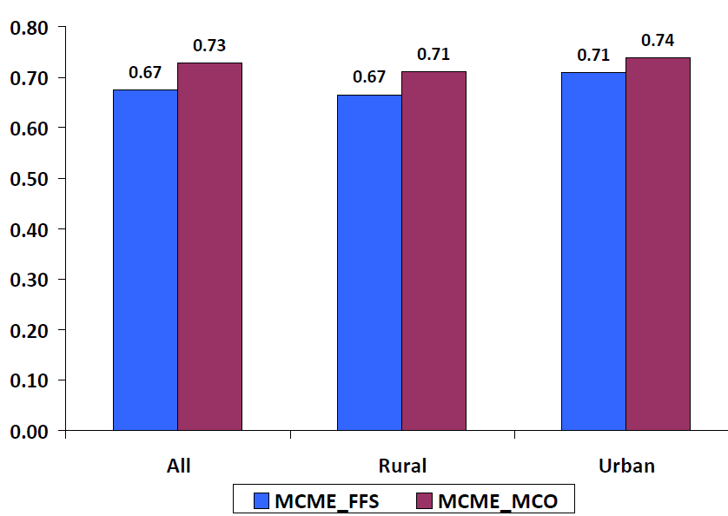
Average ER Visits: All members
4.1%
8.1%
6.7%
34% 38% 34% 37% 34% 38%

Slide 18
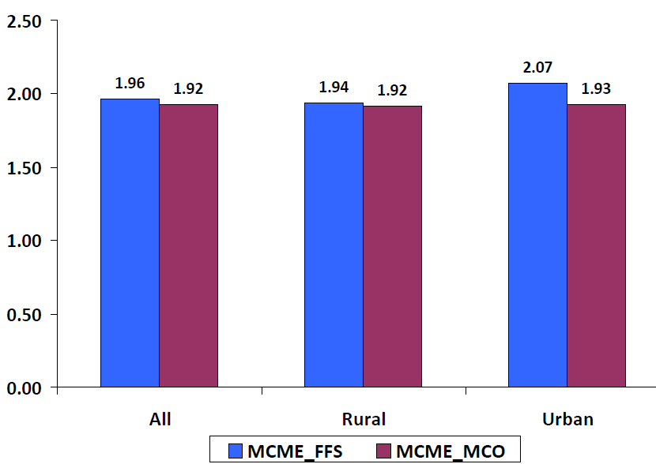
Average ER visits: members with 1+ er visit
6.9%
2.1%
1.1%

Slide 19
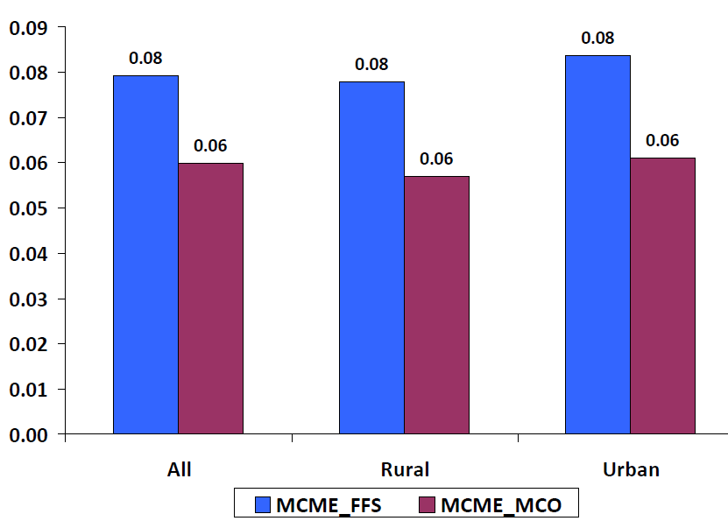
Average Inpatient admissions: all members
24.5%
26.9%
26.9%
6.1% 4.6% 6.0% 4.5% 6.4% 4.6%

Slide 20
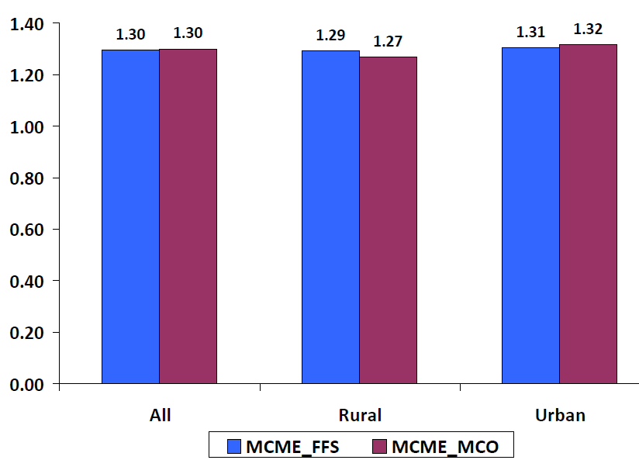
Average inpatient admissions: members with 1+ inpatient admission
1.9%
0.7%
0.5%

Slide 21
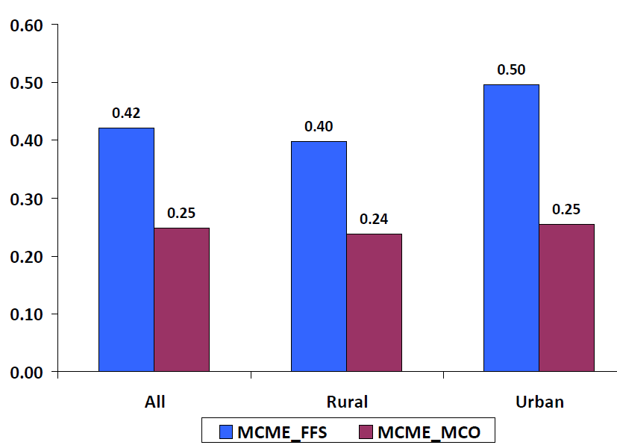
Average inpatient days: all members
48.7%
40.9%
40.3%

Slide 22
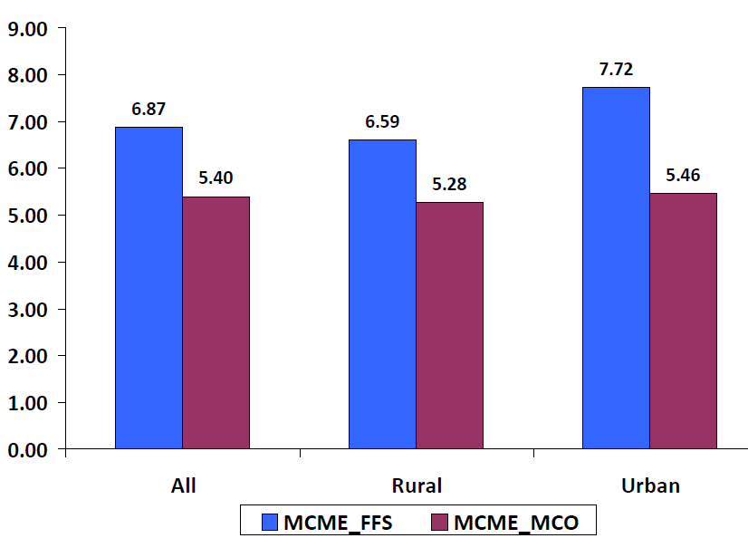
Average inpatient days: members with 1+ inpatient admission
29.3%
21.4%
19.9%

Slide 23
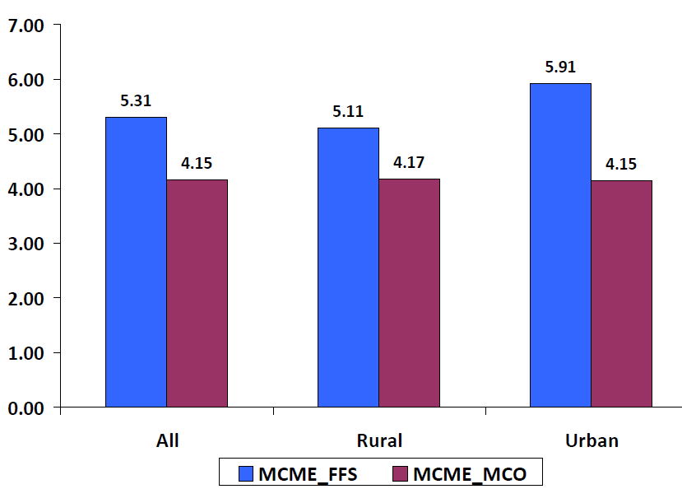
Average Hospital los (covered days): members with 1+ inpatient admission
29.8%
18.4%
21.7%

Slide 24
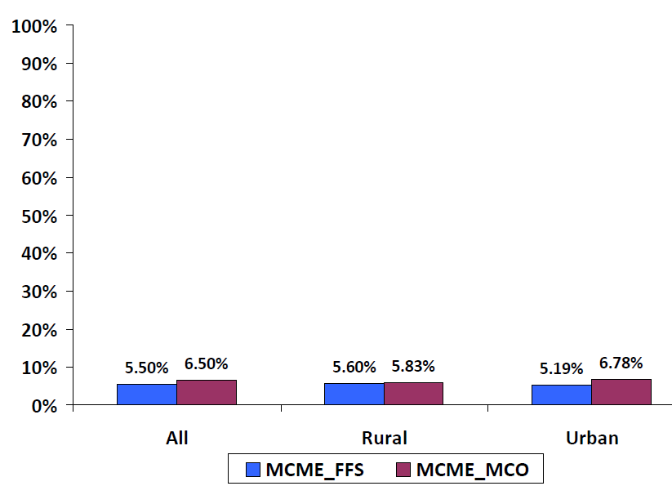
Hospital Re-Admission’s: members readmitted within 30 days
18.2%
4.1%
30.6%

Slide 25
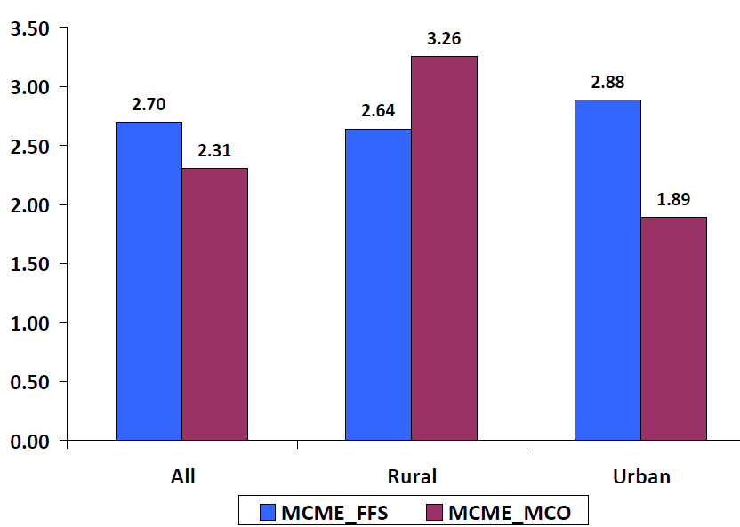
Averages E&M Visits: All Members
34.5%
14.5%
23.4%
66% 63% 65% 75% 69% 57%

Slide 26
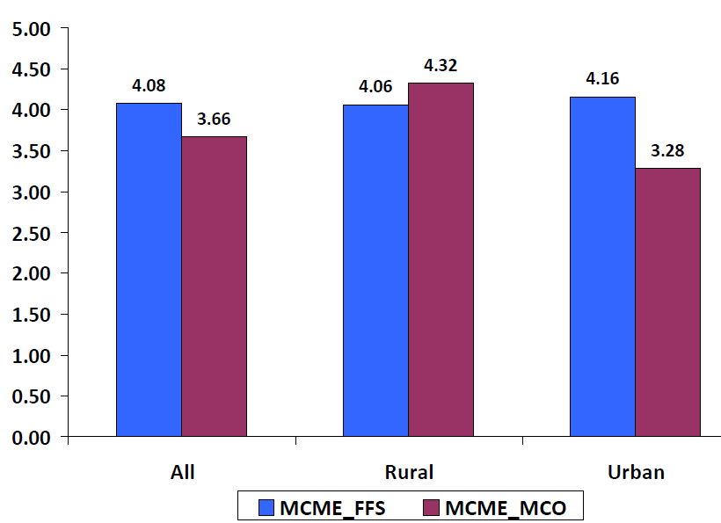
Averages E&M Visits: Members with 1+ E&M VISIT
21.1%
10.3%
6.5%

Slide 27
Utilization of Services and Provider Access
Fewer hospital admissions (25%)
Fewer Average Hospital days (40%)
Shorter length of stay (19%)
More Hospital Readmissions (18%)
More ER visits (9%)
Fewer outpatient visits (15%)

Slide 28
Comparing Performance:
Clinical Quality

Slide 29
Overall
Managed Care performed better on 8 measures
Fee-for-Service performed better on 10 measures
For 3 measures too few persons met criteria to be valid
Differences were not large (Average difference 4.3 points)
1 additional measure under development
  Initiation/Engagement of Treatment for Alcohol/Drug Abuse

Slide 30
Measures Where MC Performed better
4%
2%
9%
7%
4%
6%
.02%
0.3%
30

Slide 31
Measures where FFS Performed better
5.9%
9.4%
6.8%
2.5%
2.2%

Slide 32
Measures where FFS Performed better
2.6%
3.3%
4.4%
4.8%
4.4%

Slide 33
Actual MC Performance
Cost
  Lower overall cost (1.7%)
  Higher care management and administrative costs (149%)
Utilization of Services and Provider Access
  Fewer hospital admissions (25%)
  Fewer Average Hospital days (40%)
  Shorter length of stay (19%)
  More Hospital Readmissions (18%)
  More ER visits (9%)
  Fewer outpatient visits (15%)
Clinical Quality
  Lower on 10 of 18 clinical quality measures (1 more pending)

Slide 34
Timeline for Bidding Managed Care Contracts

Slide 35
PROCESS REVIEW
Prepare the RFP
26 weeks
Bid the RFP
7 weeks
Award the RFP
7 weeks
Prepare to Enroll
6 weeks
Enrollment & Launch
11 weeks
Total Process
57 weeks

Slide 36
Assumptions
Normal procurement takes 18 months.
Eliminates the review, discussion, changes we would normally conduct with the other departments (DHSS, DMH, DESE.) (Recently did that with the other departments for the SFY16 contract.)
Assumes there would not be any major contract changes that required policy and rate development.
Can be shortened by reducing the Open Enrollment phase.

Slide 37
PREPARING THE RFP
26 Weeks
26 weeks
    Meetings with MHD and Mercer on decision items
    Rate development tasks
    Draft RFP to Mercer
    Draft to DFAS/OA, review, questions, discussion
    Review/approve rates from Mercer
    Systems work
    RFP and data book release
Notes:
Twenty-six weeks: May 1, 2015-October 30, 2015

Slide 38
BIDDING & AWARDING
14 Weeks
Bidding the RFP – 7 weeks
    Pre-proposal conference
    Meet with enrollment broker to plan open enrollment
    Review/revise enrollment packets
    Bids due
  Awarding the contracts – 7 weeks
    Evaluation of bids
    Contract awarded
    Legal protests to the award decision can prolong this step
    Contract and rates to CMS for approval
    Renew 1915(b) Waiver
Notes:
First seven weeks: November 1, 2015-December 21, 2015
Second seven weeks: December 21, 2015 –February 8, 2016

Slide 39
PREPARING TO ENROLL
6 Weeks
  3 weeks
    Finalize enrollment broker forms
  3 weeks
    Mail enrollment packets
    Readiness reviews
    Preparation of 1915(b) Waiver Amendment
    Systems work with health plans and state
    Health Plan provider demographic files to state
    Begin member and Provider Forums
Notes:
Three weeks: February 8-February 29, 2016
Three weeks: February 29, 2016 –March 17, 2016

Slide 40
ENROLLMENT & PREP FOR LAUNCH
11-12 Weeks
  8-9 weeks
    Open Enrollment occurs for 8-9 weeks
    Continue member/provider forums
    Begin processing new/revised marketing materials
    System work for health plans and state
  2 weeks
    Auto-assignments
  Services begin
Notes:
Eight to nine weeks: March 18, 2016-May 17, 2016
Two Weeks: May 17, 2015-June 1, 2016

Slide 41
What is an
Accountable Care
Organization?

Slide 42
A Key Difference Across Payment Models -Who Is At Risk For the Cost oF Care
  Pure Models
    Patient – Uninsured People
    Payer – FFS Medicaid and Companies that self-insure
    Insurance Company – MC Medicaid and Companies that buy healthcare insurance
    Providers – Accountable Care Organizations
  In Practice – Most are mixed Models
  Historical Shifts – over past 30 years
    More big Companies keep the risk and self-insure
    More of Medicaid contracts out the risk to Managed Care
    Since 2010 several States are contracting Medicaid risk directly to providers

Slide 43
ACOs Defined
Generally – ACOs are a group of providers who are held accountable for improving health care quality while lowering the rate of growth in health care spending
Medicare Shared Savings Program ACO – a legal entity that is recognized and authorized under applicable State law…comprised of an eligible group of ACO participants that work together to manage and coordinate care for Medicare fee-for-service beneficiaries…established a mechanism of shared governance that provides all ACO participants with an appropriate proportionate control over the ACOs decision-making process
Notes:
Not a completely new concept to Medicare.

Slide 44
ACO Envisions Integrated Care
Patients
Hospital
Other Healthcare Providers
Primary Care Providers
Specialists
Payers
44

Slide 45
…from encounters…to ongoing MGMT
Fee-For-Service
Pre-Encounter
Encounter
Post-Encounter
Disengaged
X
$$$$$
X
X
Population Management
Pre-Encounter
Encounter
Post-Encounter
Disengaged
$
$$
$
$

Slide 46
Getting to the Goal:
Better Outcomes at Lower Cost
Range of Strategies for Improving Healthcare Cost and Quality
Care Coordination /
Partnerships
Full Capitation
Degree of Complexity and Risk Sharing
Bundled Payments across
the Continuum of Care
Predictive Care Paths
Quality & Efficiency Improvements
Bundled Payments for Episodes
Pay for Performance
Fee-for-Service
Degree of Comprehensiveness
Alternate payment models require quality improvements
Notes:
The diagram shows a range of strategies for improving healthcare cost and quality -- including alternative payment models and techniques that could be applied under the current fee-for-service system -- in terms of in terms of both complexity and comprehensiveness.
Predictive care paths are a gateway or pre-requisite to successful bundled payments. Bundled payments can be designed and implemented for single procedures or for broader episodes of care.
--healthcare trends reflect increasing focus on quality outcomes, transparency, care integration…
P4P - • Simplicity and clarity. • Focused approach produces results on select measures. Focused approach limits comprehensive overhaul.
Shared Savings - Aligned incentives. • Medicare provides large patient base. • Complex, with significant Infrastructure requirements. Requires care management sophistication and focus. • Limited upside opportunity, especially for communities with relatively low utilization.
Bundled Payments - Comprehensive outcomes-based approach. • Complex, and benefits tend to be limited to bundled services. No incentives to reduce episodes.
Global Payments - • Greatest financial upside. Requires highest level of integration and financial sophistication, with Significant downside risk.

Slide 47
Important Provider Competencies
Care Coordination
Clinical Integration
Care Management
Characteristics:
Outcomes-oriented
Enabled by technology
Patient-centered
Use of data and analytics
Performance transparency
Ability to partner across organizations
Notes:
Physicians and their role in ACOs.
For accountable care to take hold, three key interdependent aspects of transformation must occur, each interdependent upon the other, as in a three-legged stool: Care delivery reform, payment reform and health information technology infrastructure. Under care delivery reform, enabled by technology, we find
Care Coordination
Care Management
Clinical Integration of providers and care provision ( i.e. health information technology enabled)
Outcomes-oriented/evidence-based care

Slide 48
ACOs vs. Earlier Delivery Models
ACOs and Managed Care
    In Managed Care an insurance company bears the risk for profit or loss
    In ACOs healthcare providers bear the risk for profit or loss
    ACOs give providers more flexibility to decide how they use resources to care for patients
ACOs and Health Homes (HHs)
    Both models promote the use of enhanced resources (e.g., EHRs, patient registries)
    Both models require providers to measure and report quality of care and outcomes
    HHs do not offer explicit incentives for providers to work collaboratively to reduce costs/improve quality
    HH models calls for providers to take responsibility for coordinating care
48

Slide 49
What ACOs Are out there?
Medicare Pioneer
    32 nationally – none in Missouri
Medicare Shared Savings Program (MSSP)
    BJC, Mercy, Mosaic, St Louis Physician Alliance
Center for Medicare and Medicaid Innovation
Medicaid waivers and state plan amendments
Medicaid
    Children’s Mercy under HealthCare USA and Missouri Care

Slide 50
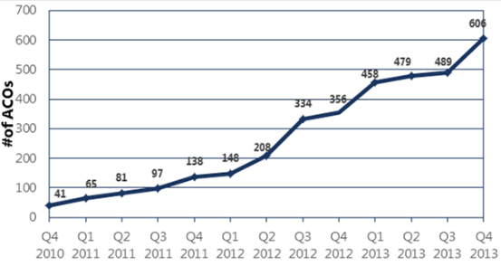
Total ACOs in U.S. 2010-2013
Source: Leavitt Partners Center for Accountable Care Intelligence

Slide 51
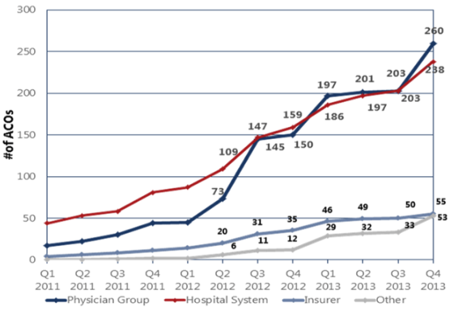
Total ACOs by Sponsoring Entity 2011-2013
Source: Leavitt Partners Center for Accountable Care Intelligence

Slide 52
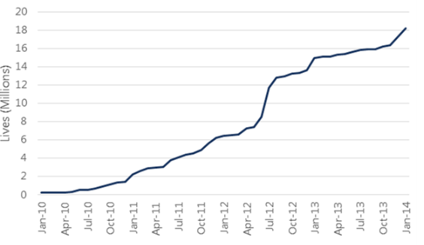
Estimated ACO Covered Lives
Source: Leavitt Partners Center for Accountable Care Intelligence

Slide 53
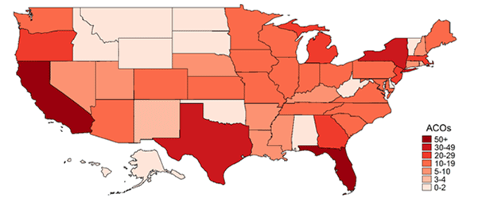
ACOs by State
Source: Leavitt Partners Center for Accountable Care Intelligence

Slide 54
Colorado Medicaid ACO
First Medicaid ACO in the nation began May 2011 following discontinuation of traditional managed care
Model (Primary Care Case Management State Plan Option)
    Services continue to be paid fee-for-service
    PCPs receive $4 PMPM
    Seven Regional Care Collaborative Organizations (RCCO) get $8-$10 PMPM
    $1 PMPMIs withhold from the PCPs and RCCOs and later paid out on a performance incentive basis
    Independent data and analytics contractor reports on performance to state
Outcomes from 2014 Annual Report
    58% of Medicaid clients enrolled at 70% of those in a medical home
    Decreased: ER visits, hospital readmissions, and high-cost imaging
    Savings: $100 M gross, $69 M program cost, $31 M net savings to the state

Slide 55
Utah Medicaid ACO
Medicaid ACO began January 2013 delivered through 4 MCOs
Model (Managed Care 1915b Waiver)
    Operates I 4 urban counties with 70% of state population
    Modified existing MCO contracts
    ACOs receive monthly risk adjusted full risk capitation payments
    Pharmacy carved in except for hemophilia and psychiatric medications
    Mental health in separate pre-paid plans
Outcomes – none yet

Slide 56
Oregon Medicaid ACO
Began 2013 delivered through 16 Coordinated Care Organizations (CCO) statewide
Model (1115 Waiver)
    90% of Medicaid enrollees are in a CCO including dual eligibles and CHIP, considering adding state employees
    1% of capitation withheld for quality reporting and bonus pool
    CMS waiver provides $1.9 billion over five years with potential for reduction if one to 2% cost reductions not met
    CCOs are a mixture of not-for-profit and for-profit organizations
Outcomes
    85% of Medicaid population enrolled
    Decreased ER use, hospital admissions, and hospital readmissions
    Reduced cost of care for 19 out of 21 financial measures monitored

Slide 57
Comparison of Medicaid ACOs
 | Colorado | Utah | Oregon
Delivery System | FFS plus PMPMs for networks and providers | Capitated payments | Capitated payments
Payment at risk based on quality? | Yes, small amount of PMPM at risk based on quality/utilization targets | No, but contract requires quality performance | Yes, additional bonus pool for quality performance
Services included | Help beneficiaries access behavioral health, long-term care (but those services not part of payment) | Physical health | Physical health, Behavioral health, Dental health
Populations excluded | Excludes beneficiaries residing in an institution | Excludes beneficiaries residing in an institution | Excludes program for all-inclusive care for the elderly (PACE)
Mandatory enrollment? | Passive enrollment with opt-out | Yes, for four most populous counties | Yes
% of Medicaid enrollees | 47% | 70% | 90%
Rice, D. (2014). Medicaid accountable care organizations in other states. Fiscal Research Division. North Carolina General Assembly.

Slide 58
Iowa Medicaid ACO
Began July 2012
Model (1115 Waiver)
    Implemented as part of an Innovations Grant
    Services are paid fee for service with each ACO allocated a global budget
    Five Regional ACOs with 30,000 attributed patients
Payments
    $4 PMPM PC Case Manager fee
    $25 per patient per year for a Health Risk Assessment
    $10 per patient if over 50% get an annual physical
    $4 PMPM for after hours access and supporting healthy behaviors
    Up to $4 PMPM for meeting quality measures
Outcomes
    83% of providers qualify to participate
    Third Quarter 2014 performance payments totaled $126,368 statewide

Slide 59
Minnesota Medicaid ACO
Developed and issued RFP in 2011, Implemented January 2013
Model (1115 Waiver)
    Similar to Medicare MSSP - services paid FFS with performance bonus based on quality and shared savings
    All Medicaid except Dual Eligibles
    Patient attribution based on Health Care Homes and PCPs
    Seven Clinical and 2 patient experience measures
Outcomes
    $10.5 M savings across 6 ACOs serving 100,000 patient
    Three of the six ACOs saved enough to get a shared savings payment
    Three additional ACOs added in 2014

Slide 60
New Jersey Medicaid ACO
Law enacted August 2011, Draft regulations released May 2013, planned to launch in 2015
Model (1115 Waiver)
    ACO responsible for all Medicaid enrollees in a set geographic area
    ACOs must be non-profit provider collaborations that include Hospitals, PCPs, BH providers, and Community members
    Medicaid MCOs (4 total) permitted but not required to participate

