Slide 1
FOSTER CARE 101
MO CARE Pre-Service Training
Notes:
INTRODUCTION AND WELCOME
FACILITATOR CLASSROOM GUIDE Modified January 2022

Slide 2
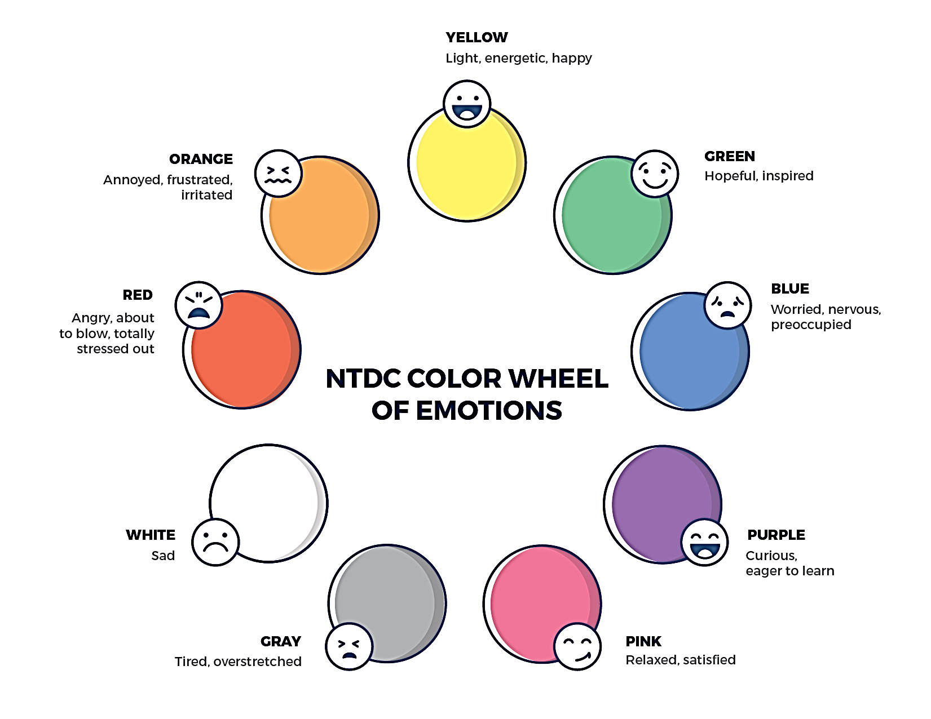
NTDC COLOR WHEEL
Notes:
FACILITATOR'S NOTE
Have this slide showing onscreen as participants assemble for the first class of the day. As participants come in, welcome them back and ask them to take a few minutes to do a self-check using the Color Wheel. NOTE: The Color Wheel should only be done one time per day; before the first theme of the day. If combining several themes together on one day, facilitate the Color Wheel at the beginning of the first class of the day as participants are coming into the room.
SAY
Welcome back. We are so glad that you have taken time out of your day to join us for another exciting learning opportunity. As you recall, tuning in to how you’re doing on a daily basis may not be something everyone here is used to, but this type of regular self-check is critical for parents who are adopting or fostering children who may have experienced trauma, separation, or loss, as it will be helpful to become and stay aware of your own state of mind. It may seem like a simple exercise but be assured that knowing how we’re doing on any given day strengthens our ability to know when and how we need to get support and/or need a different balance. Doing this type of check in will also help us to teach and/or model this skill for children! Please take a moment to look at the color wheel and jot down on paper the color(s) that you are currently feeling.
DO
Wait a little while to give participants time to complete the Color Wheel.
SAY
Now that everybody has had the opportunity to do a quick check in, would someone like to share what color(s) they landed on today for the Color Wheel?
DO
Call on someone who volunteers to share their color(s). If a challenging emotion or feeling is shared, thank the person and acknowledge their courage in sharing, pause for a moment, encourage everyone to take a deep breath, and transition to beginning the theme.

Slide 3

PLACE HOLDER FOR SLIDE WITH OPENING QUOTE
Notes:
FACILITATOR'S NOTE
The opening quote slide should only be used for the first theme of the day. It is important to always emphasize with this slide that this type of parenting involves lifelong learning and it will be critical for families to be invested in their own learning before and after a child is placed in their home.
PARAPHRASE
We are excited to share this lesson with all of you today. We are going to focus on developing your capacity to support children and families. Learning the policies and practices within Missouri are important when advocating for yourself and children who are fostered and/or adopted.
3

Slide 4
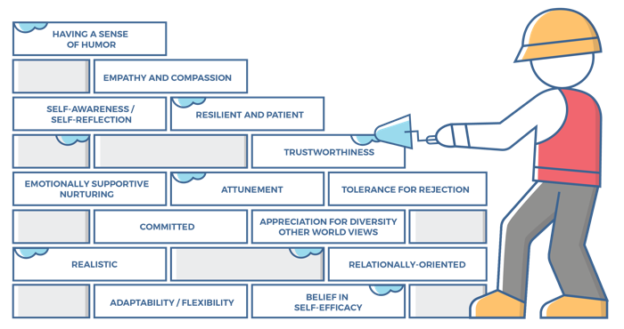
CHARACTERISTICS OF SUCCESSFUL FOSTER
AND ADOPTIVE PARENTS
4
Notes:
FACILITATOR'S NOTE
This slide is shown at the start of each theme.
SAY
You made it! Our final session! As we wrap up the course, our hope is that you feel equipped to demonstrate all of the 14 competencies of successful foster and adoptive parents. Today we are going to talk specifically about how we put these competencies into action as foster parents in Missouri. We will cover a lot of information, and much of it might be unfamiliar. It’s ok to feel a little overwhelmed. As with most new experiences, there is a learning curve. You won’t leave this session an expert. The information we cover today is meant to be an introduction and a launch board to topics you will learn more about over time.

Slide 5
TRAINING OUTCOMES
Equip foster parents to effectively navigate the child welfare system by educating them on key terms and processes.
Empower foster parents to best meet the needs of their family and the children in their care through connections to resources.
Encourage foster parents by cultivating a foster care community where caregivers feel understood and supported.
Notes:
SAY
The goal of this training is to:
Equip foster parents to effectively navigate the child welfare system by educating them on key terms and processes
Empower foster parents to best meet the needs of their family and the children in their care through connection to resources
Encourage foster parents by cultivating a foster care community where caregivers feel understood and supported

Slide 6
SECTION 1:
EXPERT PANEL
MO CARE Pre-Service Training
Notes:
FACILITATOR'S NOTE
By a wide margin, training participants cite the expert panel as the most memorable, enjoyable, and impactful part of their entire pre-service training experience. So, thoughtful planning and facilitation of this activity can go a long way to reinforce important training concepts.
Try to budget around 45 minutes to an hour for this activity. It can be moved to the end of the session if desired/
A recommended panel size is approximately 3-5 panelists. Suggestions for panel participants: foster parents of various tenures (for example: licensed under 5 years, licensed over 5 years), Foster Parent Ambassadors, foster parents experienced with different levels of care (medical, level A, level B, TFC), CASA volunteers, family court attorney, former foster youth, case worker, Family Resource Center representative, older biological child within a foster family.
Opening: Have panelists briefly introduce themselves by providing their name and relationship to foster care (ideally, no more than 3-5 minutes each, to allow plenty of time for discussion).
Panel Discussion: Encourage training participants to ask questions of the panelists. Be prepared with a list of questions you can ask the panelists to keep the conversation going, if needed.
Closing: Give the panelists an opportunity to answer:
What is the best piece of advice you could give newly licensed foster parents?
Here are some sample questions you could ask to facilitate discussion, if needed:
Describe your most rewarding experience with foster care.
What motivated you to get involved with foster care?
What are the most significant ways foster care has impacted your life?
In what ways have relationships with friends or family been changed by your involvement with foster care?
What new relationships have you gained by being involved with foster care?
What does your support network look like?
How do you handle emotionally challenging situations involving foster children and their families?
What self care strategies are most helpful to you to avoid compassion fatigue?
How do you handle the stress and emotional toll that comes with being involved with foster care?
What role does self-care play in your work with foster care, and how do you practice it?
What are your favorite strategies to build relationships and partnership with the families of the children in your care?
How do you approach building a positive relationship with parents?
How do you handle emotionally challenging situations involving foster children and their families?
How do you approach working with parents who are resistant to your involvement in their family?
How do you approach building trust with a child who has been through trauma?
How do you maintain confidentiality in sensitive situations?
How do you ensure that the cultural needs of a child are respected and met?
What qualities make you effective in your position within the child welfare system?
Can you provide an example of a time when you successfully advocated for a child’s best interests?
Describe an experience collaborating with other team members to support a foster child’s well-being.
Describe an experience you have working with diverse populations, including LGBTQ+ youth and children from different cultural backgrounds.
Have you ever worked with children with special needs or disabilities? If so, how did you ensure they received appropriate support and accommodations?
What strategies do you use to help foster children maintain connections with their siblings, extended family members, or other important individuals in their lives?
In your opinion, what are the most significant challenges facing the foster care system today?
What is the biggest challenge in fostering?
What strategies do you use to keep yourself updated with the latest regulations and best practices in foster care?
Can you describe a situation where you had to make a difficult decision in the best interest of a child?

Slide 7
SECTION 2:
CHILDREN’S DIVISION OVERVIEW
MO CARE Pre-Service Training
Notes:
PARAPHRASE
The Children's Division is responsible for the administration of child welfare services. The Children's Division, sometimes referred to as CD, works in partnership with families, communities, the courts, and other governmental entities to ensure the safety, permanency, and well-being of Missouri children. In different regions of our state, sometimes certain tasks or roles are provided by agencies that are contracted through the Children’s Division. For example, contracted agencies might provide case management or resource development, which is another word for licensing.
Your Participant Resource Manual includes a handout titled “Legislation Governing the Children’s Division”.

Slide 8

CHILDREN’S DIVISION WEBSITE
Child Welfare Manual
E-Forms
Foster Connections Newsletter
Foster Parent Bill of Rights
“I am a Foster Parent” page
Foster Parent Handbook
mo.dss.gov/cd
Notes:
PARAPHRASE
The Children’s Division website is a wealth of information. In your Participant Resource Manual, you have a handout titled “Children’s Division Website” that outlines some of the many resources available.

Slide 9
PERMANENCY PLANS
Reunification
Guardianship
APPLA
Adoption
Notes:
PARAPHRASE
Ultimately, the goal of the child welfare system is to provide children with a stable and continuous relationship with nurturing and loving parents, and the permanency plan sets the path of how that will be achieved. We have discussed a number of these throughout this course. Refer to the handout titled “Permanency Plans” in your Participant Resource Manual for more a more in-depth explanation of each permanency plan option.

Slide 10
SECTION 3:
TEAM MEMBERS
MO CARE Pre-Service Training
Notes:
PARAPHRASE
Foster parents are colleagues in the child-welfare team and are to be treated as such. Likewise, foster parents should treat the children in their care, the child's birth family, and members of the child welfare team in a manner consistent with their ethical responsibilities as professional team members.
You will be informed of and able to participate in all team meetings concerning your licensure status or for children placed in your home.
10

Slide 11
Parent who Fosters
Direct Service Providers
TEAM
MEMBERS
Licensing Worker & Supervisor
CASA
Child
Guardian ad Litem
Case Worker & Supervisor
Parent Aid or Designee
Judge/
Commissioner
Juvenile Officer
All Attorneys
Biological Family
Notes:
PARAPHRASE
There are a lot of people that play a vital role in supporting children in foster care. The child is the most important part of the team. Their needs and best interest should always be at the center of all decisions made. It’s important to point out that not all of the members listed will be a part of every case team. As an example, some circuits do not have a CASA program. You can learn more about the roles of each team member in your Participant Resource Manual handout titled “Team Members”. Included in your Participant Resource Manual is an additional handout titled “Working Collaboratively On a Team” that offers best practices for ethical and professional team interactions.

Slide 12


TEAM MEETINGS
72 Hour Meeting
(preliminary plan & concurrent plan established)
30 day
90 day
12 month
60 day
6 month
18 months
Placement Stability Meeting
(When Placement Stability is threatened)
Notes:
PARAPHRASE
When a child is placed with you, a Family Support Team is formed to help safely reunite the family, if possible. The Family Support Team will usually meet for the first time within 3 days of the child coming into care to help develop a treatment plan for the parents and a visitation plan. The Family Support Team will continue to meet regularly throughout the time the child is in care, typically with meetings planned around court timeframes. The point of these meetings is to review plans and discuss progress, additional concerns, or changes that need to be made.
Placement Stability Family Support Team Meetings should be held prior to taking any action relating to a change in placement of a child in the custody of the Children’s Division. These meetings should be held any time that a child’s placement stability is threatened; whether a request has been made to move the child from the foster home or the placement provider is in need of additional services.

Slide 13
COURT HEARINGS
Protective Custody
72 hours
Adjudication Hearing
30-60 days
Dispositional Review Hearing
90 days later
Dispositional Hearing
90 days
Permanency Hearing
Within 12 months
Notes:
PARAPHRASE
The court removes children from their homes, approves the permanency plans and visitation schedules, and decides if a child can safely return home or if termination of parental rights will be granted. There are several different hearing types, and you can learn more about these in your Participant Resource Manual handout titled “Court Role and Hearing Types”.

Slide 14

COURT ETIQUETTE,
EXPECTATIONS
Business casual is the appropriate attire.
Caregiver Court Information Form:
https://dss.mo.gov/cd/foster-care/information-for-foster-parents.htm
Notes:
PARAPHRASE
Foster, relative, and kinship providers have the right to receive notice of court hearings held with respect to children in their care. In addition, you have a right to be heard in any such proceeding. You are encouraged to attend as you have valuable information to share with the court. Likewise, this gives you an opportunity to support the child and/or the biological parents. Not to mention you learn a lot of information regarding progress, goals and court orders.
You will want to confirm with the team if the child is expected to attend court. In most proceedings the Judge/Commissioner will want to see the child. Likewise, older youth should be a part of the proceedings so their voice can be heard. However, children/youth’s presence may be waived under certain circumstances with prior approval. If children are attending, you might consider having someone come with you in case they have to be taken out of the courtroom. That way you do not miss anything.
You have the right to submit a Caregiver Court Information Form prior to court. It will become a part of the official court record, and everyone that is party to the case will be given a copy. So, you should remember to be factual and choose your wording carefully. You can find the Court Caregiver Report on the Children’s Division website.
Business casual is the appropriate attire for court hearings, and is defined as a style of clothing that is less formal than traditional business wear, but is still intended to give a professional impression.

Slide 15
SECTION 4:
FOSTER PLACEMENTS
MO CARE Pre-Service Training
Notes:
PARAPHRASE
You’ve invested a lot of time and effort into the licensing process, and now that you are near the finish line, the prospect of bringing a child into your home can be both exciting and somewhat intimidating. Many people at this stage want to know, “How long will it be before I get a placement?” Unfortunately, there is no uniform answer to this question. Much of it depends on the number of children brought into care in your area and your placement preferences. It is generally the case, but not always, that the narrower your placement criteria is, the longer it might be before you are matched with an appropriate placement. In the meantime, there is plenty you can do to prepare.

Slide 16
PREPARING FOR PLACEMENT
Locate Services:
Childcare
(https://childcare.mo.gov/s/parent-landing)
School district services
(birth – 12th grade)
Pediatrician, Dentist, Optometrist, Therapist, Other Doctors and Mental Health Providers
(https://findaprovider.homestatehealth.com/location)
Hair care services
Necessities:
Beds & bedding
Car seats
Acquire after accepting child:
Clothes
Diapers
Formula/Food (specific needs)
Baby wipes
School supplies
Toys
Hygiene products
Notes:
PARAPHRASE
In preparation for your first placement it’s a good idea to locate services and proactively reach out about enrollment processes and timelines.
You can search for childcare options in your community on the Missouri Office of the Childhood childcare website.
You can find referrals for a doctor, dentist, optometrist or behavioral health provider in the Show Me Healthy Kids network on their website.
Prepare a plan to secure resources instead of trying to have everything on hand. It’s stressful and unrealistic to have every single thing you might need on hand. Instead, focus on securing the things you will need immediately, based on your target ages. Many foster parents find it helpful to maintain a running list of items they might need, depending on age level, and where they can obtain them. For example, size and season appropriate clothes can often be found by visiting the clothes closet at your nearest Family Resource Center.
You might also want to talk with your family and friends about how they can best support you when you receive a placement: picking up needed items, providing your family with meals, assisting with care for other children in the home, etc.

Slide 17
LEVELS OF CARE
RESPITE
T
TFC
Emergency
Medical
Elevated Needs – Level B
Elevated Needs – Level A
Traditional
Notes:
PARAPHRASE
Foster care placement shall be the least restrictive placement setting to meet the specific needs of the child. Sometimes, a child may require a higher level of care, for instance due to behaviors or medical conditions. Here is an introduction to some of the most common placement types.
Traditional: This is the broadest category. Most children new to care will enter care as traditional placements. As teams learn more about the child’s needs, the level of care needed can be changed, if needed.
Emergency: Short term placement, less than 60 days. Likely to be placed after traditional business hours, when a child is brought into care in a crisis situation or placement has been a challenge to secure for some other reason. Emergency placements can, and often do, become longer-term placements.
Medical: A child with medically diagnosed extraordinary medical condition and/or physical or mental disabilities.
Elevated Needs Level A: Child with elevated needs that requires greater structure and supervision, and are less able to assume responsibility for their daily care. They have documented moderate or serious emotional and/or behavioral needs.
Elevated Needs Level B: A child appropriate for Level B foster care has serious emotional and/or behavior problems that require the 24-hour availability of a highly skilled resource parent. Elevated Needs Level B and Career Foster Placement are terms often used interchangeably.
Treatment Foster Care (TFC): Therapeutic services for foster children between the ages 6 or older with significant medical, developmental, emotional, or behavioral needs. TFC offers specific treatment services to the child based on their individual needs to help offer additional support.
Respite: Is available for all levels of care. We will discuss this more in a bit.

Slide 18

FINDING PLACEMENT
Preferred procedure for your county
Regularly check in with your Licensing Worker
Provide respite for other foster families
Network with other foster families
Notes:
FACILITATOR'S NOTE
If you aren’t already familiar, you will need to research the preferred placement procedures for your area. Be prepared to provide any contact information needed.
PARAPHRASE
Each county or circuit in the state has their preferred placement procedures. It’s possible that you will be offered placement from outside the county that you reside, so it’s important to have a level of familiarity with the procedures in your geographic area.
Some other ways to learn of placement openings are by having regular check-ins with your licensing worker, provide respite for other foster families, and network with other foster families.

Slide 19
PLACEMENT CONSIDERATIONS
Licensing limits
Family composition
Lifestyle
Logistics
Work schedule
Childcare Availability
Cultural competency
Notes:
PARAPHRASE
Being honest and thoughtful about your circumstances and your capacity to serve a child in foster care will help guide appropriate placement decisions and prevent unnecessary placement disruptions. Some considerations will be regulatory in nature, related to licensing criteria. Others provide greater insight into resources available in your home and community.
Legal limits on the number and ages of children allowed in the home
Family composition
Lifestyle
Logistics of your home (such as number of bedrooms) and vehicle size
Work schedule
Ability to enroll in child care (i.e. too young to enroll/newborns, extraordinary medical needs, no available child care options, non-traditional work shifts, etc)
Cultural competency
The great news is that you don’t have to have your entire fostering journey figured out today. As your life seasons and circumstances change and you grow more confident in your parenting abilities, you can always make adjustments!

Slide 20
PLACEMENT QUESTIONS
  Am I allowed to ask questions?
  What if I say no?
  Will they ever call me again?
  What are some things I should ask about?
Notes:
PARAPHRASE
When you receive a placement call, it’s ok, and even encouraged, for you to ask questions. When you better understand the needs of the child and family, you can make a more informed decision about your capacity to meet their needs. You will need to keep in mind, however, that sometimes the caller might not have all the information. This is especially true when children are just entering care. Refer to the handout “Placement Questions” in your Participant Resource Manual for a brief list of questions you might want to ask. Many foster parents print out this list and have it easily available to reference when they receive a placement call.

Slide 21
I HAVE PLACEMENT, NOW WHAT?
Short-Term “To Do” List
Long-Term “To Do” List
Medicaid authorization
Placement Letter
Team Introductions
Contact information
Initial Health Exam
Full Screening
Enroll in School
Enroll in WIC
Clothing Voucher or Reimbursement
Doctor Visits
Dentist Visits
Eye Exams
Therapy
Medication Log
Memory Box/Life Book
Situational Possibilities:
First Steps Evaluation
Psychological Evaluation
IEP/504
Notes:
PARAPHRASE
There will be some things that will need to be done immediately, and others that will occur over time.
Short Term “To Do” List
Obtain placement letter and Medicaid authorization
Introduce yourself to the team and exchange contact information
Initial health exam within 24 hours
Full screening within 30 days
Collaborate with the Case Manager to enroll in school as practical as possible
Enroll in WIC Program, if under 5 years old
Discuss clothing voucher with Case Manager
Long Term “To Do” List
Regular wellness doctor exams
Dentist visits
Eye exams
Ongoing therapy or other supportive services
Monthly Medication Log (form CD-265). This can be found in the e-forms section of the Children’s Division Website.
Maintain a memory box and/or Life Book
Depending on the child’s needs/age, you may also want to secure a First Steps Evaluation, a psychological evaluation, and/or begin the process of establishing or revising education supports, such as an IEP or 504 plan.
You can learn more about family visitation and tips to support the children in your care in your Participant Resource Manual handout titled “Visitation”.

Slide 22

NOTIFICATION REQUIRED
Immediate
Serious illness (requiring treatment)
Serious injury (requiring treatment)
Unauthorized absence
Deem Appropriate
Within 2 hours
  Missing foster child
  Notify local law enforcement agency
  Notify National Center for Missing and Exploited Children
Within 2 weeks
  Family problems, or changes
Within 60 days
  of case manager’s initial inquiry for your desire to adopt
Notes:
PARAPHRASE
When there is an emergency situation involving a child in care, you always secure the child’s safety first! Some examples of things that would be considered an emergency situation are serious illness or injury requiring medical treatment or unauthorized absence from the home. In other situations the expectation is that you will utilize sound judgment. You will want to contact the child’s case manager at the first available opportunity.
If you discover that your foster child has run away or is missing, you will need to notify the child’s case manager immediately. Within two hours of discovering that the child is missing, you should also file a missing child complaint with the law enforcement agency having jurisdiction and inform the National Center for Missing and Exploited Children.
Some other notification timelines to be mindful of include notifying the case manager within 2 weeks for pertinent conditions, problems, or family changes. Also notify the case manager within 60 days (of case manager’s inquiry) to express a desire to adopt your foster child.
There will be times that approval from the case manager in advance of taking certain actions. Some example are listed in your care in your Participant Resource Manual handout titled “Approval Needed”.

Slide 23
Placement Disruptions
Open communication
Advocate for Support
Mentor & Advocate
Specific Training
If Disruption must occur:
Provide written notice (2 weeks)
Except in Emergency situations
Notes:
PARAPHRASE
Be proactive! Be proactive! Be proactive! It’s worth repeating; one of the best ways to avoid disruption is by regularly and openly discussing concerns with the team so it doesn’t become a crisis situation.
Advocate for supports to stabilize placement
Seek assistance of a trusted mentor and/or advocate
Request additional formal behavioral or medical training or utilize informal training, such as podcasts, webinars and books
If you are unable to develop a plan to meet the child’s needs and you request removal of a child from your home, you must give two weeks written notice to the child’s case manager. Before a child is removed from your care you are also given two weeks notice and a written statement of the reasons. The two week notice applies except in emergency situations.

Slide 24
SECTION 5:
FOSTER PARENT SUPPORT
MO CARE Pre-Service Training
Notes:
PARAPHRASE
Foster parents in Missouri have access to a wide variety of resources designed to support their family and the children in their care.

Slide 25
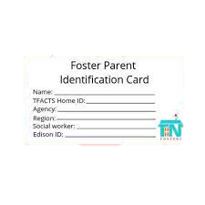
FOSTER PARENT ID CARDS
Notes:
PARAPHRASE
Your resource development team will provide you a form to fill out and return to obtain a Foster Parent ID Card. They will also be your point of contact in the event of a lost or stolen card. Foster parent identification cards can be used for various purposes, including verifying you are a foster parent and/or accessing discounts at participating local businesses.

Slide 26
Financial Supports
Show Me Healthy Kids Managed Care Health Plan
Maintenance Payments
Clothing Allowance
Infant Allowance
Mileage Reimbursement
Childcare through authorized provider
(https://childcare.mo.gov/s/parent-landing)
Free lunches for school-aged children
WIC for children under 5 years old
Notes:
PARAPHRASE
All of Missouri’s foster children are eligible for medical coverage through Missouri Medicaid (MO HealthNet). Most children will get their coverage through Show Me Healthy Kids, a special managed care plan for youth in state custody.
The maintenance reimbursement is a monthly payment to offset the cost of room and board, incidentals, and clothing for the child. You can learn more about maintenance payments in your Participant Resource Manual handout titled “Maintenance Payments”.
Children will receive a yearly clothing allowance. The child’s case manager can inform you how much money is available for the child and the agency’s procedure for clothing allowance. Sometimes a store-specific voucher is available, and other times you will purchase the clothing and then get reimbursed. All items purchased with clothing allowance stay with the child.
Infant allowance is paid for children from birth up to their third birthday to help defray the additional costs for providing for the specific needs of infants such as formula, diapers, special food, extra clothing, and supplies.
You may be able to receive mileage reimbursement for transportation costs when traveling with the child, for the child, or for attending training. The mileage form can be found on the e-forms section of the Children’s Division website.
Childcare is available through an authorized provider. Sometimes childcare is difficult to find. If a relative or friend is helping you by providing childcare, they can become a registered provider and be compensated. The process to become a registered provider is easier than the daycare licensing process.
All school-aged children in foster care are eligible for free school lunches through the School Lunch Program. Contact your child’s school for an application. On the application form, list them as a “Household of One.” The monthly income box should reflect the child’s maintenance rate.
Most foster children under the age of 5 automatically qualify for WIC services. You can receive free baby formula, cereal, eggs, milk, peanut butter, juice and other nutritional foods to meet a child’s individual needs.

Slide 27

LICENSING WORKER
Quarterly in-home visits
Counsel & Approval for appropriate placement(s)
License renewal progress & training (renewal every 2 years)
Write home study/updates
Ongoing Support
Referrals for Community Resources
Notes:
PARAPHRASE
Licensing workers coordinate the licensing, approval, and maintenance of all foster homes. This coordination includes recruitment, training, and support. It also includes providing guidance to foster providers, ensuring the home continues to meet licensing standards.
Your licensing worker will conduct quarterly in-home visits, which should include a walk through of the home. Quarterly visits are conversational, allowing for the sharing of concerns as well as accomplishments and development of a mutual relationship of trust. The visits are to be used as a prompt to have meaningful conversations about pertinent issues and assess compliance with licensing requirements.
Other responsibilities of the licensing work include:
Approve and counsel on appropriate placements
Track license renewal progress (renewal every 2 years)
Write home study/updates
Support in times of crisis
Provide referrals for community resources
You can learn more about training requirements required for renewal in your Participant Resource Manual handout titled “Training”.

Slide 28
FAMILY RESOURCE CENTERS
  Public Information
  Training
  Peer Support Groups
  Social and Community Activities
  Financial or Material Supports
  Respite Care
  Advocacy, Navigation, & Support
  In-home Therapeutic Services
Notes:
PARAPHRASE
Fostering or adopting children is rewarding, but also challenging. Family Resource Centers (FRCs) are support systems that provide resources, training, peer support, respite, and other services families need to navigate raising children through foster care, adoption, and guardianship. These centers are regional. Family Resource Centers provide core support services for foster, adoptive, and relative care families. One area of support that a Family Resource Center could provide is regarding Child Abuse and Neglect Hotlines. You will find a handout in your Participant Resource Manual titled “Child Abuse and Neglect Hotline” to learn more.

Slide 29
OTHER HELPFUL RESOURCES
Local foster parent support organizations
Clothing closets
Seasonal donation drives (ie. Back to School, Christmas)
Local discounts
Facebook communities- national, state-wide, local, special interest groups, faith-based groups
Other helpful websites
Notes:
FACILITATOR'S NOTE
You might consider creating and providing participants a list of local support groups, helpful websites, and other area supports.
PARAPHRASE
These are a few examples of other supports available to fostering families. Refer to your Participant Resource Manual for more information on local supports in the handout titled “Other Helpful Supports”. There is also a helpful handout on educational advocacy titled “Navigating the Education System”.

Slide 30

FOSTER PARENT AMBASSADORS
  Recruitment
  Mentor & Self-Advocacy & Support
  Representation of foster parents in work groups
  How to get a mentor
Notes:
PARAPHRASE
Foster Parent Ambassadors are experienced foster parents who volunteer their time to assist with foster recruitment events, support foster families through mentoring and self-advocacy, and represent the foster parent perspective in state-wide child welfare stakeholder work groups.
It is highly recommended that every newly licensed foster parent sign up for a Foster Parent Ambassador mentor. Your training facilitator or your licensing worker can provide you with the sign up form.

Slide 31
RESPITE
Respite vs Babysitting
Units
Timeframes
Choosing a Respite Provider
Forms
Notes:
PARAPHRASE
Respite care is the temporary, substitute care of foster children placed in your home. Respite is not for regular child supervision situations when a parent would normally use ordinary child care, like a babysitter for an afternoon or evening out or for attending foster parent training or seminars. Respite care may be planned in advance or used in emergency situations. Respite care should be used to maintain stable placements but should not be used to exclude foster children from ordinary and traditional family activities.
Foster parents receive 12 units of respite per year. A unit of respite care is between 12-24 hours. You may also use a half-unit of respite care. Use of respite is not to exceed 12 units per child during a 12-month period. The 12-month period will begin on the date the child was placed in your home and will reset on the anniversary date of the child’s placement. Unused units for the previous 12-month period are not rolled over to the new 12- month period.
You can use the reasonable and prudent parenting standards in selecting a respite provider, but keep in mind that unlicensed providers are not eligible for payment.
Respite reimbursement forms are available in the e-forms section of the Children’s Division website, and will need to be submitted to the child’s case manager.

Slide 32

SELF
CARE
Build your community
Ask for help
Prioritize your mental and physical health
Maintain joyful activities & interests
Take regular breaks
Notes:
PARAPHRASE
By nature, foster parents are caregivers. So it comes as no surprise that many foster parents put their own needs last. But, caring for children who have endured trauma is taxing in many aspects. Preventative self care strategies will help you avoid burn-out and compassion fatigue. Here are a few recommendations:
Build a community of supportive people who understand what you’re going through
Don’t be shy about asking for or accepting help. If there are tasks you can hire out to free up some of your time, do it. Many people are looking to find ways to support foster families, like providing a meal, watching the other children in your home when you have court or other appointments, mowing your lawn, or assisting with small household tasks.
Take care of your mental and physical health
Don’t abandon the activities and interests that replenish you
Take regular breaks- make appointments for “me” time

Slide 33
SECTION 6:
WRAP-UP
MO CARE Pre-Service Training
Notes:
FACILITATOR'S NOTE
Open the floor to questions one last time. Remind your trainees of your contact information should they have any ongoing needs. You might consider suggesting participants share contact information if desired so that they can support each other on the journey.

Slide 34

EVALUATING YOUR
NEW TOOLS
Notes:
PARAPHRASE
As we conclude, I want to encourage you to reflect on your “why”- your why is the reason you chose to be a foster parent. It’s your purpose for doing what you do. There might be times along your journey that you feel defeated, that the system is irretrievably broken, or that you are putting in a lot of effort with little to show for it. Revisit your why. Let it be a guidepost for decisions and a reminder that you can do hard things because you are making a difference.
You have worked hard to enhance your tool box. I encourage you to complete the Self- Assessment after class to evaluate your progress and identify any areas you want to focus on going forward.

Slide 35

LIFELONG LEARNING
Right Time Trainings
https://ntdcportal.org/training-for-families
Notes:
SAY
It is critical that as you go through this journey, you continue to enhance your knowledge and skills. It is important that you continue your own learning by taking advantage of resources that are available to you. Right time training available after class. Access to online content anytime-when you need it the most at (https://ntdcportal.org/training-for-families/)

Slide 36

PLACE HOLDER FOR SLIDE WITH CLOSING QUOTE
Notes:
PARAPHRASE
Thank you for attending and for your thoughtful participation and attention. Although this training may seem long, it is critical for you to gather the knowledge, attitude, and skills that are needed as you embark on this journey because you ultimately will play a huge role in the lives of children and families.
36

Slide 37
Questions?
MO CARE Pre-Service Training
Notes:
PARAPHRASE
I wanted to provide my contact information one final time. I'd encourage you to maintain an open line of communication with your licensing worker as well. And, remember to keep your participant manual handy, so you can refer back to information and strategies as you encounter situations along your journey.

Slide 38
All facilitators must take the following survey following each session:
www.surveymonkey.com/share/1ebe00ec-c5d0-4332-85dc-a5dbdb3e1733

