Slide 1
FSD Web Application & Benefit Center

Slide 2
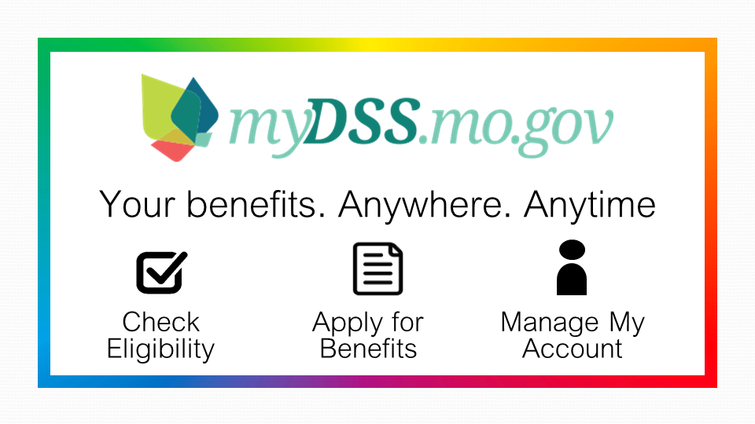

Slide 3
To Apply Online
You can apply online anywhere or any time
At https://mydss.mo.gov/
Spanish version of all pages is available
Apply at local Resource Center using the Public Access Work Stations where available
Apply using a smartphone, tablet, computer
FSD Resource Centers have available :
new MyDSS business card
MyDSS half-page flyer with online application information.

Slide 4
myDSS Home Page
Do I Qualify?/Apply
Click on the “Do I Qualify?/Apply button to begin the process. The Missouri Pre-Eligibility Tool is is a simple questionnaire that can give you an idea of programs you may possibly want to apply for. The results page provides links for applications or resources. You can apply for new or recertification applications online. Food Stamp MCR (Mid-Cert Reviews) are not available online at this time.
Check My Status
If you already have an account for the Benefit Center & also have an active case or pending application for Food Stamp, Child Care, Temporary Assistance or Medicaid for Aged/Blind or Disabled; click on the “Check My Status” button to see your benefits or what is needed to complete the application you submitted online.
Report a Change
If you have a Benefit Center account and an active Food Stamp, Child Care, Temporary Assistance or Medicaid for Aged, Blind or Disabled case, you can report Changes online as well as upload verification documents on this site.
Notes:
Go to https://mydss.mo.gov/ to access the “myDSS” Home page. You can start the process here to apply for Food Stamps, Child Care, Temporary Assistance or MO HealhtNet coverage for Aged, Blind or Disabled and/or MO HealthNet for Families and Children.

Slide 5
myDSS home page
Notes:
From the myDSS home page you can see if you may qualify for services by clicking on the “Do I Qualify?/Apply button. This takes you to the Missouri Pre-Eligibility tool.
Check My Status button will allow you to review benefits you already receive or see status on a pending application.
Report a Change button will allow you to create an online account and report changes if you are already receiving benefits.

Slide 6
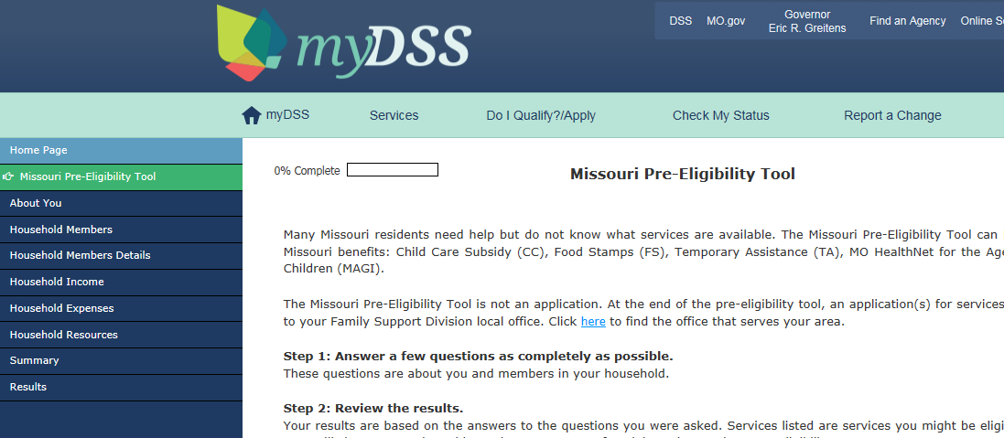
Missouri Pre-Eligibility Tool
Notes:
The Missouri Pre-Eligibility Tool also provides link to search for a local Family Support Division office.
Completing the Pre-Eligibility Tool informs you of other programs you may want to apply for.
After completing the questionnaire you will see the Results/Summary page on the following page. This page provides you with links to apply for programs and other Resources information.

Slide 7
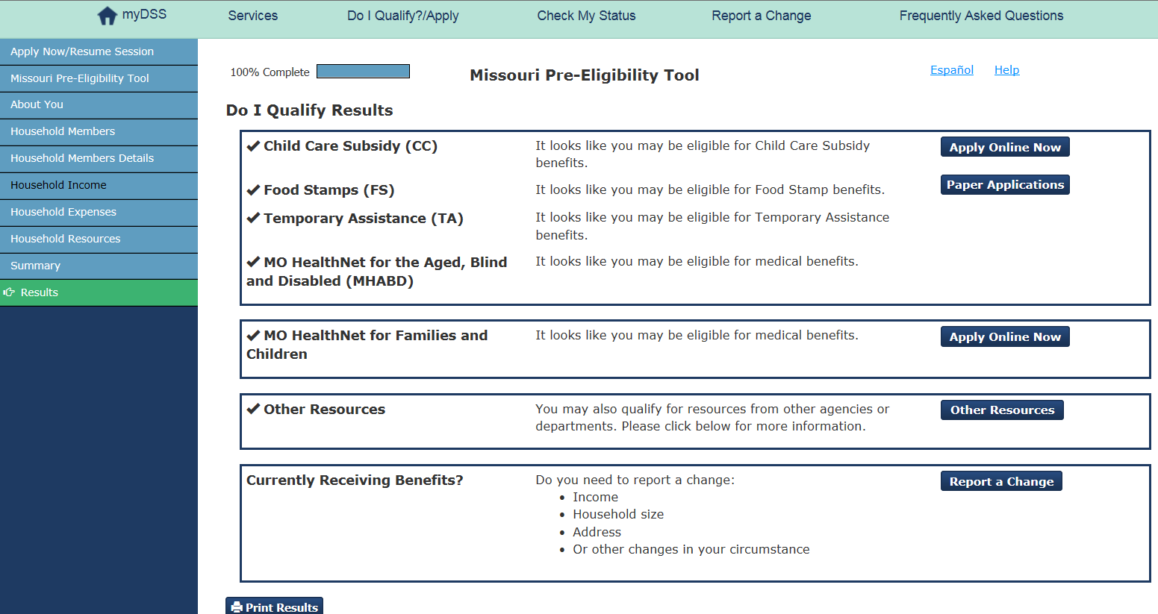
Missouri Pre Eligibility Results Page Links to Apply Online for Foods Stamps, Childcare, Temporary Assistance, MO HealthNet for Aged, Blind, Disabled or Families & Children. Also links to Paper Applications, Resources & Report Changes.
Notes:
You will see links to Apply Online for: Food Stamps, Temporary Assistance, Child Care, MO HealthNet for Aged, Blind or Disabled, MO HealthNet for Families & Children.
There are also links for Paper Applications where you can print/fill out and mail/fax or drop off the application.
There is a link to Other Resources and a link to report Changes if you currently receive benefits. (Note: You must set up an online account in order to report changes online)

Slide 8
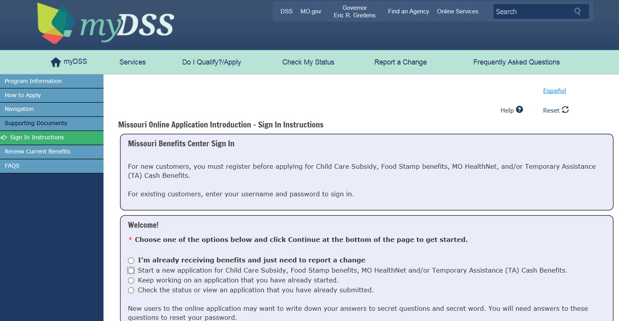
“Apply Now” Missouri Online Application Introduction-Sign In
Notes:
Clicking on the Apply Now button for Food Stamps, Child Care, Temporary Assistance or MO HealthNet for Aged, Blind or Disabled will take you to the Missouri Online Application Introduction & Sign In Instructions page.
Users are able to choose from several options on this page: Report a change (already receive benefits), Start a new application, keep working on an application or check status/view application already submitted.

Slide 9
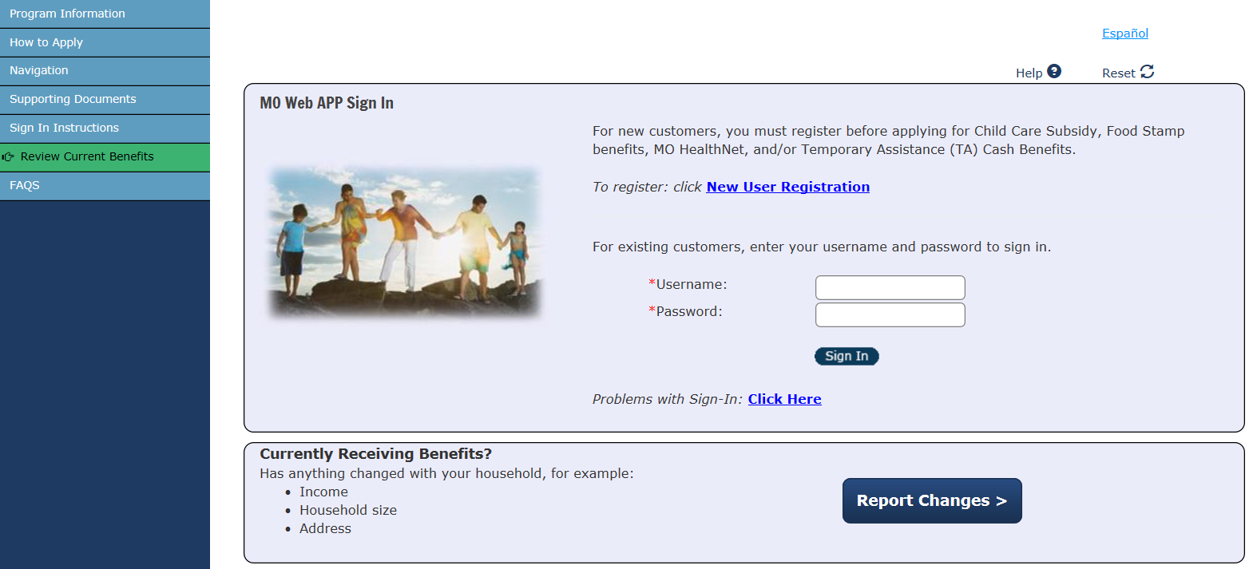
Sign In – New User Registration
Notes:
If you are a new user, click on New User Registration. You will enter your personal information and create your User Name, Password and secret questions which will help you in resetting or retrieving account information if needed. It’s a good idea to write this information down for future reference. You will need an email address in order to activate your online account. After creating your account you are now ready to sign in. If you need the Spanish version simply click on the “Espanol” link at top right corner of any page.

Slide 10
Customers can choose from several options on the online application sign in page
New User Registration
Sign In for existing customer
Report Changes
Navigation Bars on the left of page
Provide program information, Instructions on how to apply, supporting documents, Sign In Instructions, Review Current Benefits & FAQS
Notes:
The navigation bars on the left (on smart phone these are drop down menus) give you information on all the programs you can apply for on this system, instructions on how to apply, list of documents you might need (ID-Driver’s License, check stubs etc), sign in instructions, option to Review Current Benefits and the Frequently Asked Questions (these are available for each page of the application to help you).

Slide 11
Choose the programs you want to apply for
The first page of the online application gives you the programs that you can choose from to apply.
The next step is to enter your name and address.
Click through the pages and enter answers to the questions. On the last page you will read & check the box for the program notifications.
You will have an opportunity to register to vote
Next you will have the option to upload supporting documentation to your application.

Slide 12
1st page of online application
Notes:
Choose the programs you wish to apply for on the first page of the online application, then enter your address information. If applying for Food Stamps you may enter emergency screening eligibility section information, then click Continue button at bottom of the page. Continue entering information on the application. The final page contains the program benefit penalties section, Voter’s Registration section, Uploading documents for verification section and the Electronic Signature section.

Slide 13
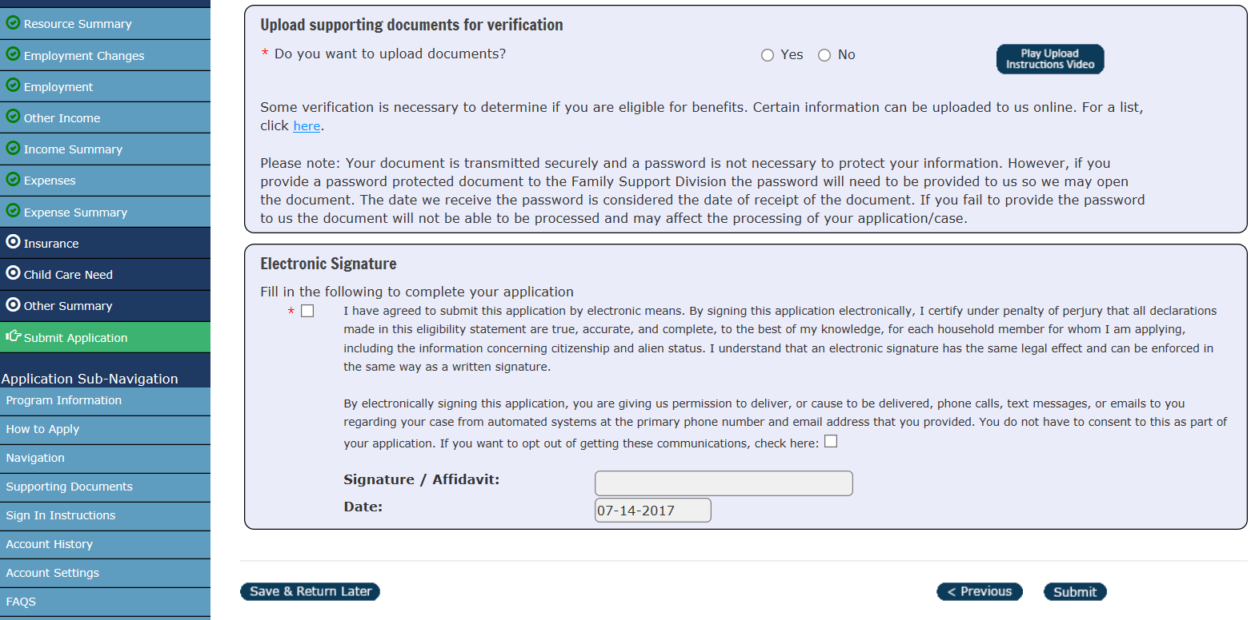
Upload & E-Signature page
Notes:
After completing the Voter’s Registration section, you have the opportunity to upload documents for verification to your application. There is also a video demonstrating this process, you can review or delete items and upload additional documents of these types: PDF, PNG, JPG, JPEG, TIF or TIFF. There is also a link to a list of common documents you may need to provide for verification.

Slide 14
Uploading Documents
You can upload documents with your Online Application or with your Online Change Reports. Documents must be one of these types: PDF, PNG, JPG, JPEG or TIFF.
You can also sign in later to upload to a pending Online Application or pending Online Change Report only. (Paper applications must provide verification by mail, fax or drop off)
To Assist in the process:
There is an Instructional Video on the upload sections to assist you in the uploading/scanning process
There is a list of supporting documents for reference
You can review their uploaded documents prior to submission. You will receive confirmation of uploaded document on the “Thank You” page and will also receive a confirmation email and/or text if requested.

Slide 15
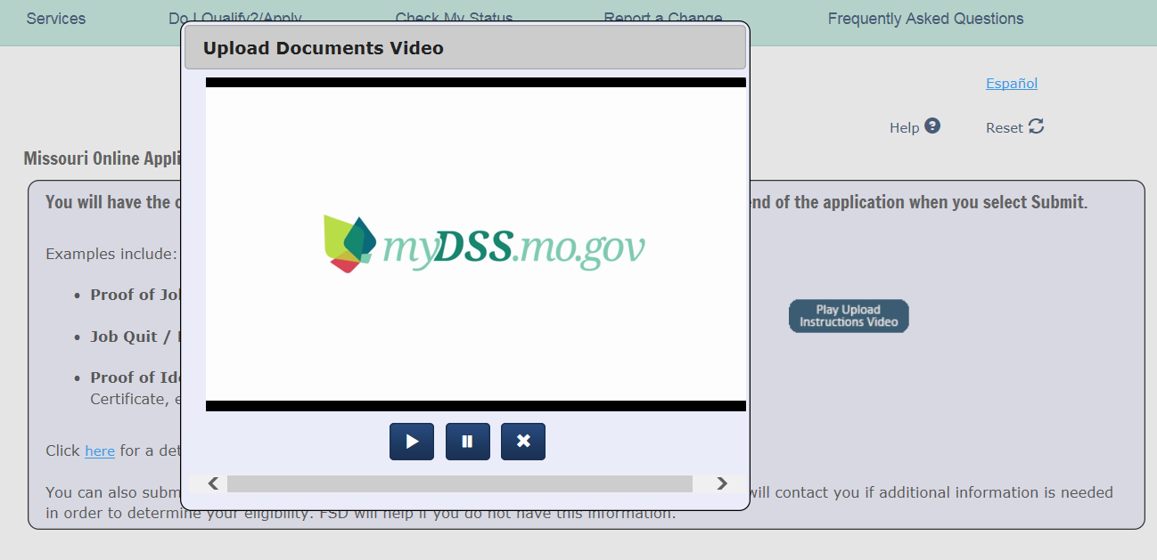
Upload Documents Video
Notes:
Click on the Play Upload Instruction Video button to view the demonstration.

Slide 16
Thank You – submission page
You will receive a “Thank You” confirmation page after completing the E-Signature and submitting the application. This page includes:
Web Application Number (assists staff in locating the application in the Virtual File Room)
Confirms any uploaded documents
Print application option available (it is not required to have this as it is filed automatically in the Virtual File Room)
Receive Confirmation Email
Link provided to apply online for MO HealthNet for Families and Children
Customer Survey available

Slide 17
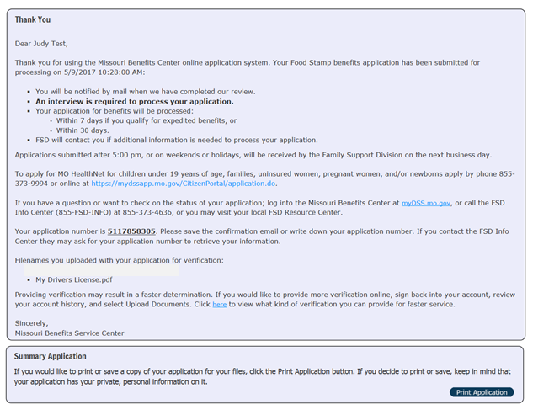
Customer,

Slide 18
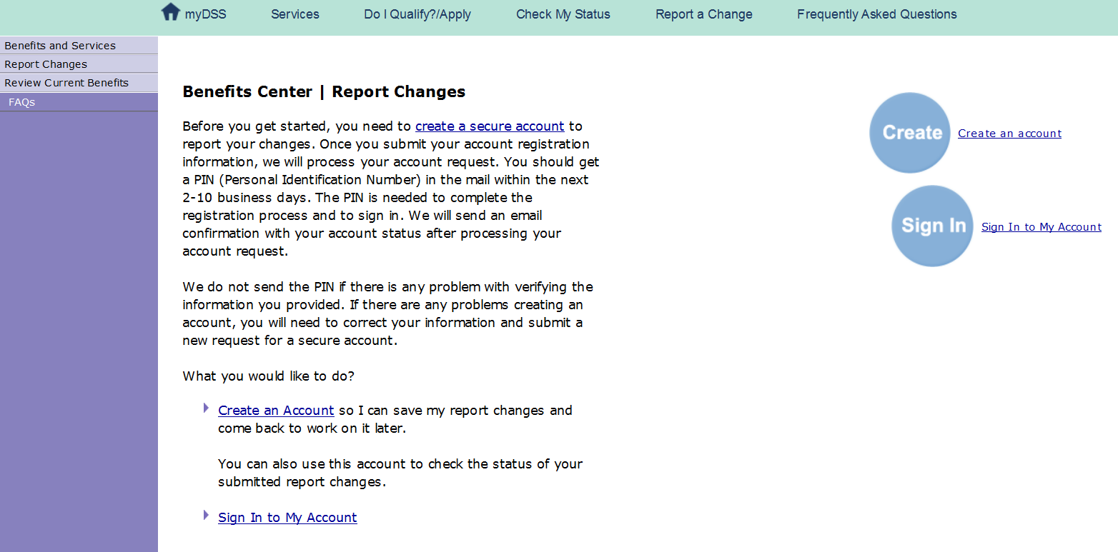
Benefits Center – Report Changes
Notes:
If you have any active case with FSD, you can “Review Benefits” on the Benefit Center page.
(Family Medical coverage “review”: you must enter the individual’s information to review coverage for each individual)
You must create an account in order to report changes online. Once you have an activated account, you can report a change online & upload verification documents for the change. (changes already in progress reported by phone/mail or in person at a Resource Center must have verification provided by one of those methods-currently uploading documents online is only available for online changes) This home page shows the link to Create an account OR Sign In to My Account

Slide 19
Benefits Center
If you have an active case with FSD, you can “Review Benefits” on the Benefit Center page.
Family Medical coverage “review” must enter the individual’s information to review coverage for each individual
You must create an account in order to report changes online. Once you have an activated account, you can report a change online & upload verification documents for the change. (changes already in progress reported by phone/mail or in person at a Resource Center must have verification provided by one of those methods-currently uploading documents online is only available for online changes)

Slide 20
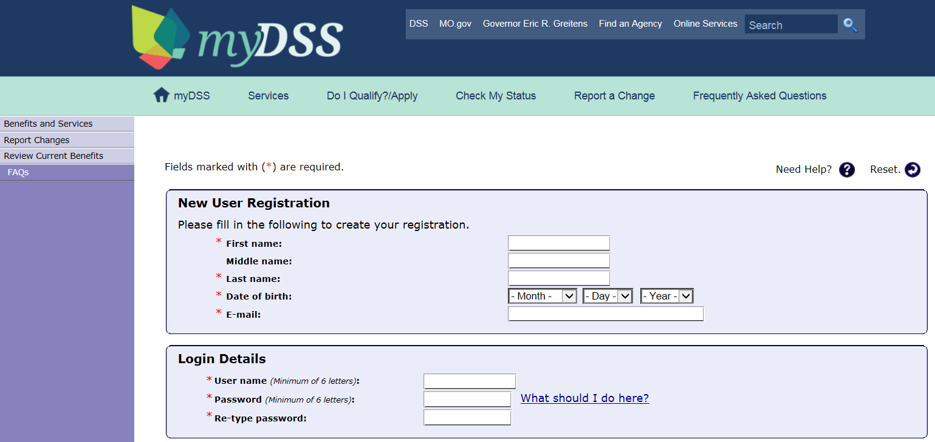
Create an Account
Notes:
Creating an account requires a User Name, password, Social Security Number (SSN) or DCN to verify their account. Customer must choose additional security-secret questions and secret word, then agree to the Missouri User Acceptance Agreement & click on the Register button. You will receive a PIN in the mail in about 3-7 days to use to activate your account online. Until you receive the PIN you may report changes by phone, mail or visit your local FSD Resource Center.

Slide 21
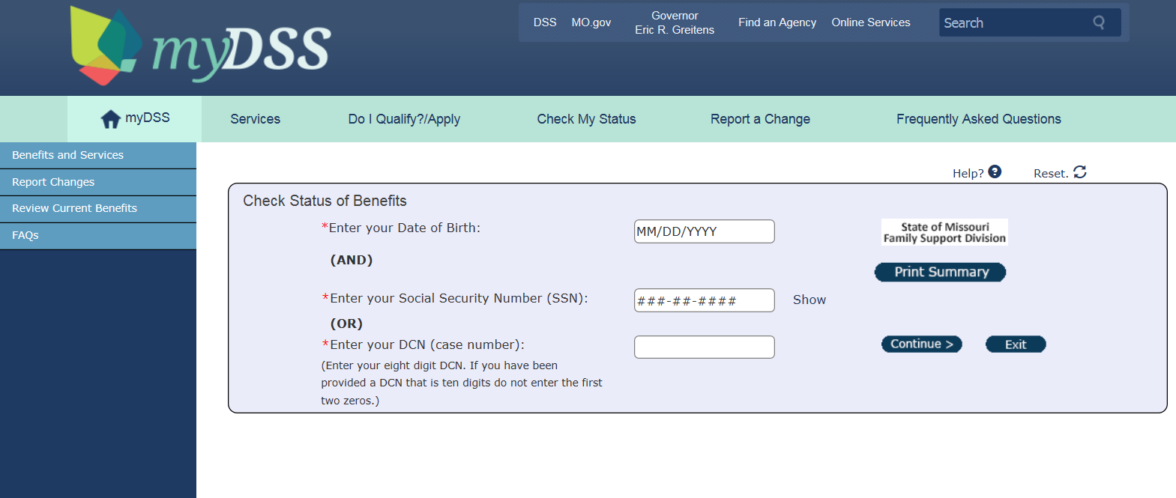
Check Status of Benefits
Notes:
Customer enters Date of Birth and either the Social Security Number OR the DCN. If looking up medical coverage for a child-must use the child’s information. Customer can print summary from this page by using the Print Summary button at the side.

Slide 22
Sign In

Slide 23
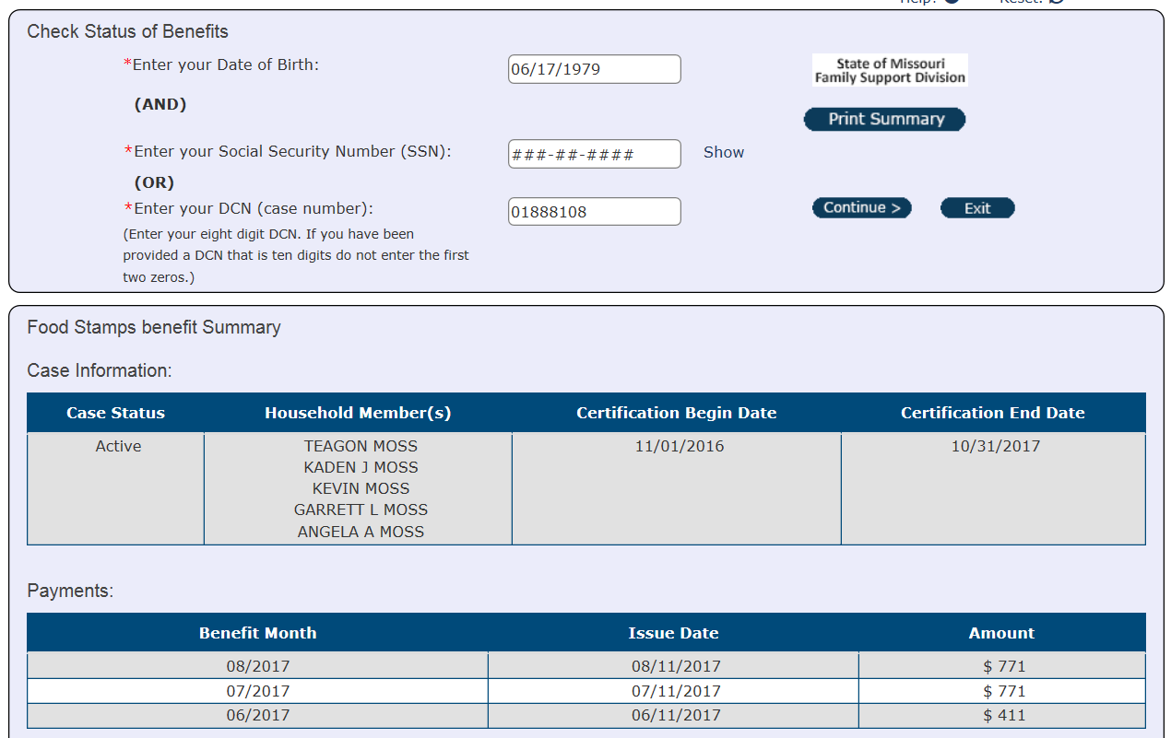
Notes:
Review Benefits summary page

Slide 24
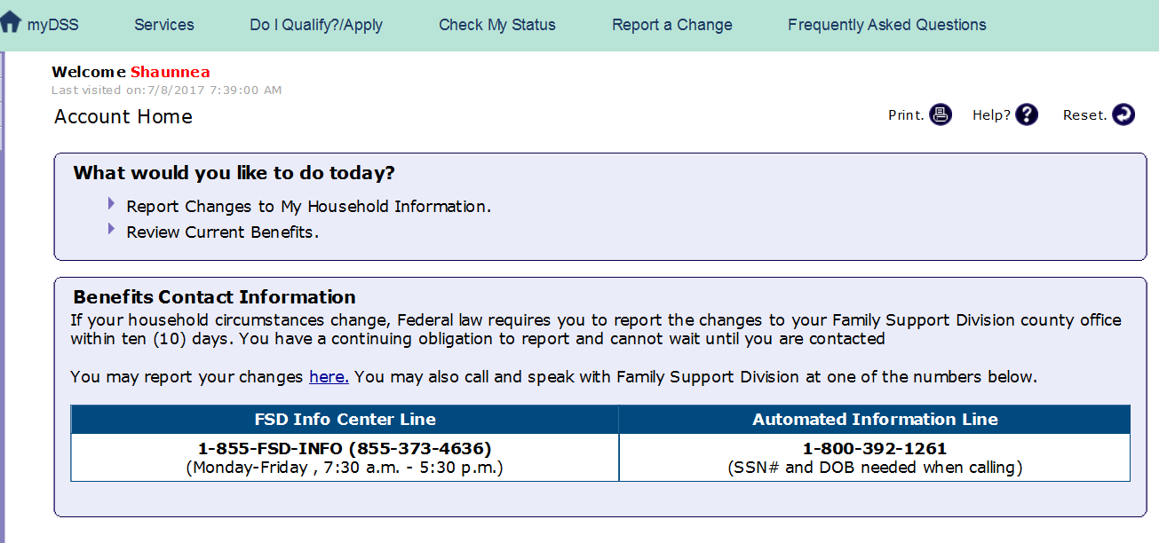
Report Changes
Notes:
Sign In – Account Home page. Choose from Report Changes or Review Current Benefits.

Slide 25
Select the Change type:
Notes:
You may report a Household Change, Person Change (name change, mailing address, income, expsenses, phone number etc.) or Add/Remove someone. Enter the information as needed and continue to the submit page.

Slide 26
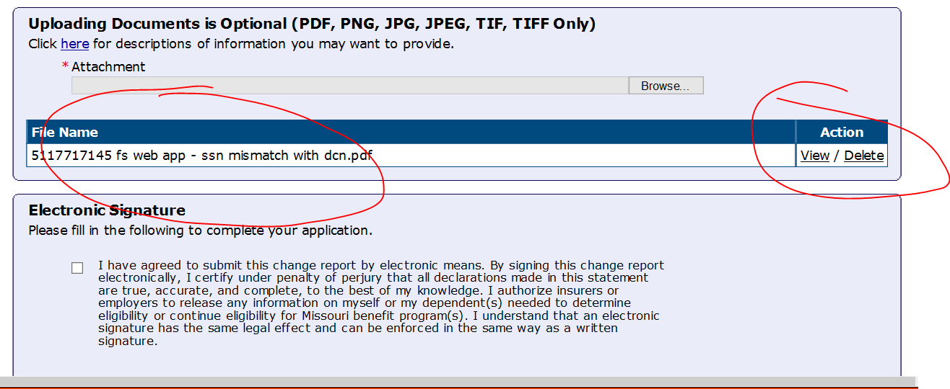
Submit Change page
Notes:
Customer must sign acknowledgement of Rights & Responsibilities. Below that is an Upload documents and the Electronic Signature section. After completing the Electronic signature section click on the Submit button and customer will receive a Confirmation page.

Slide 27
Uploading Documents
You can upload documents with your Online Application or with an Online Change Report
There is an Instructional Video on the upload sections to assist you in the uploading process
You can review your uploaded documents prior to submission. You will receive confirmation of uploaded document on the “Thank You” page and will also receive a confirmation email.
There is also a link available to apply online for MO HealthNet for Families if desired.

Slide 28
Applying for MO HealthNet
The Citizen Portal is a separate system where you may apply for :
Children under 19 years of age
Families
Uninsured women
Pregnant women & Newborns

Slide 29
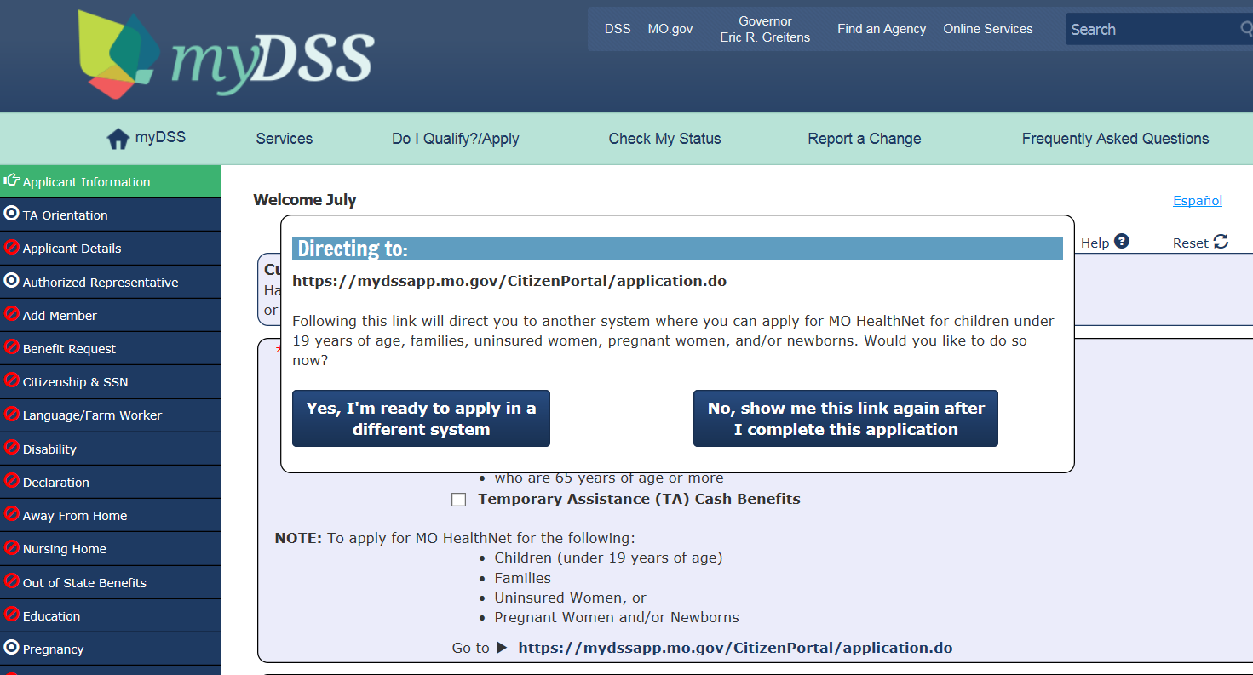
Web App: How to apply for MO HealthNet within the Web Application
Notes:
You can click on the MO HealthNet link at the beginning of web application to go to the Magi Customer Portal, or you can choose to complete your Food Stamp/Child Care/Temporary Assistance or MO HealthNet for Aged, Blind or Disabled application(s) first and receive this link at the end of that application.

Slide 30
MO HealthNet for Families Citizen Portal https://mydssapp.mo.gov/CitizenPortal/application.do
Notes:
If you wish to apply for MO HealthNet while in the Web app, you will be directed to this site by clicking on the link “Yes I’m ready to apply in a different system”.
You can also reach it from the URL above. Once in the Citizen Portal the you will create a User Account here before applying. You will also complete an eligibility tool prior to entering the application itself. You can access this page at https://mydssapp.mo.gov/CitizenPortal/application.do

Slide 31
Training Materials
Training material for the Web App and MO Benefits Center can be accessed by clicking on this link http://dss.mo.gov/fsd/training/
Available Training:
MO Pet: Accessing and Navigating the Pre-Eligibility Tool
FSD Web Application (with Upload document option)
MO Benefits Center-Review Benefits and Report Changes (with Upload document option)

Slide 32
