Slide 1



Jobs for America’s Graduates
Department of Social Services

Slide 2

Agenda
Program
Links
Data Collected
Monitoring
Process
Importance
Forms
Success Stories
Importance
Forms and Examples
Invoicing
Process
Importance
Forms
Deadlines
Survey Update
Signed Release Forms
Notes:
Introduction

Slide 3
Program

Slide 4
Important Links
JAG Provider Training Portal
FY27 JAG TANF Reporting Survey

Slide 5

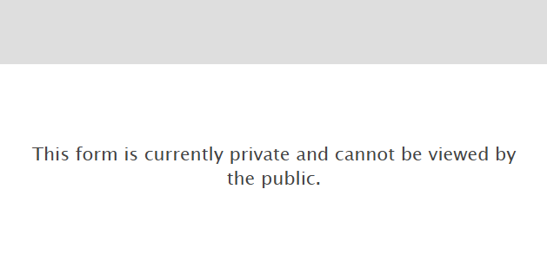
JAG TANF Reports
The link has updated. If you try to use the old link you will get the following error message:
Please complete the JAG TANF Reporting Survey quarterly.
Notes:
https://riskanalysisunit.wufoo.com/forms/jag-tanf-reporting-survey-fy27/

Slide 6
Submission Deadlines
1st Quarter: June through August
2nd Quarter: September through November
3rd Quarter: December through February
4Th Quarter: March through May
Deadlines are:
1St Quarter is due 10/15/2026
2nd Quarter is due 12/15/2026
3rd Quarter is due 3/15/2027
4th Quarter is due 6/30/2027
Notes:
Reports are due by the 15th of the month following the reporting quarter. It is very important that these are submitted timely, as it could result in a finding in your monitoring report.
Please do not submit a report during the reporting quarter, wait until at least the first day of the following month.
The only exception to this reporting deadline is for First Quarter. As we know that your class numbers are not usually set in stone until the end of September, we have extended this deadline to October 15th for that month only.
You would need to submit First Quarter by October 15th.

Slide 7
Incorrect Submissions
What if you complete a submission and upon review of your confirmation email, you realize you’ve made a mistake?
DO NOT RESUBMIT
Send an email to Lindsey Thomas for correction
Notes:
Forward me your copy of the submission confirmation.
What information needs to be changed, be specific
Your contact information in case there are follow up questions on our end.

Slide 8

Importance
Improved Data analysis
Increased Consistency
Efficiency
Notes:
Why is it important to submit your reports accurately and timely?

Slide 9
Reporting Purpose
Tells the Story of the program.
Shows that this program is exposing students to a multitude of experiences and opportunities.
We can back this story up with data to prove that the programs are participating in events.
Notes:
Ultimately, these reports allow us to provide our state legislators and stakeholders with your story. It allows us to brag a little bit about this wonderful program and helps us to back up our statements with data. That’s why its so important for this information to be accurate and provided on time.
Quarterly questions ensure programs are participating in events. The expectation is each program participate in events to expose students to a multitude of experiences and opportunities.

Slide 10
Budget Book Data
What data do we collect for our yearly budget book?
Activity: Total number of students enrolled.
Quality: Yearly sum of the average number of contact hours per student.
Impact: Number of Graduates at the end of the school year.
Efficiency: Percentage of students transitioning to post-secondary education, gaining employment, entering the military, or any combination thereof (Follow Up services questions).
Notes:
What data do we collect for our yearly budget book?
Every year we have to provide a budget book to our legislators. Each program has to provide four measures to demonstrate the effectiveness of the program. The four budget book data categories that we collect for JAG are the following;

Slide 11

FY26 Outcomes
Activity: 4,343 students enrolled across the state
Quality: the sum of the average monthly contact hours per student was 158.22 hours
Impact: we had a 98.01% graduation rate with 935 graduates.
Efficiency: Our positive outcome rate was 92%
GREAT JOB!
Notes:
So, what were our outcomes for FY26?
Every single outcome met or exceeded FY25 outcomes!
Activity: 4,343 students enrolled across the state
Quality: the sum of the average monthly contact hours per student was 158.22 hours
Impact: we had a 98.01% graduation rate with 935 graduates.
Efficiency: Our positive outcome rate was 91.70%
GREAT JOB!

Slide 12
Success Stories

Slide 13
What are Success Stories?
Success stories are a way for DSS to highlight individuals who find success within your program.
We ask that these be individual success stories with the person named and if possible photographed for the story.
There is a template available: JAG | Missouri Department of Social Services
A signed release form is required for the submission of the success story.
Notes:
If it is a small group that you would like to highlight, please have a signed release for all members.

Slide 14
Success Stories Examples
Success stories should be as specific as possible, to ensure that we are getting the full story.
They should not be generalized or for the entire class.
We do not want to see “Our JAG Class went to xyz and learned abc…”
We do want to see: “Joe Cool received $xx in scholarships to his chosen school.” or “Emily Dickenson got recognized for her excellence in poetry at xyz competition” etc.

Slide 15
Signed Releases
You must include a signed release in the submission of the Success Story for everyone named in the story. This ensures that we can share this story with our stakeholders.
Please have the individual (if they are over 18) or their parent/guardian sign the release. It is not appropriate for the teacher to sign the release for the student.

Slide 16
Success Story Process
We ask that schools provide a success story to DSS on a quarterly basis.
Success stories are submitted via the JAG TANF Survey. You will need to upload the story with the template and signed release form at the bottom of the survey.
We recommend that you collect all signed releases at the beginning of the year.
Notes:
There is now a format template available. This can be found here: (Office of Workforce and Community Initiatives Portal | Missouri Department of Social Services (mo.gov))
We also need a signed release form for the student that is being highlighted (Office of Workforce and Community Initiatives Portal | Missouri Department of Social Services (mo.gov))
We recommend that you collect all signed releases at the beginning of the year and submit the appropriate student in a combined file to the success story template.

Slide 17
Invoicing

Slide 18
Invoicing Timeframes
By September 1st provide the following:
  Invoicing Schedule
    Quarterly or Monthly
  Budget Form
  Budget Narrative
Invoices are due by the 15th of the following month of the expenditure period.
  Monthly: October 15th for September 1st through 30th expenses
  Quarterly: October 15th for July, August, and September Expenses
Notes:
JAG Invoicing (≈ 12 min) - JAG Missouri Program Training | Rise 360
It is very important that invoices are submitted timely, as our invoicing team has hundreds of invoices that they have to process each month. Timely submission of invoices will ensure timely payment.
Invoices can not be paid unless DSS has a fully executed contract and these documents on file. These documents can be found on the JAG Provider Portal link.

Slide 19
End of Year Invoicing Timeline
Our system shuts down in early June to prepare for the next fiscal year. Because of this, we have a hard deadline in the first week of June every year for expenses up to May 31.
So, what happens with June expenses? There is an invoice due July 15th for June expenses; however, these expenses cannot come out of the previous fiscal year’s budget. Our system will not allow it. These expenses will come out of the next year’s fiscal budget.
Notes:
I know many of your schools have policies to pay out summer salary/benefits in June. BUT If you want the salary to come out of the current fiscal year’s allocation. This payment must be made by 5/31/26 and included in the final invoice to DSS. Otherwise, the salary and benefits must come out of the following fiscal year’s budget and those funds that were allocated in your budget and budget narrative could lapse at the end of the fiscal year if they are allocated for salary and benefits but not paid out by the appropriate deadline. This is why we HIGHLY recommend that any summer salary/benefits payment be made in May so that there is no issue with lapse of funds or carryover into the new fiscal year. If your school’s policies do not allow for a may payment of salary and benefits, we recommend completing a budget modification PRIOR to the end of the fiscal year to move those funds to other allowable expenses, including supplies, equipment, or travel expenses.

Slide 20
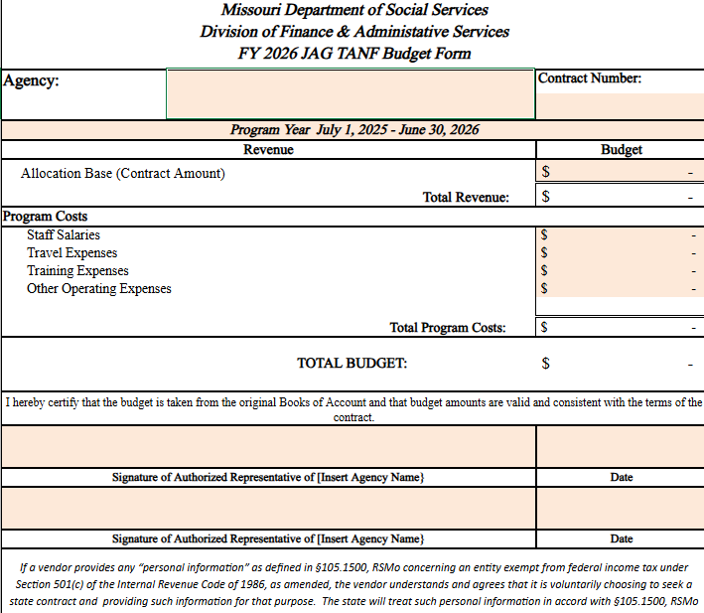
Budget Form
This must be submitted and approved prior to invoices being submitted.
It must have the signature of two authorized representatives.
This budget should list expected program costs for the Fiscal Year
Notes:
Budget form

Slide 21
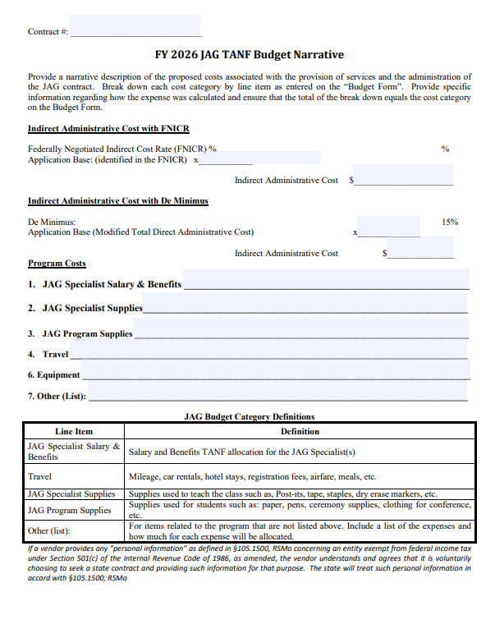
Budget Narrative
Detailed outline of expected expenses.
An invoice cannot be paid until we have an approved Budget Narrative on file.
Notes:
If you find you need to make a change throughout the year for your budget, please submit an updated budget and budget narrative to the invoicing inbox. The forms can be found on the portal.

Slide 22
Invoicing Forms
Please include the following forms with your invoices:
  Invoice Form
  Expenditure Report
  Supporting Documentation, if required
If you have no expenses for the month/quarter, please email the invoicing inbox to let them know.
Notes:
If it is your first 2 years as a JAG program, you must submit all supporting documentation with each invoice.
If you have been a JAG Program for more than 2 full years, you are no longer required to provide supporting documentation, however this documentation must be kept for at least 5 years and provided upon request.

Slide 23
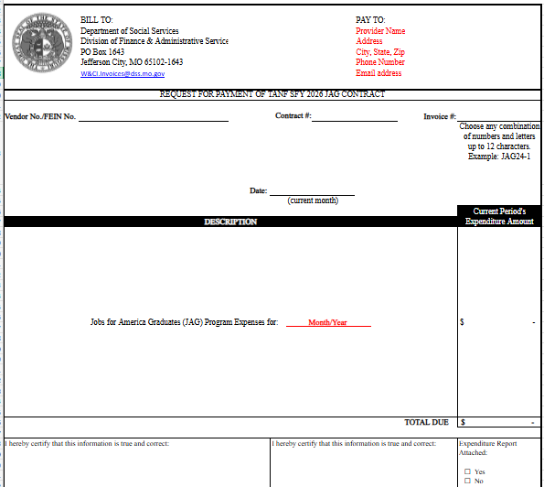
Invoice
The invoice number must be up to 12 characters and unique. i.e.: FY27JAGAug
It must be signed by 2 authorized representatives of the school.
Notes:
meaning, you haven’t used it before when invoicing the state.
For example, FY27JAGAug

Slide 24
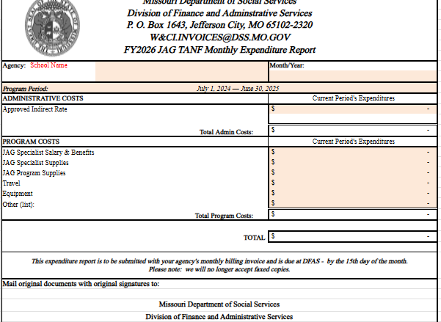
Expenditure Report
Use the expenditure report to detail the various expenditures categorized by expense type.
It must be signed by two authorized representatives.
Expenditure amounts cannot exceed the amounts detailed in your approved budget and budget narrative.

Slide 25
Use of TANF Funds
Allowable Expenses
Disallowed Expenses
JAG salaries and benefits
Supplies used only by JAG program
Equipment used only by JAG program
Travel for JAG Activities
Shared Equipment
Donations
Classroom Projects used by non-JAG Students
Gifts

Slide 26
Training Link
For a more in depth process training for Invoicing, please use the following link.
JAG Invoicing (≈ 12 min) - JAG Missouri Program Training | Rise 360
It is in the process of being updated for FY27

Slide 27
Monitoring

Slide 28
Program Monitoring
Our goal is to identify and correct performance issued before they may result in non-compliance.
We encourage you to view the monitoring as a preventive function.
An opportunity to determine any needs for assistance.
We want you to succeed!

Slide 29
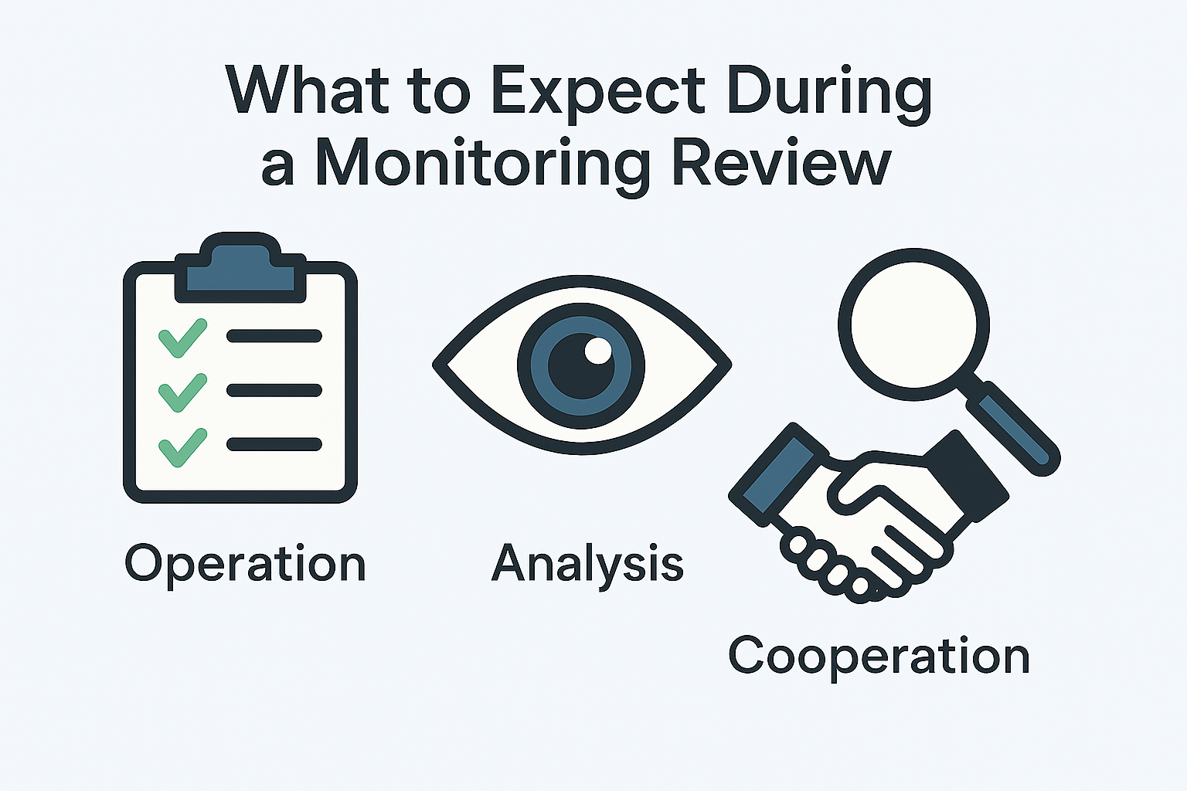


Slide 30
Before Monitoring
Prior to the Desktop Monitoring you will be given a list of randomly selected students and asked to provide:
An interview questionnaire
JAG Highlights and Best Practices
Notes:
The JAG Specialist will receive an email approximately 30 days prior to the month of monitoring stating the documents requested and the due date for them.
The email will include: providing you the opportunity to showcase your strengths and brag about your JAG program, activities, competitions, field trips, etc.

Slide 31
During Monitoring
Required documentation includes but is not limited to:
Signed Parent/Student Commitment Forms
Documentation demonstrating efforts to involve parents/guardians, such as event flyers, invitations, parent/teacher conference records, or entries documents as a Model Service.
Notes:
Monitoring staff will review documentation provided for the randomly chosen cases. The JAG Specialist is responsible for submitting all required JAG documentation for each file. JAG Force Data System will be used to review any additional information needed to complete the monitoring process.

Slide 32
Model Services
Weak examples vs Strong examples
Weak - Students partnered with a local business to complete community service.
Strong - We partnered with Community Betterment to paint shutters, complete yard work, assembled furniture, and more, to help prep houses for the 3MG crew that comes in the 1st week of June.
Weak - Students attended Build My Future.
Strong – Students attended Build My Future in Springfield on [date]. The students talked to many of the vendors about career opportunities they offered.
Weak - Students served at Convoy of Hope.
Strong – On [date], students gained a brief insight of what Convoy of Hope does and then broke into groups to put together hygiene kits and repackage other items for their community.
Notes:
It's important to implement a consistent process to enter detailed model service information into the JAGForce system daily. Regular data entry will support accurate monitoring, timely reporting, and improved service delivery oversight.

Slide 33
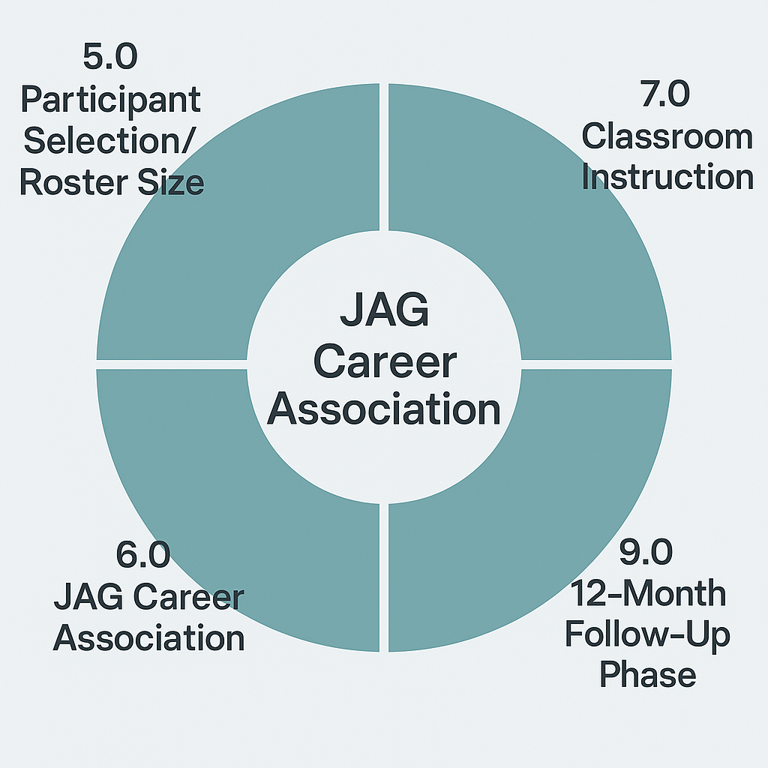
JAG Model Standard Review Components

Slide 34
5.0 Participant Selection/Roster Size
Participant profile completed and data verified
Student was interviewed prior to receiving program services
Student eligible based on the number of the enrollment criteria/barriers
Documented efforts to involve parents/guardian
Signed student/parent consent on file
Graduation or GED/HSE Equivalency
Graduates obtain employment
Employed graduates obtain full-time employment
Full-time positive outcomes
Further education rate: All post-secondary, Credential/Certificate, Apprenticeship (Enrolled or Completed)
Unable to contact Graduate/Non-Graduate students

Slide 35
6.0 JAG Career Association
Opportunities to participate in conference and Chapter activities.

Slide 36
7.0 Classroom Instruction
Received/on-track to complete 37 JAG competencies in senior year, or 87 for those participating in grades 9-12
42 for middle school

Slide 37
9.0 12-month Follow Up Phase
Minimum of one monthly contact
Graduate placed in quality job, provided guidance for additional education, training, coaching, etc.
Non-graduate provided guidance in completing HS Diploma/GEG, counseling, support, etc.

Slide 38
10.0 Tracking and Reporting Data
All information for participants entered into JAG Force.

Slide 39
After Monitoring
The monitoring report will be issued within 30-45 days after the review is completed.
If there are no findings in your report, the review is complete, and no further action is needed.
Notes:
The monitoring report will detail what information was reviewed, what strengths the report found during the monitoring, opportunities for improvement for the program, and any findings that the monitoring discovered.

Slide 40
Corrective Action Plan
If the report includes findings, you will have 30 days to submit a Corrective Action Plan (CAP). A CAP template will be provided for your convenience.
Notes:
A Corrective Action Plan (CAP) is a step-by-step documented strategy used to identify, resolve, and prevent the recurrence of issues, errors, or underperformance. It serves as a structured roadmap to fix immediate problems while eliminating their underlying root causes

Slide 41
Corrective Action Plan (CAP)
Finding(s) | Actions Taken/ Planned to Meet Requirement | Target Completion Date | Person(s) Responsible
List the finding exactly as it appears on your monitoring report. Do not rephase or summarize. | Provide a detailed plan of action, including specific steps that demonstrate how you will address the finding. The plan should be substantial enough for program staff to verify implementation during follow-up. | Solid dates are needed for correction/ completion, even if its just 06/30/2027 which is the end of the monitoring period. | You can list “JAG Specialist” here.
Notes:
Once the corrective action plan is accepted, program staff will follow up with JAG staff periodically to determine if the finding has been sufficiently corrected and can be closed. Once all findings have been closed, the CAP will be ended, and you would be monitored again on a 3 year schedule.

Slide 42
Fiscal Monitoring
Information Session
Fiscal Monitoring is conducted by a third party.
The most recent fiscal monitoring was conducted by Public Consulting Group (PCG) in FY26 reviewing data from FY25.
The next fiscal monitoring will be in FY29 reviewing data from FY28.
Notes:
Financial monitoring helps to ensure that public funds are being used properly and in line with state and federal guidelines and regulations. Our goal is to confirm that TANF funds utilized by the JAG program are being managed as intended, so that services can continue to make a positive impact.

Slide 43
Importance of Fiscal Monitoring
Stay aligned with Federal Expectations
Compliance and Internal Controls
Respond to Issues Promptly
Notes:
Pass through entities like DSS, are responsible for subrecipient performance and financial compliance. Regular monitoring is how that responsibility is fulfilled.
Subrecipients (the schools administering JAG Program) are responsible for: Following federal statutes, regulations, and contractual terms, Establishing strong internal controls to ensure funds are being used as intended.
Monitoring provides a structured way for DSS to identify challenges early and determine what support may be needed to help a program to meet its financial and programmatic responsibilities.

Slide 44
Fiscal Monitoring Process
Pre-Desk Review
Desk Review
Post Desk Review
Notes:
Pre Desk Review: Initial contact, data request, expenditure selection, subrecipient sends documentation
Desk review: Conduct monitoring using the information provided in response to the data request, and exit interview
Post Desk Review: report, corrective action plan, CAP response.

Slide 45
What documentation do you need to keep?
Cost allocation timesheets or semi-annual attestation of 100%-time certifications.
Financial Policies and Procedures Manual
Cost Allocation Plan
Subrecipient monitoring documents
Bank Statements and reconciliations
General Ledger
Payroll Register
Credit Card Listing
Annual Audit Report
Notes:
This list includes but is not limited to the following. This data needs to be kept on file and made available upon request. The third-party agency will only request this information as it relates to the JAG program. It is not all encompassing.

Slide 46
Fiscal Monitoring Documentation
Depending on the JAG specialist’s level of effort on JAG-Missouri Activities, (full time or part time), they must complete and maintain one of the following forms for their records to be provided upon request. These forms can be found on the JAG Training Portal.
  100% Employee Time Certification (Semi-Annual)
  JAG Cost Allocation Weekly Timesheet
Notes:
After the fiscal monitoring, our team recognized a gap in our reporting and tracking of cost allocation and time spent on JAG. Because of this, program has worked closely with the fiscal monitoring team to create two different attestations of time spent on JAG. These documents need to be kept on file and made available when requested
from our third-party fiscal monitoring team. If you have any schools with active CAPs/findings who need these documents, please have them use these templates so that they are consistent across the program. All programs must begin using these templates starting FY27.
Should you start out at one type, and then switch to another type, please start using the appropriate documentation as of when the change is made.

Slide 47
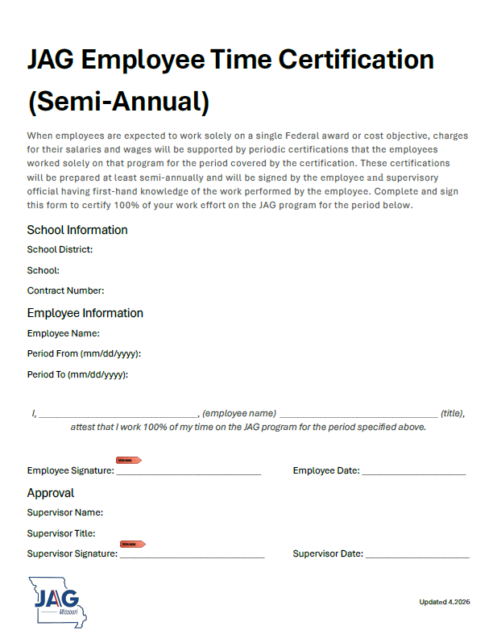
100% Employee Time Certification (Semi-Annual)
Meant for JAG Specialists who spend 100% of their work time on JAG Activities
Must be filled out at least twice a year
Keep on file for fiscal monitoring
Must be signed by employee and their supervisor
Notes:
100% Employee Time Certification (Semi-Annual)
This form is intended for JAG Specialists or other staff who spend 100% of their work time on JAG activities. Federal guidelines require a semi-annual verification stating that the employee worked exclusively on the JAG program during the fiscal year. The form must be signed by both the employee and their supervisor.

Slide 48
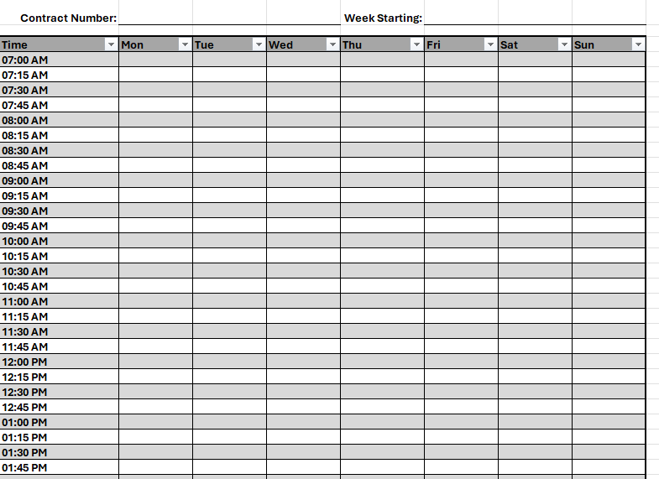
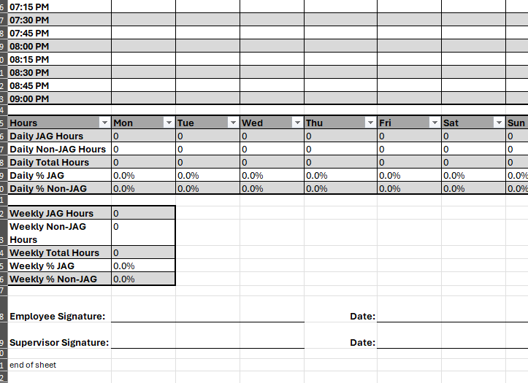
JAG Cost Allocation Weekly Timesheet
This template should be used by staff who spend only a portion of their work time on JAG
This spreadsheet allows the employee to track the following daily task types:
  JAG
  Non-JAG
  Non-Work Hours
It has been automated to calculate percentage of time attributable to the JAG Program. Please do not change any formatting.
This form must be completed weekly and signed by both employee and supervisor.
Notes:
JAG Cost Allocation Weekly Timesheet
This template should be used by employees who spend only a portion of their time on JAG. The weekly timesheet allows the employee to track daily hours worked on JAG and non-JAG activities, along with Non-work hours, calculating the percentage of time attributable to the JAG program. This form must be completed weekly and signed by both the employee and supervisor.

Slide 49
Contact Us
Program
Program Related Questions, contact Lindsey Thomas at 573-751-7867 or Lindsey.Thomas@dss.mo.gov
Invoicing
Invoicing Related Questions, please email W&CI.INVOICES@dss.mo.gov
Program Monitoring
Fiscal Monitoring Questions, please email Katie Pulley at Katie.Pulley@dss.mo.gov
Fiscal Monitoring
Monitoring Questions, please email FSD.E&TMonitoring@dss.mo.gov

Slide 50

Thank you!
Any Questions?

