Slide 1


Asthma Policy Update
Joshua Moore, PharmD
MO HealthNet Director of Pharmacy
March 17, 2022

Slide 2
Asthma Treatment
Asthma can be effectively treated, and most patients can achieve good control of their asthma. When asthma is under good control, patients can:
  Avoid troublesome symptoms during day and night
  Need little to no reliever medication
  Have productive, physically active lives
  Have normal or near normal lung function
  Avoid serious asthma flare-ups (exacerbations or attacks)
Treatment with inhaled corticosteroid (ICS) containing medications reduces frequency and severity of asthma symptoms and reduces the risk of flare-ups and dying due to asthma.
Asthma flare-ups can be fatal. They are more common and more severe when asthma is uncontrolled.
References:
1. GINA Pocket Guide 2021 - https://ginasthma.org/wp-content/uploads/2021/05/GINA-Pocket-Guide-2021-V2-WMS.pdf

Slide 3
Asthma Treatment Recommendations
For safety, the Global Initiative for Asthma (GINA) recommends that every adult and adolescent with asthma should receive an ICS-containing controller medication to reduce risk of serious exacerbations, including patients with infrequent symptoms.
Every patient with asthma should have a reliever inhaler for as-needed use:
  ICS-formoterol or short acting beta agonist (SABA)
  ICS-formoterol is preferred as it reduces the risk of severe exacerbations compared to SABA
  ICS-formoterol should not be used as the reliever when the patient is taking a different maintenance ICS-LABA, these patients should receive a SABA
References:
1. GINA Pocket Guide 2021 - https://ginasthma.org/wp-content/uploads/2021/05/GINA-Pocket-Guide-2021-V2-WMS.pdf

Slide 4
SABA Overutilization
Although SABA provides quick relief of symptoms, SABA-only treatment is associated with increased risk of exacerbations and lower lung function.
Regular use of SABA increases allergic responses and airway inflammation and reduces the bronchodilator response to SABA when it is needed.
Use of ≥3 canisters per year is associated with an increased risk of severe exacerbations.
  40.5% of MO HealthNet participants that received at least 1 SABA in 2021 received 3 or more in 12 months.
Use of ≥ 12 canisters in a year is associated with increased risk of asthma-related death.
  6.4% of MO HealthNet participants that received at least 1 SABA in 2021 received 12 or more in 12 months.
References:
1. GINA Pocket Guide 2021 - https://ginasthma.org/wp-content/uploads/2021/05/GINA-Pocket-Guide-2021-V2-WMS.pdf

Slide 5
Leukotriene Inhibitors
Many providers are unaware of montelukast’s black box warning regarding the risk of serious mental health effects.
For use in asthma, leukotriene receptor antagonists are less effective compared to a regular ICS, particularly for preventing exacerbations.
For use in allergic rhinitis, the FDA has determined that montelukast should be reserved for patients who have not responded adequately to other therapies or who cannot tolerate these therapies.
References:
1. GINA Pocket Guide 2021 - https://ginasthma.org/wp-content/uploads/2021/05/GINA-Pocket-Guide-2021-V2-WMS.pdf
2. https://www.fda.gov/drugs/drug-safety-and-availability/fda-requires-boxed-warning-about-serious-mental-health-side-effects-asthma-and-allergy-drug

Slide 6
SABA Utilization by MHD Participants
# of Participants who received at least one SABA MDI in CY 2021
18 And Under | Over 18 | Grand Total
48,854 | 46,931 | 95,785
>4 MDI/Year | 18 And Under | Over 18 | Grand Total |  | >6 MDI/Year | 18 And Under | Over 18 | Grand Total
Asthma | 3,456 | 1,582 | 5,038 |  | Asthma | 2,118 | 1,126 | 3,244
Both | 33 | 926 | 959 |  | Both | 22 | 751 | 773
COPD | 27 | 7,443 | 7,470 |  | COPD | 16 | 5,619 | 5,635
None | 4,626 | 5,371 | 9997 |  | None | 2,607 | 3,644 | 6,251
Grand Total | 8,142 | 15,322 | 23,464 |  | Grand Total | 4,763 | 11,140 | 15,903
 | 17% | 33% | 24% |  |  | 10% | 24% | 17%
>10 MDI/Year | 18 And Under | Over18 | Grand Total |  | >12 MDI/Year | 18 And Under | Over 18 | Grand Total
Asthma | 855 | 548 | 1,403 |  | Asthma | 521 | 317 | 838
Both | 10 | 432 | 442 |  | Both | 6 | 256 | 262
COPD | 6 | 3,079 | 3,085 |  | COPD | 4 | 1,565 | 1,569
None | 977 | 1,659 | 2,636 |  | None | 575 | 791 | 1,366
Grand Total | 1,848 | 5,718 | 7,566 |  | Grand Total | 1,106 | 2,929 | 4,035
 | 4% | 12% | 8% |  |  | 2% | 6% | 4%
Figures are for CY2021 and exclude participants diagnosed with cystic fibrosis

Slide 7
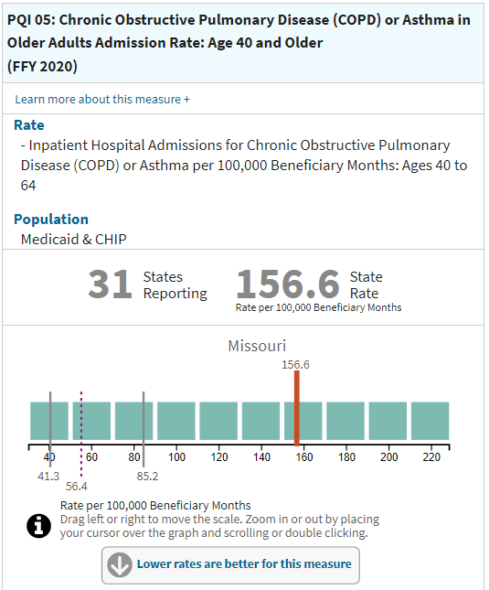
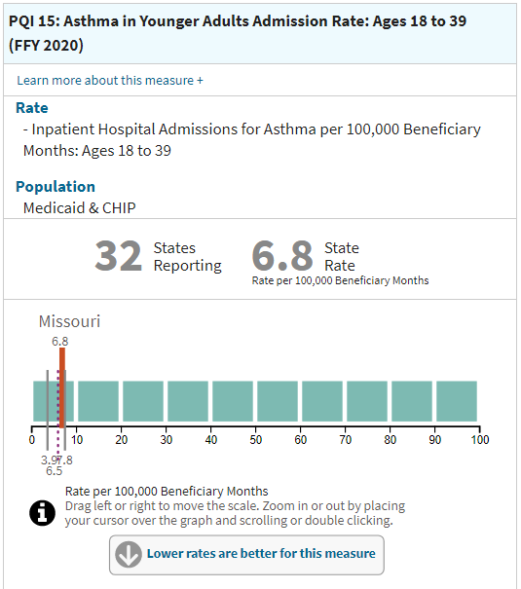
MHD Compared to other Medicaid Programs
References:
1. https://www.medicaid.gov/state-overviews/stateprofile.html?state=missouri

Slide 8
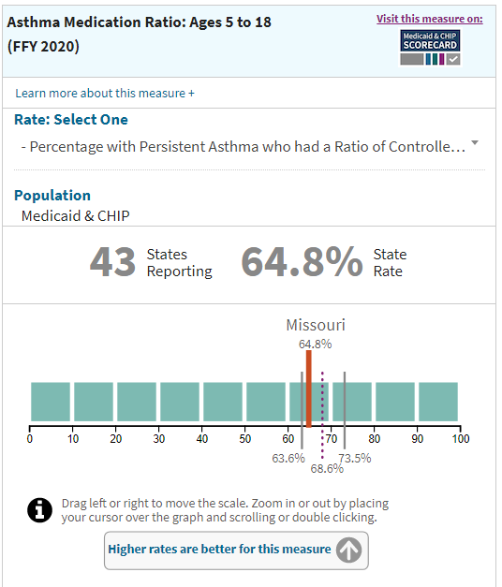
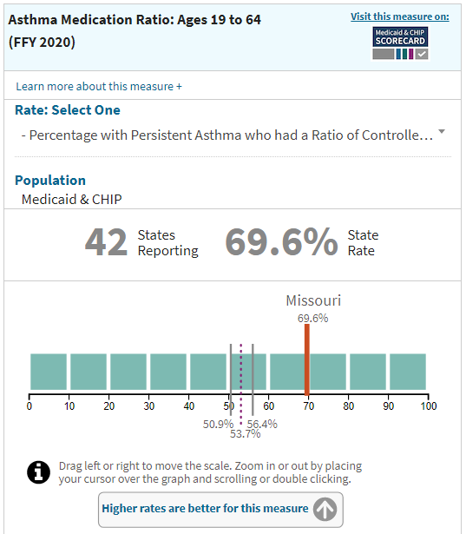
MHD Compared to other Medicaid Programs
References:
1. https://www.medicaid.gov/state-overviews/stateprofile.html?state=missouri

Slide 9
Proposed Policy Changes (effective July 2022)
Goal of changes: notify prescribers of over utilization of SABA and promote the use of SMART and maintenance medications to prevent exacerbations.
Quantity limits for SABA MDI (albuterol and levalbuterol):
  Participants <18 years old: 5 canisters per 180 days (5.6 puffs per day)
  Participants ≥18 years old: 3 canisters per 180 days (3.3 puffs per day)
  Participants with cystic fibrosis are excluded from the quantity limit
Quantity limit for albuterol or levalbuterol inhalation solution:
  120 vials per 60 days
  Participants with cystic fibrosis are excluded from the quantity limit
Leukotriene inhibitors will require prior authorization for new starts
  Asthma: History of ICS/LABA for 90 or more days
  Allergies: History of 2nd generation antihistamine and nasal steroid, both for 90 or more days
  Eosinophilic Gastroenteritis
  Obstructive Sleep Apnea/Sleep Disorder Breathing

Slide 10
72 Hour Emergency Supply
The dispensing of a 72-hour emergency supply is reimbursable only when dispensed outside of Pharmacy Help Desk regular working hours.
The intent of this requirement is to assure participants have access to prior authorized drugs when necessary. Not to circumvent the PA process. Claims submitted for an emergency supply are tracked and reviewed for possible abuse by participants and providers. If such abuse is detected, appropriate action is taken. For questions about this policy, please contact Pharmacy Administration at (573) 751-6963.
References:
MO HealthNet Pharmacy Provider Manual – Section 13.6.C found at
http://manuals.momed.com/collections/collection_pha/print.pdf

Slide 11
Communication Plan
Outreach to MO HealthNet Providers via:
  Provider e-mail blasts
  Direct communication with provider groups, including prescribers and pharmacies
  MHD staff available to speak to provider groups at conferences and webinars
  Drug utilization review message is already being sent to pharmacies at point of sale

Slide 12
ASTHMA EDUCATION AND ENVIRONMENTAL ASSESSMENT SERVICES
MO HealthNet covers asthma education and environmental assessment services
Providing a combination of asthma education and environmental assessments leads to better health outcomes in the pediatric population.
These services are outlined in the Payment Policy for Asthma Education and In-Home Environmental Assessments 13 CSR 70-25.150.
  All asthma education and asthma environmental assessment services must take place in the participant’s home.
  The annual limit of asthma education visits will be dependent on the codes used, but shall not exceed one (1) hour per year with the exception of one (1) 90- minute self-management session.
  The annual limit for asthma environmental assessments is 2 sessions.

Slide 13
ASTHMA EDUCATION AND ENVIRONMENTAL ASSESSMENT SERVICES
For participants to be eligible for asthma education and asthma environmental assessment services the individual must meet the following criteria:
  Currently enrolled in MO HealthNet, and
  Younger than 21 years of age, and
  Have a primary diagnosis of asthma, and
  Have had one of the following events as a result of asthma in the last 12 months:
    1 or more Inpatient Hospital stays, or
    2 or more Emergency Department (ED) visits, or
    3 or more Urgent Care visits, or
    A high utilization of rescue inhalers (short-acting inhaled beta-2 agonists) defined as 4 or more prescription refills, or underutilization of ICS (inhaled corticosteroids) defined as missing 4 or more refills based on their enrollment months, and at least one ED or Urgent Care visit.

