Slide 1
Opioid Policy Updates Joshua Moore, PharmD MO HealthNet Director of Pharmacy December 16, 2021

Slide 2
Historical Opioid Utilization by MO HealthNet Participants per SFY
 | 2012 | 2021 | Difference | % Difference
# of Participants | 191,981 | 109,055 | (82,926) | -43%
# of Claims | 945,319 | 442,854 | (502,465) | -53%
# of Units/Tablets | 63,856,453 | 20,111,663 | (43,744,790) | -69%
Morphine Milligram Equivalents (MME) | 791,593,422 | 211,400,737 | (580,192,685) | -73%
MME per Utilizer | 4,123 | 1,938 | (2,185) | -53%
MME per Claim | 837 | 477 | (360) | -43%

Slide 3
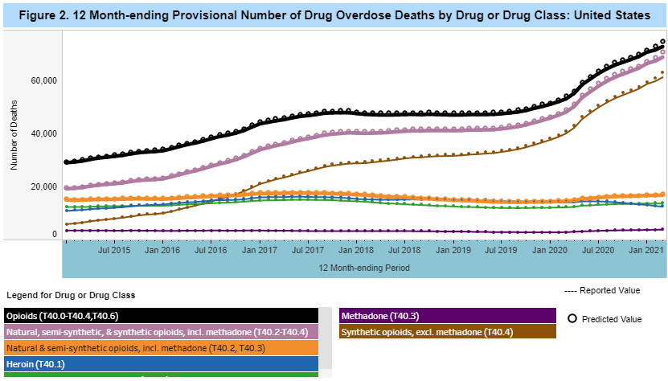
Still Room for Improvement
Opioid overdose deaths, including natural and synthetic opioids*:
United States: 65,004 in CY 2019 (up 41,385 from 2012)
Missouri: 1,360 in CY 2019 (up 829 from 2012)
In the last 12 months ending March 2021, over 72 thousand have died in the United States and 1,470 in Missouri due to opioid overdose
References
1. https://www.kff.org/other/state-indicator/opioid-overdose-deaths-by-type-of-opioid/?currentTimeframe=7&sortModel=%7B%22colId%22:%22Location%22,%22sort%22:%22asc%22%7D
https://www.cdc.gov/nchs/nvss/vsrr/drug-overdose-data.htm
*not limited to Medicaid

Slide 4
Non-Opioid Policy Changes
Non-Opioid Agent Restrictions:
Removed diagnosis restrictions for diclofenac gel (4/20) and lidocaine patches (10/21)
Diclofenac gel utilization has tripled since 3/20
Removed PA criteria from celecoxib (4/20)
Celecoxib utilization up approximate 45% since 3/20
Non-Medication Pain Management:
Complementary Health and Alternative Therapies for Chronic Pain Management (4/19)
Combines the use of chiropractic therapy, acupuncture, physical therapy, and/or cognitive-behavioral therapy
Risk Reduction Measures:
Clinical Edit for long term use of benzodiazepines (example: Xanax)
Utilization decreased by 21% of participants receiving benzos and number of units decreased by 37% from 2019 to 2021
High Risk Therapy clinical edit to increase access of naloxone (4/21)
Monthly utilization of naloxone has tripled since implementation
Removed PA from buprenorphine/naloxone (2017)
Utilization up 78% since 2017

Slide 5
Current Opioid Policy
Opioid policy exemptions:
Participants diagnosed with cancer or sickle cell disease
Participants enrolled in Hospice care or receiving palliative care
Initial opioid prescription for opioid naïve participants limited to 7 days and 50 MME per day
After the initial fill, participants may receive up to 90 MME of a single agent or 150 MME combined per day for up to 60 days prior to requiring a PA
Participants receiving over 150 MME must receive a PA and may require annual review
Participants receiving both an opioid and benzodiazepine are required to receive naloxone at least once every 2 years to have on hand

Slide 6
New Opioid Policy
Opioid policy exemptions:
Participants diagnosed with cancer or sickle cell disease
Participants enrolled in Hospice care or receiving palliative care
Initial opioid prescription for opioid naïve participants limited to 7 days and 50 MME per day
After the initial fill, participants may receive up to 50 MME total per day without requiring PA
Participants receiving over 50 MME must have a diagnosis supporting the use of opioids on file

Slide 7
New Opioid Policy - Continued
Participants newly receiving over 90 MME must submit progress notes and medical necessity to support the use of opioids
Participants already over 90 MME will be allowed to maintain dosage or decrease dose without PA
Dosage increases will require a new submission of progress notes and medical necessity
Participants receiving both an opioid and benzodiazepine are required to receive naloxone at least once every 2 years to have on hand

Slide 8
Transitioning to New Policy
Transition from requiring a PA for participants after two months of therapy and move to MME centered PA limits based on risk
Reduce MME accumulation limit from 150 MME per day to 90 MME per day before requiring PA, progress notes, and medical necessity documentation
Allow for transparent dose reductions when providers taper a regimen above 90 MME to another regimen still above 90 MME per day (example from 150 MME to 120 MME per day)
Revised pharmacy helpdesk procedures to clarify reason for denials and improve interactions with providers

Slide 9
Statistics
Monthly MO HealthNet Statistics:
33,000 participants receiving at least one opioid prescription
3,300 participants receiving greater than 150 MME per day
900 participants receiving between 90 – 150 MME per day
3,000 participants receiving between 50 – 90 MME per day
25,800 participants receiving less than 50 MME per day
MO HealthNet currently manually reviews and approves 800 plus opioid regimens per month

Slide 10
Why?
7 Days on Initial Prescription (existing policy):
A patient receiving a 1 day supply for the initial opioid prescription has a 6% chance of being on opioids one year later, this increases to 13.5% for greater than 7 days, and 29.9% for greater than 30 days.
50 Morphine Milligram Equivalents and 90 Morphine Milligram Equivalents:
Dosages of 50–99 MME/day have been found to increase risk for opioid overdose two-fold to five-fold compared with dosages of 1–19 MME/day, and dosages ≥100 MME/day increase risk of overdose up to nine times the risk at 1–19 MME/day.
Among a national sample of Veterans with chronic pain receiving opioid treatment and dying of opioid-related overdose, average prescribed dosage was 98 MME day (compared with an average dosage of 48 MME/day among patients not experiencing fatal overdose), suggesting the need for caution before dosages approach 100 MME daily.
Most calls today are for participants who are receiving <50 MME and end with an approval after diagnosis is conveyed to helpdesk. These changes will reduce calls and allow staff to focus on higher value calls.
References
https://www.cdc.gov/mmwr/volumes/66/wr/mm6610a1.htm
https://www.cdc.gov/opioids/providers/prescribing/faq.html

