Slide 1


MO HealthNet PharmaCy Program and Budget Update mhd drug utilization review board october 19, 2022
Elizabeth Short, Program specialist

Slide 5

MEDICAID EXPANSION
AUGUST 2022
PARTICIPANTS 240,649
EXPENDITURES $27,748,551
CLAIM COUNT 236,485

Slide 6

TOP 4 DRUG CLASSES PER FY
 | FY2021 Expenditures | FY2021 Claim Count
Paliperidone Palmitate(Invega) | $50,783,647 | 19,191
Adalimumab(Humira) | $47,631,914 | 6,928
Lurasidone HCL(Latuda) | $40,962,690 | 34,399
Methylphenidate HCL(ADHD) | $32,590,476 | 121,636
 | FY2022 Expenditures | FY2022 Claim Count
Adalimumab(Humira) | $65,085,308 | 8,983
Paliperidone Palmitate(Invega) | $55,188,350 | 20,453
Lurasidone HCL(Latuda) | $43,154,241 | 35,334
Methylphenidate HCL(ADHD) | $35,358,173 | 130,708
 | FYTD2023 Expenditures | FYTD2023 Claim Count
Adalimumab(Humira) | $29,579,181 | 3,807
Paliperidone Palmitate(Invega) | $20,676,480 | 7,453
Biktarvy(HIV) | $17,384,640 | 5,528
Lurasidone HCL(Latuda) | $15,640,214 | 12,628

Slide 10
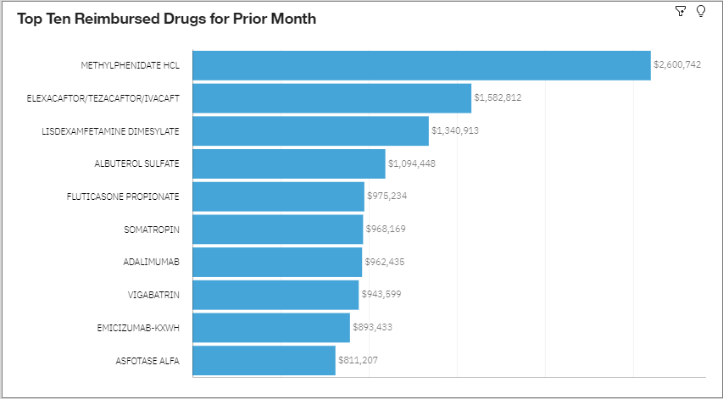
Sept 2022 TOP TEN REIMBURSED DRUGS FOR CHILDREN 0-17

