Slide 1


MO HealthNet PharmaCy Program and Budget Update
Missouri Pharmacy Advisory Boards OCTOBER 2023
Elizabeth Short, Program specialist

Slide 7
FY22-FY24(July/Aug) AEG Expenditures/participant count

Slide 9
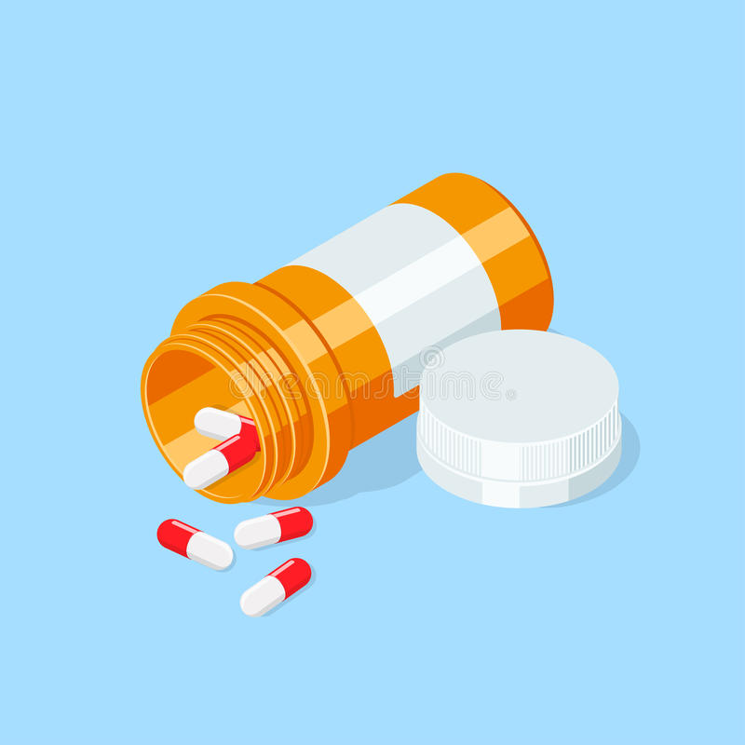
TOP 10 HICL DRUG CLASSES FOR FYTD 2024
DRUG | FYTD2024 Expenditures
ADALIMUMAB(Humira) | $29,656,224
TRULICITY(Diabetes) | $21,405,544
BIKTARVY(HIV) | $20,340,812
PALIPERIDONE PALMITATE(Invega) | $18,951,007
INSULIN ASPART(Diabetes) | $10,921,546
TRIKAFTA(Cystic Fibrosis) | $10,634,089
METHYLPHENIDATE HCL(Stimulant)(Ritalin) | $10,303,299
MAVYRET(Hep C) | $10,287,748
BUDESONIDE/FORMOTEROL FUMARATE(Asthma) | $10,052,396
OTHER | $9,748,593

