Slide 1
MO HealthNet Oversight Committee Meeting February 4, 2021

Slide 2
Agenda February 4, 2021
12:00 – 12:15 | Welcome/Introductions/Minutes Approval of November 12 meeting minutes New Committee Member – Senator Holly Rehder | Dr. Nick Pfannenstiel, Chairman
12:15 – 12:45 | Director’s Update COVID-19 Update Medicaid Expansion | Todd Richardson, MHD Director
12:45 – 1:00 | Chief Transformation Officer Update Missouri Benefit Enrollment Transformation Project | Kirk Mathews
1:00 – 1:15 | Chief Operating Officer Update Introducing our new Program Integrity Pharmacist Long Acting Reversible Contraception (LARC) | Jessie Dresner Olivia Rush
1:15 – 1:30 | IT Update BIS EDW Update Conduent System Migration Update | Darin Hackman/Tisha McGowan
1:30 – 1:45 | Managed Care RFP Update | Rebecca Logan
1:45 – 2:00 | Pharmacy Director Update Specialty Drugs – High Cost Therapies in Medicaid | Josh Moore
2:00 – 2:15 | Legislative Update | Caitlin Whaley
2:15 – 2:30 | Budget Update | Tony Brite
2:30 – 2:45 | Public Comment
2:45 – 3:00 | Family Support Division Update | Kim Evans, FSD Director

Slide 3
Director’s UPDATE

Slide 4
MEDICAID EXPANSION PLANNING PROJECT

Slide 5
COVID UPDATE

Slide 6
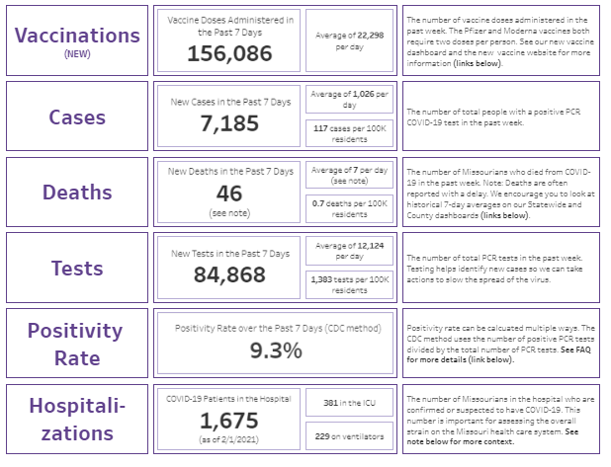
Public dashboard – 2/4
Source: Data are from DHSS and HHS via TeleTracking

Slide 7
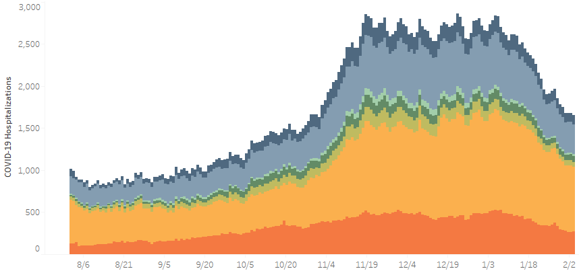
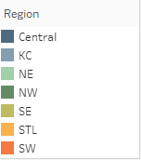
Hospitalizations continue their downward trend
Statewide suspected and confirmed COVID-19 hospitalizations, data through from Aug 1 through Feb 3
Peak: 2,862 on 12/22
1,651 Missouri hospitalizations on 2/3
Source: Data are from HHS via TeleTracking

Slide 8
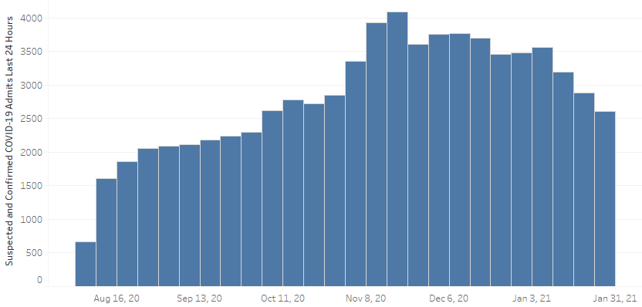
New hospital admissions continue to decline
Statewide suspected and confirmed COVID-19 hospital admissions by week, Aug 1 through Feb 3
2,610 hospital admissions during week of January 24th
Source: Data are from HHS via TeleTracking

Slide 9
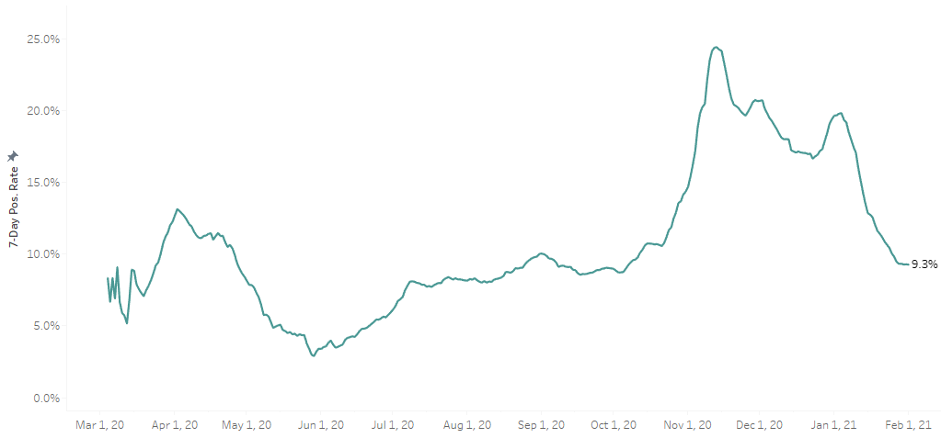
Positivity rate has fallen sharply in the past three weeks
Moving 7-day positivity rate (CDC method) since March
Peak of 25.4% on 11/11
9.3% today
Source: Data are from DHSS

Slide 10
Transmission rates (“R_{e}”) dropped below 1 statewide
Northeast Region 0.88 -> 0.88
Estimated Statewide Weighted R_{e}
1.06 -> 0.96
Northwest Region 1.13 -> 1.06
Atchison
Nodaway
Worth
Mercer
Putnam
Schuyler
Scotland
Clark
Harrison
Holt
Gentry
Grundy
Sullivan
Adair
Knox
Lewis
Andrew
Central Region
1.03 -> 1.03
DeKalb
Daviess
Linn
Livingston
Macon
Shelby
Marion
Buchanan
Clinton
Caldwell
Carroll
Chariton
Randolph
Monroe
Ralls
Platte
Clay
Ray
Pike
Saline
Howard
Audrain
Greater Kansas City 1.09 -> 1.05
Jackson
Lafayette
Boone
Montgomery
Lincoln
St Louis Region 1.05 -> 0.95
Johnson
Pettis
Cooper
Callaway
Warren
St. Charles
Cass
Moniteau
St. Louis
St. Louis City
Henry
Morgan
Cole
Osage
Gasconade
Franklin
Bates
Benton
Miller
Maries
Jefferson
St. Clair
Hickory
Camden
Crawford
Washington
Ste.
Understanding R_{e}
R_{e} > 1 = COVID cases are growing
Vernon
Pulaski
Phelps
St.
Genevieve
Perry
Cape Girardeau Region 1.02 -> 0.84
Cedar
Dallas
Laclede
Iron
Francois
Barton
Polk
Dent
Madison
Dade
Texas
Reynolds
Cape Girardeau
Jasper
Greene
Webster
Wright
Shannon
Wayne
Bollinger
Lawrence
Scott
Newton
Christian
Douglas
Carter
Stoddard
Mississippi
Barry
Stone
Ozark
Howell
Oregon
Ripley
Butler
McDonald
Taney
New
Springfield Region
1.08 –> 0.88
Madrid
Dunklin
Pemiscot
* Data date range: 01/26/21 – 02/1/21

Slide 11
Missouri is currently #44 in new cases per capita
<5 per 100K
5-9
10-50
New cases per 100k by report date in the past 7 days (Jan 27 – Feb 2)
50-100
>100
Top 10 states
Top 32-51 states
Texas
Dist. of Columbia
Colorado
South Carolina
Nevada
Washington
Missouri’s case rate is lower than most of its neighbors
Rhode Island
Iowa
Vermont
Arizona
Maryland
Alaska
Oklahoma
Missouri
Michigan
New York
Illinois
South Dakota
Kentucky
Wisconsin
Minnesota
Arkansas
Idaho
Oregon
New Jersey
Nebraska
North Dakota
North Carolina
Wyoming
Hawaii
Source: Nationwide data are from USA Facts; red / yellow / green thresholds are from the White House Coronavirus Task Force

Slide 12
Chief transformation officer update

Slide 13
Missouri Benefits Enrollment Transformation Project Update MOHealth Net Oversight Committee February 4, 2021

Slide 14
Project Timeline:
2020 | 2021
Q3 | Q4 | Q1 | Q2 | Q3 | Q4
Application
Correspondence
Plan | Design/ Testing | Implementation
 | Design/Testing

Slide 15
Phase 2: Design and Test
Three Application Policy Reviews:
Version 1 Review: November 16 - December 4
Version 2 Review: January 11-22
Final Review: February 8 – 19
Submit for CMS review: March 1

Slide 16
Phase 2: Design and Test
Tight time line… but on schedule
2nd Version review complete
Testing going well
Diverse group of FSD Staff
Diverse group of participants
Phase 3: New App. Implementation
March - July

Slide 17
Chief operating officer update

Slide 18
Long Acting Reversible Contraception
 | Drug Claims |  |  | Procedure Claims
Calendar Year | Participant Count | Claim Count | Total Reimbursement | Participant Count | Claim Count | Total Reimbursement | Average Participant Count
2017 | 9,614 | 9,703 | $7,915,205 | 9,028 | 9,934 | $595,039 | 987,114
2018 | 7,068 | 7,120 | $5,995,427 | 8,498 | 9,365 | $541,427 | 951,839
2019 | 8,074 | 8,137 | $6,618,402 | 8,799 | 9,648 | $565,905 | 867,542
2020 | 7,957 | 8,026 | $6,563,591 | 8,388 | 9,187 | $523,708 | 941,164
Effective April 14, 2019, the MO HealthNet Division (MHD) no longer pays claims for long-acting reversible contraceptives (LARCs) submitted by pharmacy providers.

Slide 19
IT update

Slide 20
Business Intelligence Solution – Enterprise Data Warehouse (BIS-EDW) Update

Slide 21
BIS-EDW Goals
Better management and use of information
Better decisions
Better outcomes for the State and our citizens
Future scalability for the Missouri Medicaid Enterprise

Slide 22
BIS-EDW Overview
Seven projects
Three distinct implementations

Slide 23
Implementation 1- Feb 2021
EDW - Creates the base data warehouse to bring in all of the data and organize it
DART - Detailed Analysis and Reporting Technology to create complex reports
SMART - Summarized Management and Administrative Reporting Technology creating data marts, cubes and dashboards
Data governance – defining, managing, and distributing data

Slide 24
Implementation 1- Status
Data Governance Council (DGC) established, data stewards meet regularly, and business terms and definitions are being documented for DGC review and approval
User Acceptance Testing completing 2/5/2021. Correction of defects identified in system test and the subsequent reload of data resulted in delays to the start of user acceptance testing. This should minimize the number of defects for users in their testing.
BIS-EDW Go Live planned February 2021 – system is rolled out to the users within Mo HealthNet

Slide 25
Implementation 2- TBD
Data extracts – developing a repeatable process for managing and sending our data to authorized subcontractors/vendors/etc.
Currently in design/development.
May be delayed based on the delay in
Implementation 1. Schedule is being updated now.

Slide 26
Implementation 3 – October 2021
Federal Financial Reporting – CMS required reports
Design sessions have started
T-MSIS – specialized data extracts for the national Medicaid data repository
Design/development sessions have started
Historical Claims Project – claims older than July 2011
Requirement sessions have started

Slide 27
Pharmacy POS, CyberAccess and SmartPA Migration to Cloud

Slide 28
Tools
Pharmacy Point-of-Sale System – applies clinical and pharmacy edits to claims submitted by pharmacies
CyberAccess - Portal used by providers to access participant claim information
SmartPA – system used to capture and process service authorization requests

Slide 29
Issues
Software and hardware platform used for the tools was outdated and in need of upgrade
MO HealthNet was experiencing increases in system outages and performance issues

Slide 30
Migration to Cloud
Vendor proposed to upgrade the platform software, rebuild the application software, and migrate the system from the vendor’s data center into the Microsoft Azure cloud
Migration and cutover to the new system was completed in December

Slide 31
Benefits
Upgraded platform software that is supported by the manufacturer
Improved system security
Improved system performance
Improved scalability of the system – ability to add capacity as needed
Improved disaster recovery capabilities – quick failover to secondary site

Slide 32
Questions?

Slide 33
Managed CARE update

Slide 34
Managed Care Program Updates SFY22
Addition of Adult Expansion Population (AEG) to Managed Care
Former Foster Care Youth from Other States
CAR-T Therapies
Psychosocial Treatment of Obesity
Interoperability Rule

Slide 35
Managed Care RFP SFY23
Managed Care RFP Development Timeline for SFY23
Task | Target Date
Development, Stakeholder Engagement, Reviews | 6/01/20 to 2/26/21
Submission to Oversight and Administration | 3/1/21
RFP Release | 7/21
Pre-Proposal Conference | 8/21
Evaluation and Award | 9/21 to 11/21
Readiness Review | 11/21 to 6/22
Implementation | 7/01/22

Slide 36
PHARMACY DIRECTOR update

Slide 37
Specialty Drugs – High Cost Therapies in Medicaid Joshua Moore, PharmD MO HealthNet Director of Pharmacy February 4, 2021

Slide 38
The Pipeline
In the next 12 – 24 months, the FDA expects to review 45 new treatments with an anticipated cost of greater than $200,000 per patient per year
Projected wholesale acquisition costs vary from $200,000 to $3,000,000
The most common diseases treated by these high-cost therapies are cancer and blood disorders (such as sickle cell anemia and hemophilia)
Almost all these products are for rare diseases (defined as <200,000 cases in the United States)
An estimated 25 million to 30 million Americans have a rare disease
These medications treat diseases through genetic therapy, modifying a patient’s cells to attack cancer cells and several other new technologies
Often these medications are for diseases that have no alternatives or alternatives with limited benefit for the patient

Slide 39
Utilization Management Strategies
MO HealthNet must offer a path to coverage for all drug products of manufacturers that have a signed rebate agreement with CMS
Rebate percentage has increased to 65% of ingredient cost across total pharmacy spend
Hundreds of step therapy, PDL, and clinical edits are in place to ensure utilization of the lowest net cost therapy
Current compliance to the PDL is 97+%
Utilization management strategies for rare disease products are limited due to the lack of viable alternative treatments
MO HealthNet has better control on physician-administered drugs than other State Medicaid Programs
All new rare disease medications are reviewed by the Rare Disease Advisory Committee

Slide 40
Predicting Future Utilization
Due to the nature of medications for the treatment of rare disease, it is difficult to predict expenditures for specific products
Example 1: Zolgensma - Gene Therapy for treatment of SMA
SMA is a rare genetic disease impacting 8.5 – 10.3 per 100,000 live births.
In 2018, there were 73,281 live births in Missouri
Estimated incidence in Missouri would be 6.2 to 7.5 live births per year with SMA
Zolgensma costs $2,125,000 for one gene treatment
MO HealthNet estimated 7 patients would receive the medication
Only 3 MO HealthNet participants have received the medication so far
Now there are 3 medications for the treatment of SMA, but the drugs are distinctly different and there are no real competitors to Zolgensma

Slide 41
Predicting Future Utilization
Example 2: Trikafta – oral product for the treatment of CF
Cystic Fibrosis is a rare genetic disease
MHD claims history showed 203 participants with a history of CF diagnosis on file
73 participants were receiving treatment with an older CFTR product
Trikafta was estimated to treat 90% of CF patients, compared to 45% for the older therapy
Trikafta cost per year is approximately $300,000
Predicted range of participants who would utilize Trikafta was 93 - 146
Approximately 84 participants are currently taking Trikafta at a cost of $2 million per month (12/2020)
All CFTR products are manufactured by 1 company creating a market with no competition

Slide 42
Predicting Future Utilization
Example 3: Roctavian – Gene therapy for the treatment of Hemophilia A
Hemophilia A is a rare genetic disease.
MHD claims history showed 99 participants being treated for Hemophilia A
70 participants would be defined as severe Hemophilia A
National consensus in the Hemophilia community is 5 – 10% of those eligible will receive the gene therapy within 3 years of approval
Roctavian price estimates were $3 million per gene therapy
Predicted range of participants who would utilize Roctavian was 3 - 7
Estimated reimbursement amount for these participants would be $9 – 21 million
Roctavian was not approved by the FDA in August 2020 as anticipated

Slide 45
State Share of Medicaid Drug Expenditures
Average Ingredient Cost: $93.34
Federal Rebate consists of statutory rebate, best price adjustments and CPI penalty. Statutory minimums are:
13% for generics
17.1% for pediatric and clotting agents
23.1% for brand names
Supplemental rebates are negotiated at the state level generally when there is market competition
Cost to GR: $13.34
Federal State Split is blended at 65/35

Slide 46
State Share of Medicaid Drug Expenditures
Example of a new rare disease drug for adults: $300,000
Federal Rebate consists of statutory rebate, best price adjustments and CPI penalty. Statutory minimums are:
13% for generics
17.1% for pediatric and clotting agents
23.1% for brand names
Supplemental rebates are negotiated at the state level generally when there is market competition
Cost to GR: $80,745.00
Federal State Split is blended at 65/35

Slide 47
Legislative update

Slide 48
budget update

Slide 49
MO HealthNet Budget Request State Fiscal Year (SFY) 2022 February 4, 2021

Slide 50
MO HealthNet (MHD) Supplemental Request
State Fiscal Year (SFY) 2021
SFY 2021 Supplemental Department Request
 |  | Dept Req |  | Gov Rec
Requests |  | GR | Total | GR | Total
MHD SFY 2020 Supplemental |  | $227.7M | $721.1M | $222.5M | $700.6M
Amount related to Public Health Emergency Requirements (included in total above) |  | $198.5M | $582.4M | $199.0M | $598.1M
AFRA Fund Authority (Ambulance Rate Increase) |  | $0.0M | $1.5M | $0.0M | $1.5M
Tobacco Shortfall GR Pickup |  | $16.8M | $16.8M | $16.8M | $16.8M
PFRA Fund Authority* |  | $0.0M | $93.0M | $0.0M | $93.0M
Total |  | $244.5M | $832.4M | $239.3M | $811.9M
*Request was approved in Special Session on Supplemental Appropriations
Source: https://oa.mo.gov/budget-planning

Slide 51
MO HealthNet (MHD) Budget Request
State Fiscal Year (SFY) 2022
SFY 2022 Request
 |  | Dept Req |  | Gov Rec
Requests |  | GR | Total | GR | Total
MHD SFY 2022 Cost to Continue (CTC) |  | $124.8M | $396.1M | $145.3M | $403.4M
Amount related to Public Health Emergency Requirements (included in total above) |  | $119.6M | $350.0M | $121.8M | $359.5M
Managed Care Actuarial Increase |  | $37.7M | $109.8M | $36.6M | $109.8M
Tobacco Shortfall GR Pickup |  | $27.0M | $27.0M | $29.2M | $29.2M
Asset Limit FY20 CTC |  | $2.0M | $6.7M | $1.9M | $6.7M
PFRA Fund Authority CTC |  | $0.0M | $43.0M | $0.0M | $43.0M
AFRA Fund Authority CTC |  | $0.0M | $1.5M | $0.0M | $1.5M
Source: https://oa.mo.gov/budget-planning

Slide 52
MO HealthNet (MHD) Budget Request
State Fiscal Year (SFY) 2022
SFY 2022 Request
 |  | Dept Req |  | Gov Rec
Requests |  | GR | Total | GR | Total
Pharmacy Specialty Per Member Per Month (PMPM) Increase |  | $24.0M | $68.6M | $23.3M | $68.6M
Pharmacy Non-Specialty PMPM Increase |  | $1.6M | $4.6M | $1.6M | $4.6M
Non-Emergency Medical Transportation (NEMT) Rate Increase |  | $1.1M | $3.1M | $1.1M | $3.1M
Medicare Buy-In Premium Increase |  | $6.0M | $18.2M | $4.1M | $12.7M
Hospice Rate Increase (Federal Mandate) |  | $0.1M | $0.4M | $0.1M | $0.4M
CHIP Enhancement Fund GR Pickup |  | $18.8M | $18.8M | $18.8M | $18.8M
Source: https://oa.mo.gov/budget-planning

Slide 53
MO HealthNet (MHD) Budget Request
State Fiscal Year (SFY) 2022
SFY 2022 Request
 |  | Dept Req |  | Gov Rec
Medicaid Management Information Systems (MMIS) Requests |  | GR | Total | GR | Total
MMIS Health Information Exchange (HIE) |  | $2.9M | $5.7M | $2.9M | $5.7M
Clinical Management Services for Claims and System for Pharmacy Claims and Prior Authorizations (CMSP) Contractual Increases |  | $0.5M | $1.5M | $0.5M | $1.5M
MMIS Security Risk Assessment (Existing System) |  | $0.8M | $1.7M | $0.8M | $1.7M
MMIS Pharmacy Solutions |  | $2.8M | $11.0M | $2.8M | $11.0M
MMIS Premium Collections (Enrollment Broker) |  | $0.3M | $1.3M | $0.3M | $1.3M
MMIS Business Intelligence Solution-Enterprise Data Warehouse (Operations) |  | $1.6M | $3.1M | $1.6M | $3.1M
MMIS Managed Care Contract Management Tool |  | $0.7M | $7.0M | $0.7M | $7.0M
Source: https://oa.mo.gov/budget-planning

Slide 54
MO HealthNet (MHD) Budget Request
State Fiscal Year (SFY) 2022
SFY 2022 Request
 |  | Dept Req |  | Gov Rec
New Items in Gov Rec |  | GR | Total | GR | Total
Medicaid Expansion (Statewide Item includes cost for DMH and Admin) |  |  |  | $129.4M | $1.89B
Health Home Expansion |  |  |  | $0.3M | $1.6M
Source: https://oa.mo.gov/budget-planning

Slide 55
Public comment

Slide 56
Fsd update

Slide 58
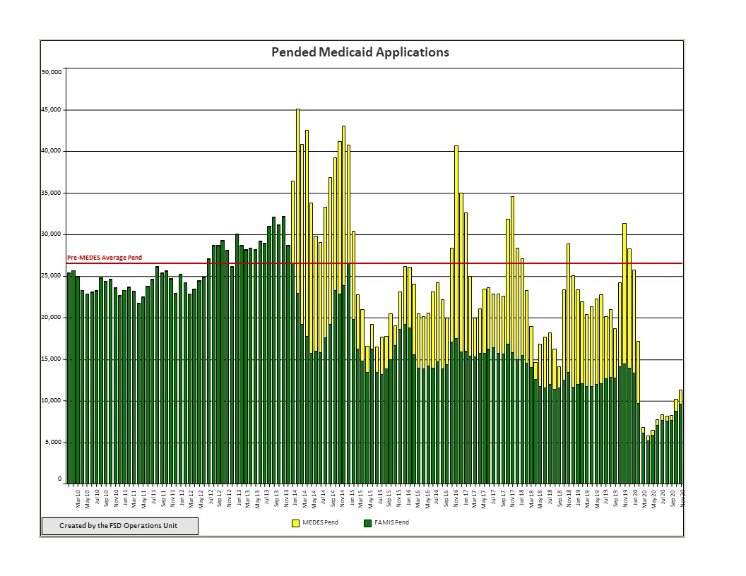

Slide 59
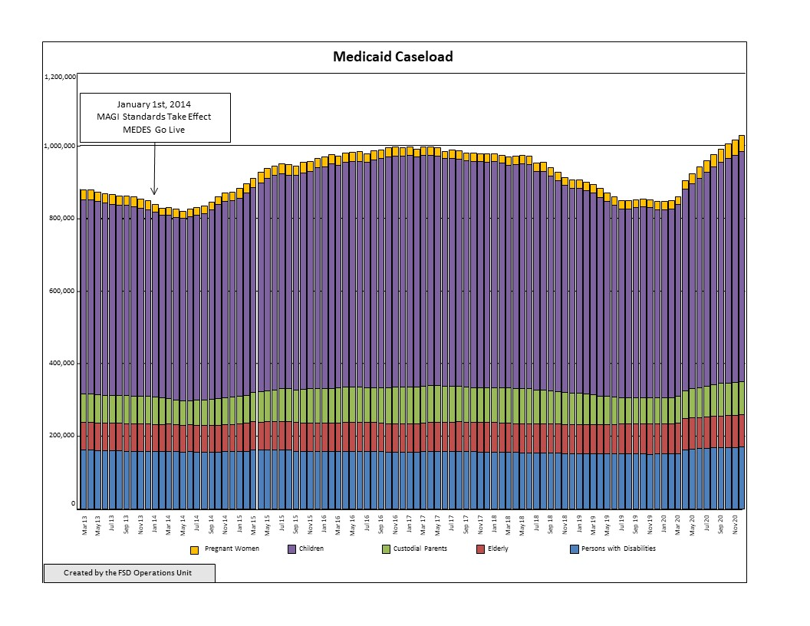

Slide 60
Charts Legend
DSS: MO Department of Social Services (i.e. General MAGI applications)
FAMIS: Family Assistance Information Management Systems
FFM: Federally Facilitated Marketplace
MAGI: Modiﬁed Adjusted Gross Income
MEDES: Missouri Eligibility Determination and Enrollment System
MHABD (ADM): MO HealthNet Eligibility for Persons Who are Aged (age 65 and over), Blind, or Disabled

Slide 61
Next meeting May 25, 2021

