Slide 1


Pharmacy Update Joshua Moore, PharmD MO HealthNet Director of Pharmacy August 19, 2021

Slide 2
Project Hep Cure
Launched 7/1/2021
Goal: Eliminate Hepatitis C in the MO HealthNet population
Screen
Test
Treat
MO HealthNet has removed all prior authorization restrictions for Mavyret
Multiple provider education programs are in progress, including Project ECHO and AbbVie hosted events
For more information go to:
https://dss.mo.gov/mhd/hepc/

Slide 3
Project Hep Cure - Materials

Slide 4
Sickle Cell Disease
Group of inherited red blood cell disorders that affects hemoglobin, the protein that carries oxygen through the body
Changes normal red blood cells which are flexible and disc shaped to inflexible and sickle shaped
The sickle shaped cells get stuck and block blood flow to parts of your body
The blocked blood flow can lead to serious health concerns

Slide 5
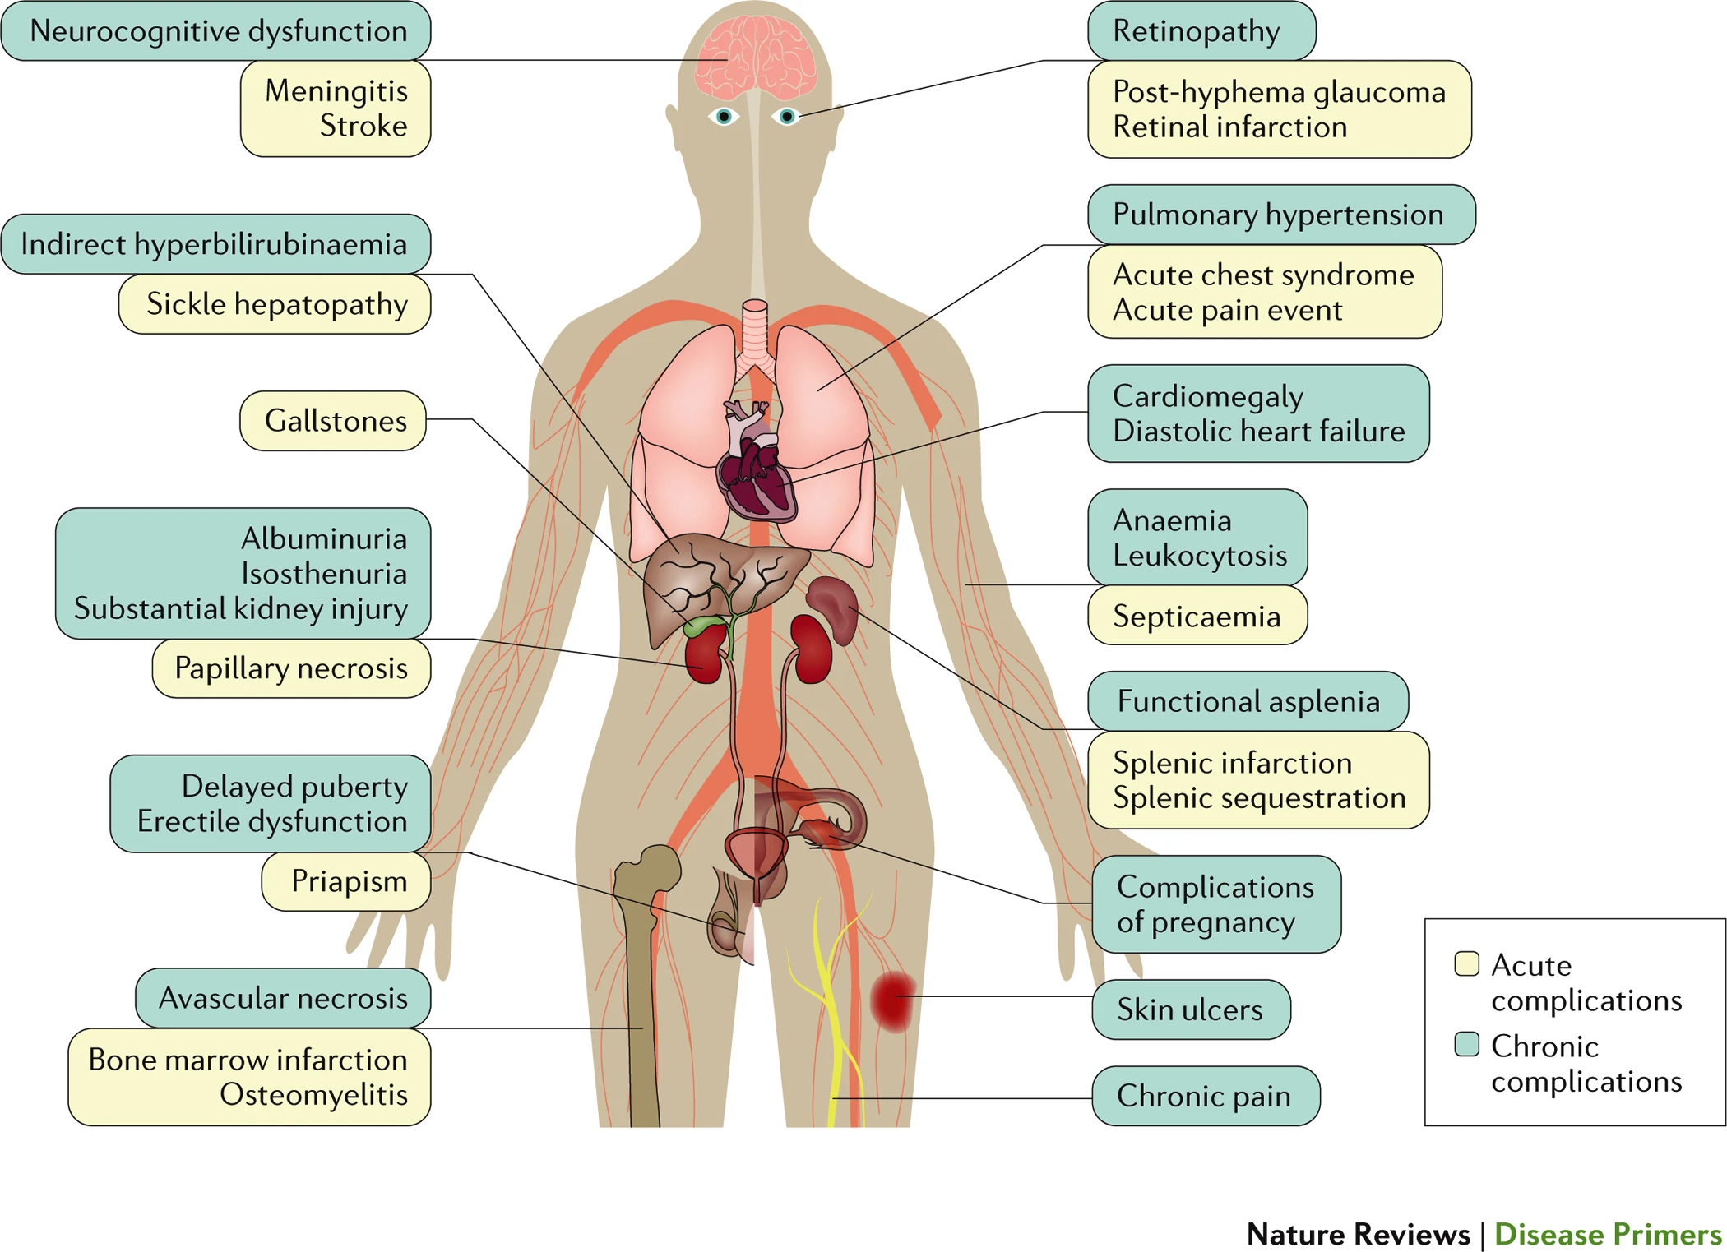
Sickle Cell Disease

Slide 6
Sickle Cell Disease
Few treatment options exist today, however, there is a pipeline of new options coming
Currently available products are (with annual cost):
Hydroxyurea ($350) – reduce and prevent complications
Adakveo ($85k - $100k) – reduce pain crises
Endari ($28k) – reduces acute complications
Oxbryta ($118k) – prevents red blood cells from sticking together
Opioids (varies) – utilized for acute pain
Transplant – increases normal red blood cells
Notes:
Zynteglo – gene therapy, estimated cost 1.2 – 1.8 million in 2023.

Slide 7
Sickle Cell Disease
Notes:
SCDMembers 1921 ADAKVEO 0.42% ENDARI 0.52% HYDROXYUREA 11.61% OXBRYTA 0.78%

Slide 8
Sickle Cell Disease
Opioids, ER Visits, and Inpatient stays:
In the past 90 days 20% of MHD sickle cell participants have utilized at least one opioid, visited an ER, or been admitted for inpatient treatment
Almost twice as many as use any preventative medication

Slide 9
Prescription Drug Monitoring Program (PDMP)
Senate Bill 63
Passed by General Assembly on 5/12/2021
Signed by Gov. Parson on 6/7/2021
Missouri currently has the St. Louis County PDMP
The St. Louis County PDMP will continue to operate until the statewide PDMP is available and fully operation for access by healthcare providers
The St. Louis County PDMP covers 85% of Missouri’s residents and 94% of Missouri’s healthcare providers
Includes Schedule II, III and IV drugs dispensed to patients
Dispensation information in the PDMP will only be utilized by healthcare providers for the provision of healthcare services
Law enforcement and regulatory boards will not have access to the PDMP or any other entity unless for the purposes set forth in HIPAA

Slide 10
Prescription Drug Monitoring Program (PDMP)
The “Joint Oversight Task Force for Prescription Drug Monitoring” will supervise the PDMP
2 members from Board of Healing Arts who are physicians or surgeons
2 members from Board of Pharmacy who are pharmacists
1 member from Board of Nursing who is an APRN
1 member from Missouri Dental Board who is a dentist
Next Steps:
The task force will work towards soliciting a vendor to operate the PDMP
Go live date is currently TBD
By 1/1/2024 the PDMP will be real time

