Slide 1
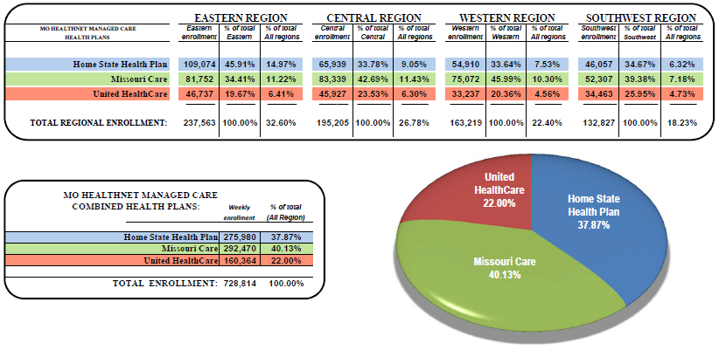
Managed Care Market Share Report
As of August 11, 2017

Slide 2
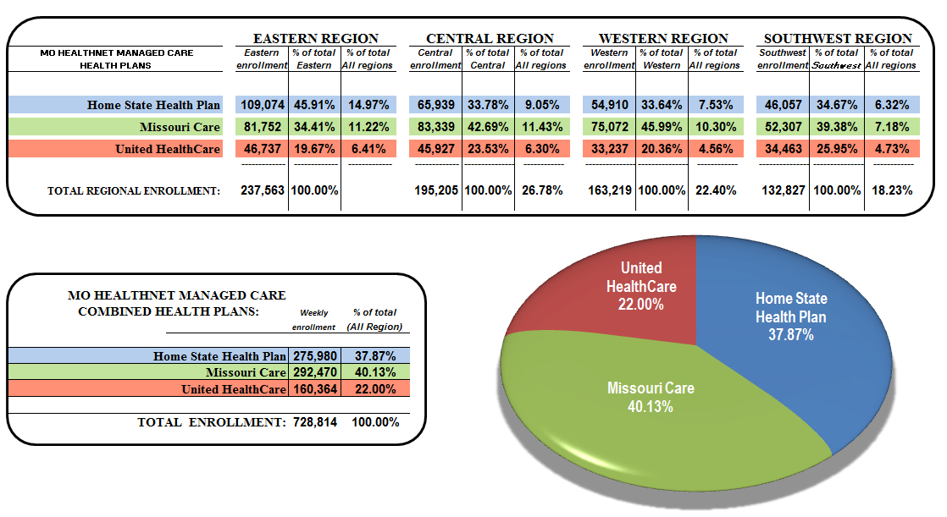
Managed Care Weekly Enrollment for 1915B & CHIP

