Slide 1

Missouri Healthcare:
Past, Present, and Future
MOHealthNet Oversight Committee Meeting
December 12th, 2017
Timothy McBride, PhD
Abigail Barker, PhD

Slide 2
Overview of Presentation Today
“Transforming Healthcare in Missouri: Ideas, Innovations and Investments”
  October 13, 2017 in St. Louis, Sponsored by Washington University in St. Louis
  For that event we presented…
Background/Context for Missouri
  Access, Workforce (including data visualizations)
  Health spending in Missouri
    National trends and figures
    Medicaid cost drivers (including data visualizations)
Moving forward
  Policy ideas from the event
  Goal: who to achieve improved access, improving population health, within Missouri’s budget

Slide 3
Background/ Context
The Uninsured in Missouri
Missouri’s Healthcare Providers Trained
Missourians’ Health
The Aging Population in Missouri

Slide 4
Percent Uninsured in Missouri and U.S., 2008-16
Uninsurance rates in Missouri were lower than in the U.S. until 2014, when the U.S. uninsured rate dropped below Missouri’s rate.
SOURCE: Bureau of the Census, September2017, https://www.census.gov/library/publications/2017/demo/p60-260.html .

Slide 5
Missouri’s Healthcare Providers Trained
In 2016, there were 448 new MDs and 413 new DOs trained in Missouri.
Meanwhile, 1699 (11%) of current active MDs are above 65, with another 3192 (20%) between the ages of 55 and 64.
Also, 298 (13%) of current active DOs are above 65, and another 541 (24%) are between ages 55 and 64.
Data Viz Link
Notes:
Source: CHEP analysis of AHRF 2015-16 data.

Slide 6
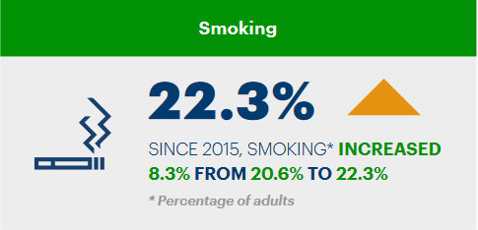

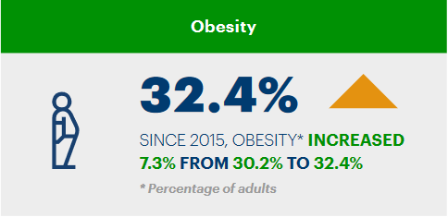
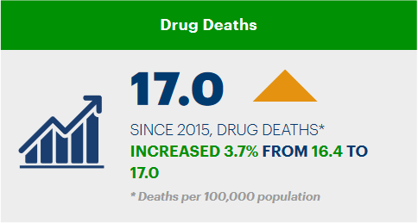
Missourians’ Health
According to America’s Health Rankings 2016 Annual Report:
In the past year
  excessive drinking increased 10% from 16.1% to 17.7% of Missouri adults.
  obesity increased 7% from 30.2% to 32.4% of Missouri adults.
  HPV immunization among Missouri males aged 13 to 17 years increased 122% from 11.3% to 25.1%.
In the past eight years
  preventable hospitalizations decreased 36% from 88.6 to 56.6 discharges per 1,000 Missouri Medicare enrollees.
In the past two years, diabetes increased 20% from 9.6% to 11.5% of Missouri adults.
Notes:
https://www.americashealthrankings.org/learn/reports/2016-annual-report/state-summaries-Missouri
RANKS- 46th in smoking; 40th in obesity; 36th in drug deaths

Slide 7
The Role of Aging
The number of people aged 65 and over in Missouri is projected to rise 41% over the next 15 years. Elders face higher health costs and are more likely to be on Medicaid, so this will drive up state spending on Medicaid.
Notes:
Source: https://www.seniorcare.com/directory/mo/ citing U.S. Census population projections.
Population Projections, United States, 2004 - 2030, by state, age and sex, on CDC WONDER Online Database,"
"September 2005. Accessed at http://wonder.cdc.gov/population-projections.html on Oct 11, 2017 2:11:04 PM"

Slide 8
Health Spending
National trends and figures
Indirect costs
Medicaid cost drivers
Taking all this in, can we find a balance between the ideas of access for everyone and a healthy state budget not dominated by health care costs?

Slide 9
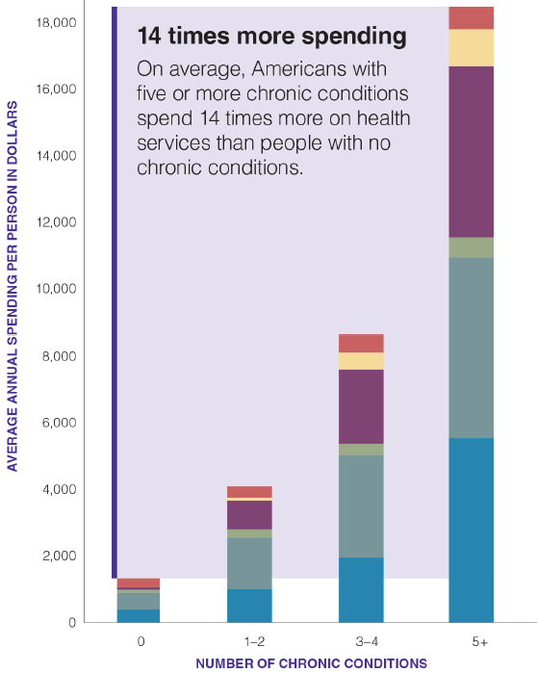
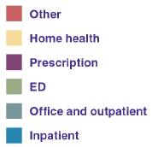
National Trends in US Health Spending
Note: Total health care spending is defined as the amount spent on health care services across all payers, including patient out-of-pocket payments.
Average utilization is presented; not everyone uses a particular service in a given year, especially inpatient stays and ED visits.
CDC: “86% of nation’s $2.7 trillion annual health care expenditures are for people with chronic and mental health conditions.”
Notes:
Spending/GDP source: World Bank
SOURCE: Multiple Chronic Conditions in the United States, Christine Buttorff et al., RAND Corporation, TL-221-PFCD, 2017 (available at www.rand.org/t/TL221).

Slide 10
Costs Due to Chronic Conditions
Chronic disease accounts for approximately 86% of nation's aggregate health care spending, an estimated $8,350 per person in U.S. each year (CDC)
Treatment of chronic disease captures an even larger of public spending:
  96 cents per dollar for Medicare
  83 cents per dollar for Medicaid.
Example: Healthcare costs for a person with diabetes are over $13,000/year; for a person without diabetes, $2,500.
  For every one point reduction in HbA1c (a measure of blood sugar over time), a 40% reduction in microvascular complications is reported (blindness, kidney disease, nerve damage) and up to $4,100 can be saved in annual healthcare costs.
Notes:
http://www.chronicdisease.org/?page=whyweneedph2imphc
updated with 2016 figures.

Slide 11
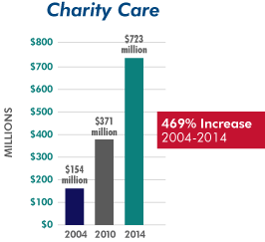
Indirect Costs: Uncompensated Care
Missouri Hospital Association reports a 469% increase in uncompensated care cost at its member hospitals over the past 10 years.
So even if we don’t cover those on Medicaid, demographically similar non-Medicaid eligible population may be adding to the trends we have seen.
Notes:
https://missourihealthmatters.com/resources/469-percent-increase-uncompensated-care-cost-missouri-hospitals-10-years/

Slide 12
Direct Costs to Missouri Medicaid
How much of the year-to-year change in Medicaid spending is attributable to what sources?
Using the data available to us, we can disentangle these sources of growth, attributing overall spending growth into growth attributable to:
  Enrollment growth
  Spending per enrollee
    Prices/inflation
    Utilization per enrollee

Slide 13
Unpacking Medicaid Spending Growth
What might account for the rise in “utilization”? Some possibilities:
  Enrollees are sicker/older and need more services
  Services are billed more intensively
    may be a provider response to low reimbursement rates
    may be due to lack of code options for less intensive services
  Unnecessary services are provided, through duplication, incomplete recordkeeping, etc.
  Other possibilities?
Let’s see how much of spending growth comes from enrollment growth vs. “utilization” growth, if we assume prices grow at the rate of inflation.
Missouri Medicaid Utilization Growth - Data Visualization

Slide 14
More on Medicaid Spending Trends
Spending Growth by Category Over Time
(This viz is very similar to the previous one but extends the timeline into the future, making projections based upon growth rate assumptions.)
Subcategory Spending Over Time
Each eligibility category consists of multiple programs. Spending is broken down for each here.
Spending Trends vs. General Revenue
This viz shows spending growth in each eligibility category over time as compared to the growth in Missouri’s General Revenue (GR) fund.

Slide 15


Transforming Healthcare in Missouri
Transforming Healthcare in Missouri event
Policy ideas

Slide 16



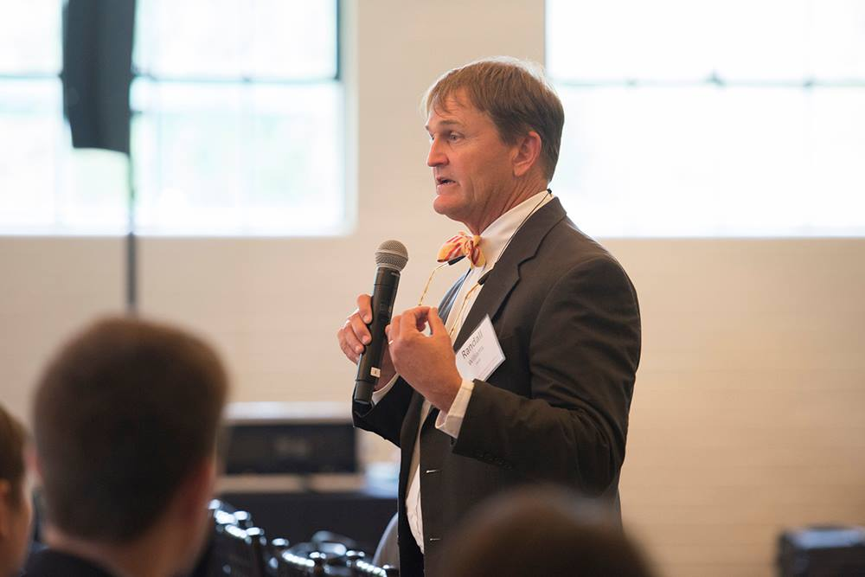
Transforming Healthcare in Missouri Event
“Transforming Healthcare in Missouri: Ideas, Innovations and Investments”
  October 13, 2017 in St. Louis
Sponsored by Washington University’s
  Center for Health Economics and Policy (CHEP), Institute for Public Health (IPH)
  Clark-Fox Institute for Public Policy, Brown School
Format:
  Keynote: Robert Hughes, Director, Missouri Foundation for Health
  State Policy overview:
    Timothy McBride, Professor, Brown School, CHEP Co-Director
  Panel Discussion
  Breakout groups on
    Mental health, Workforce, Opioids, Care coordination, Patient perspectives
Comments and reactions:
  Dr. Randall Williams, Director, Department of Health and Senior Services

Slide 17

Selected Policy Suggestions from the Event
SCOPE OF PRACTICE: Review current licensing procedures for increased marketing of nurse practitioners (NP), physician assistants (PA), midwives, and pharmacists in order for them to provide practical, safe, and effective solutions for Missouri's loss of qualified personnel.
PROVIDER LIST: Create and disseminate a list of providers that accept Medicare, Medicaid, telehealth, & crisis intervention.
PDMP: Implement a statewide PDMP for doctors and prescribers to view prior to and subsequent to prescription and distribution.
CHURN/MEDICAID NOTICES: Evaluate application and renewal process to prevent cycling in and out of Medicaid. Ensure that termination notices are sent with accurate and complete information.
THERAPY CODES: Reinstate coding in Medicaid that allows for reimbursement of physical therapy sessions post-orthopedic surgery.

Slide 18

Selected Policy Suggestions from the Event
Encourage medical schools to incentivize primary care practice.
Encourage and fund care in non-traditional settings (telehealth, schools, supermarkets, churches, mobile clinics) and by non-clinicians (community health workers, nutritionists, lactation consultants) to better target the population at large with preventive health services.
Create flexible payment options that can address social determinants of health (allow reimbursement for transportation for non-emergency healthcare, for food, housing, etc.) with attention to the social determinants occurring at the community level.
Integrate or co-locate mental health providers with primary care clinics.

Slide 19

Background Material
Website created with
  Document summarizing meeting [ https://publichealth.wustl.edu/news/transforming-healthcare-in-missouri-recap/ ]
  Policy briefs and data on
    Workforce
    Mental health
    Opioids
    Care Coordination
    Patient perspective

Slide 20
Questions?
Center Co-Director Tim McBride at
tmcbride@wustl.edu
For data questions related to this presentation,
contact Center Affiliate Abigail Barker at
arbarker@wustl.edu
Center Manager Leah Kemper at
Kemper@wustl.edu
https://publichealth.wustl.edu/centers/health-economics/
https://publichealth.wustl.edu/health-economics/interactive-data/

