Slide 1


MO HealthNet Oversight Committee Meeting
February 23, 2023

Slide 2
Agenda
February 23, 2023
1:00–1:15 | Welcome/Introductions/Minutes Approval of November meeting minutes | Dr. Nick Pfannenstiel, Chairman
1:15–1:40 | Director’s Update | Todd Richardson
1:40–2:10 | Family Support Division Update | Kim Evans, FSD Director
2:10–2:25 | Chief Operations Officer Update | Jessie Dresner
2:25–2:40 | Chief Transformation Officer Update | Kirk Mathews
2:40–2:55 | Chief Information Officer Update | Tisha McGowan
2:55–3:15 | Managed Care Update | Alex Daskalakis
3:15–3:30 | Budget Update | Tony Brite
3:30–3:45 | Legislative Update | Ryan Conway
3:45–4:00 | Public Comment
Next Meeting
May 25, 2023

Slide 3
Director’s UPDATE

Slide 4
FAMILY SUPPORT DIVISION UPDATE

Slide 5







Empower Missourians to live safe, healthy, and productive lives.
November 9, 2022

Slide 6
Update on FSD
Pending Medicaid applications
Adult Expansion Group (AEG) update. This information can be found at this link to the Caseload Counter https://dss.mo.gov/mis/clcounter/. This site is updated weekly on Monday mornings
Reports are attached to the slide deck
Multiple benefit application status
Centralized Mail implemented 1-18-2023
New Citizen Portal
New Appointment Scheduler
Resource Centers

Slide 7
Work with CMS – Mitigation Plan
Gateway
As of 12-31-2022 all individuals in the Gateway program have been reviewed and transitioned to other Medicaid categories

Slide 8
PHE Unwind
Effective 4-1-2023 states may begin the annual renewal process
Missouri will implement a 12 month process
Draft of transition plan was submitted to CMS on 2-14-2023
FSD launched a website that provides information on the transition plan , FAQs and communication toolkit. https://mydss.mo.gov/renew
Coordination with Managed Care Organizations
Insights Engine- electronic verification

Slide 9
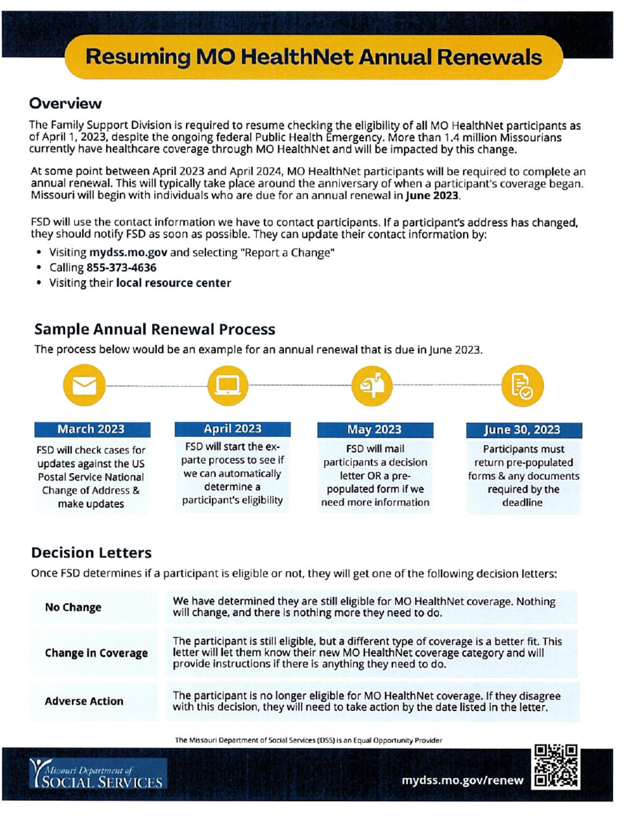

Slide 10
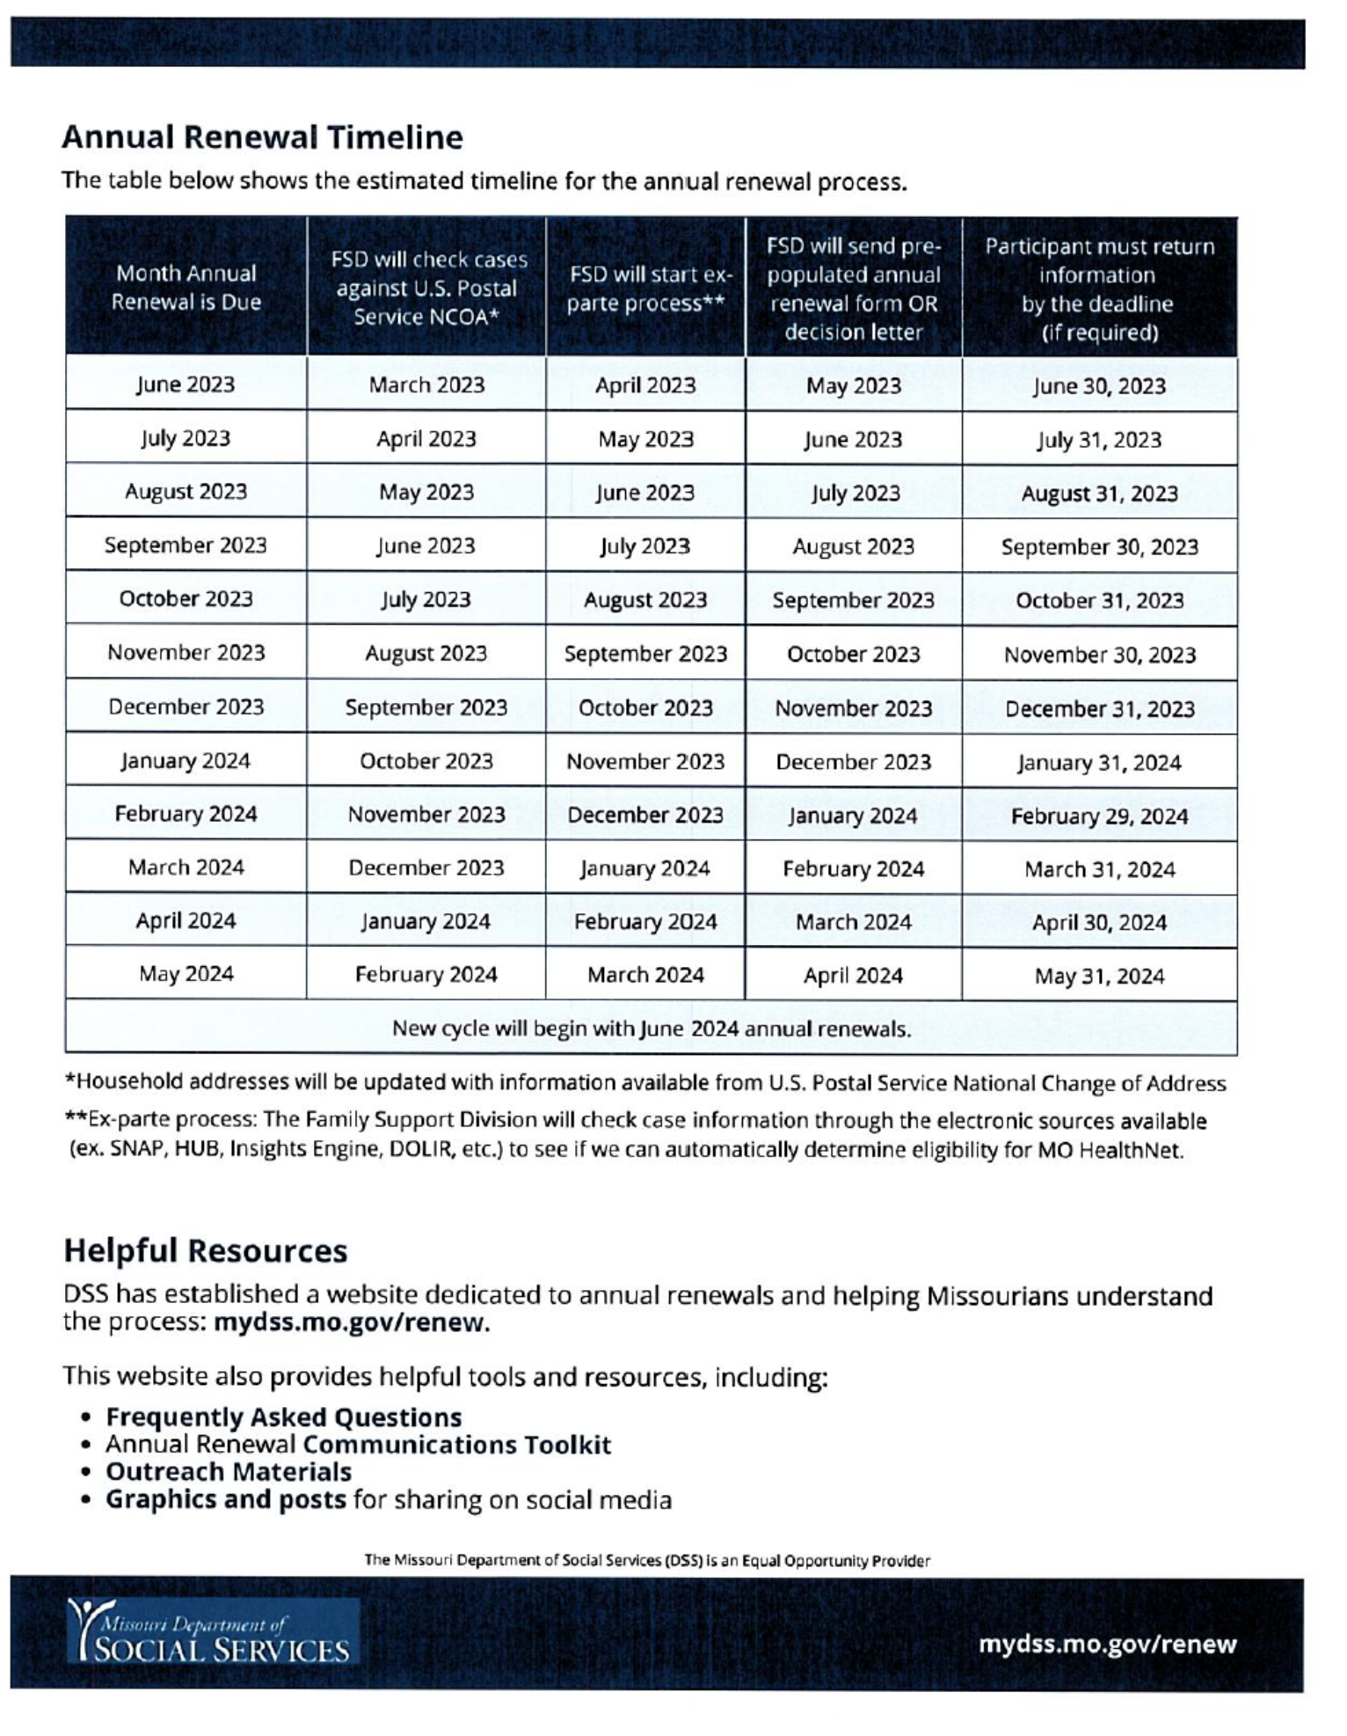
Work with CMS – Mitigation Plan
Gateway
As of 12-31-2022 all individuals in the Gateway program have been reviewed and transitioned to other Medicaid categories

Slide 11
Pended Medicaid Applications
85,000
80,000
75,000
70,000
65,000
60,000
55,000
50,000
45,000
40,000
35,000
30,000
Pre-MEDES Average Pend
25,000
20,000
15,000
10,000
5,000
0
Jan 18
Feb 18
Mar 18
Apr 18
May 18
Jun 18
Jul 18
Aug 18
Sep 18
Oct 18
Nov 18
Dec 18
Jan 19
Feb 19
Mar 19
Apr 19
May 19
Jun 19
Jul 19
Aug 19
Sep 19
Oct 19
Nov 19
Dec 19
Jan 20
Feb 20
Mar 20
Apr 20
May 20
Jun 20
Jul 20
Aug 20
Sep 20
Oct 20
Nov 20
Dec 20
Jan 21
Feb 21
Mar 21
Apr 21
May 21
Jun 21
Jul 21
Aug 21
Sep 21
Oct 21
Nov 21
Dec 21
Jan 22
Feb 22
Mar 22
Apr 22
May 22
Jun 22
Jul 22
Aug 22
Sep 22
Oct 22
Nov 22
Dec 22
Jan 23
Created by the FSD Operations Unit
MEDES Pend
FAMIS Pend

Slide 12
Medicaid Caseload
1,400,000
1,200,000
January 1st, 2014
MAGI Standards Take Eﬀect
MEDES Go Live
1,000,000
800,000
600,000
400,000
200,000
0
Jan 14
Mar 14
May 14
Jul 14
Sep 14
Nov 14
Jan 15
Mar 15
May 15
Jul 15
Sep 15
Nov 15
Jan 16
Mar 16
May 16
Jul 16
Sep 16
Nov 16
Jan 17
Mar 17
May 17
Jul 17
Sep 17
Nov 17
Jan 18
Mar 18
May 18
Jul 18
Sep 18
Nov 18
Jan 19
Mar 19
May 19
Jul 19
Sep 19
Nov 19
Jan 20
Mar 20
May 20
Jul 20
Sep 20
Nov 20
Jan 21
Mar 21
May 21
Jul 21
Sep 21
Nov 21
Jan 22
Mar 22
May 22
Jul 22
Sep 22
Nov 22
Pregnant Women
Children
Custodial Parents
Elderly
Persons with Disabilities
Created by the FSD Operations Unit

Slide 13
Charts Legend
DSS: MO Department of Social Services (i.e. General MAGI applications)
FAMIS: Family Assistance Information Management Systems
FFM: Federally Facilitated Marketplace
MAGI: Modiﬁed Adjusted Gross Income
MEDES: Missouri Eligibility Determination and Enrollment System
MHABD (ADM): MO HealthNet Eligibility for Persons Who are Aged (age 65 and over), Blind, or Disabled

Slide 14
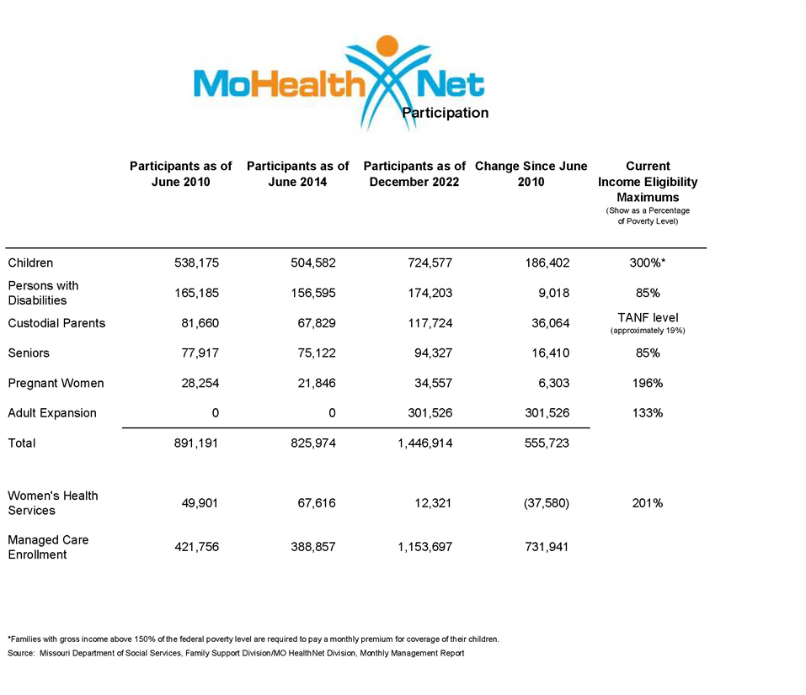

Slide 15
CHIEF OPERATIONS OFFICER UPDATE

Slide 16
CHIEF TRANSFORMATION OFFICER UPDATE

Slide 17
Chief information officer update

Slide 18
Managed care update

Slide 19
MO HealthNet
Education and Training
February 2023
Anna Wainscott

Slide 20
Changes to MHD Education & Training
JULY 2022
Changed name from Provider Education to Education and Training to encompass training for providers, participants, Managed Care health plans, MHD team members and other entities
Merged Education Specialists and Managed Care Specialists in to one group to unite and educate on all aspects of MO HealthNet
Named a Director of Education and Training to facilitate changes
Began improving and creating new online resources

Slide 21
Highlights
Vastly increased provider participation in webinars by sending targeted messages to specific program providers
Acquired new software (Articulate 360) to improve and modernize resources
Meeting monthly with MO Medicaid Audit and Compliance and Wipro to continue to create cohesive resources and improve the provider, participant and employee experience
Reaching out to providers and scheduling speaking arrangements at conferences, seminars and events

Slide 22
2023 Scheduled Presentations
Kansas City University, College of Dental Medicine
Joplin
January 19-20, 2023
Missouri Primary Care Association (MPCA)
Jefferson City
March 2023
Missouri Coalition for Oral Health
Jefferson City
March 2, 2023
Missouri Assisted Living Association
Branson
April 16-18, 2023
American Association of Healthcare Administrative Management (AAHAM)
Columbia
May 2023
MO Association of Osteopathic Physicians and Surgeons (MAOPS)
Branson
June 2-5, 2023

Slide 23
Coming Soon!
All-Inclusive MO HealthNet Provider Enrollment Guide – Step-by-step guide for all providers to navigate enrolling with MO HealthNet
eMMIS Guide – Internal guide to assist MHD team members with eMMIS, the Medicaid Information System’s capabilities, screens and features
Fee-For-Service Participant Handbook Update – Updating and re-energizing the Handbook
Member Forum Events – Kick-off and future events for our MO HealthNet participants to share opinions and speak to MHD; will include community partners, Managed Health Care Plans and more

Slide 24
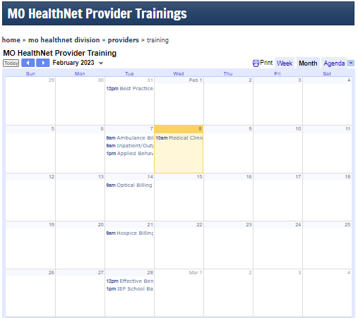
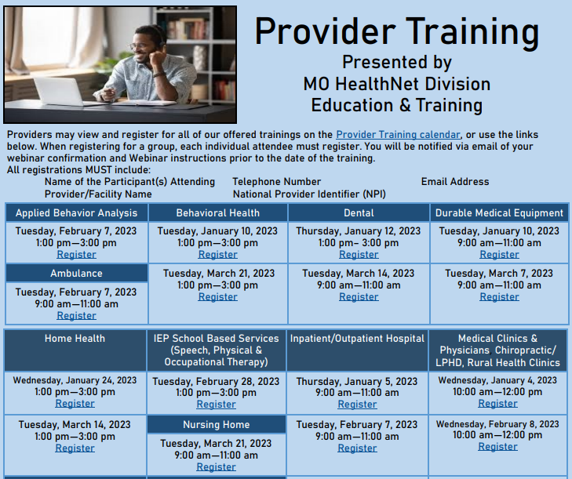
New Provider Resources
Provider Training Google Calendar
Provider Training Calendar Posting

Slide 25




New Provider Resources
Provider e-Learning Courses
Team Member e-Learning Courses

Slide 26


New Provider Resources
General Provider Resource Overviews
Training Collaborations

Slide 27
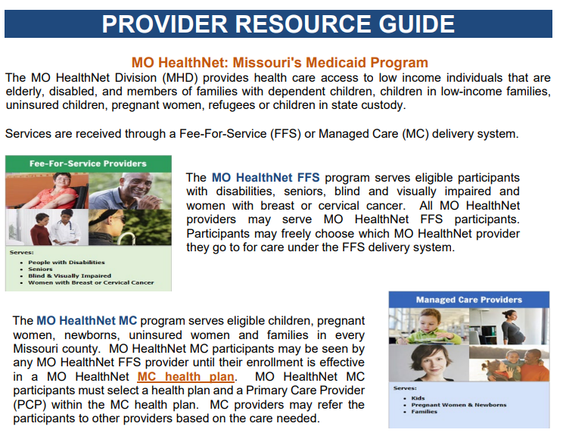
New Provider Resources
All Inclusive Provider Guides
Additional Resources
Provider Manual by Section
Third Party Liability Information for Providers
Covered Services
Provider Bulletin Index
MO Dental Association Medicaid Information Series
Good Cause Waiver
Out-of-State Non-Bordering Services

Slide 28
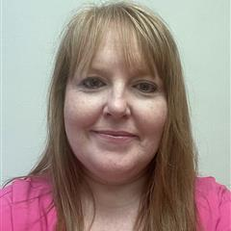
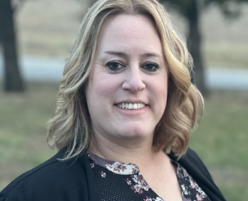
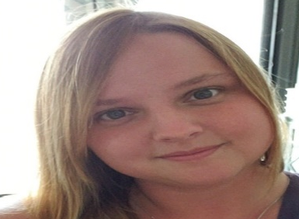
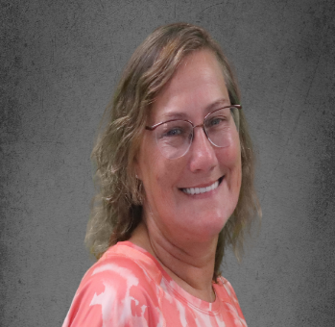
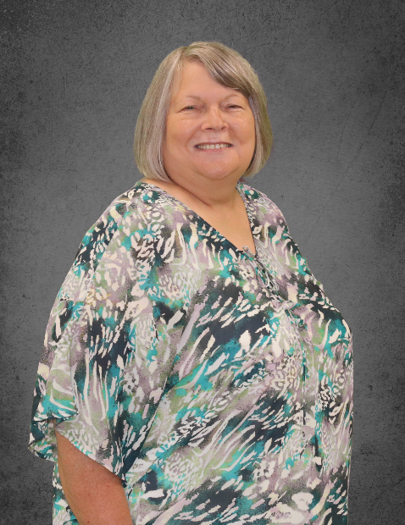
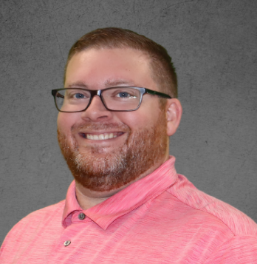
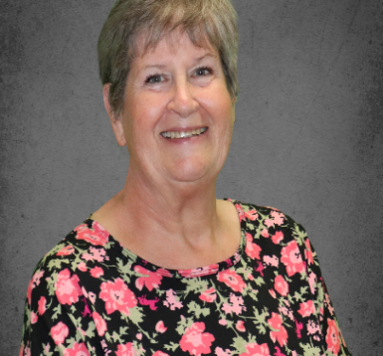
The Team
Anna Wainscott
Director of Education and Training
Amanda Fahrendorf
Lead Education Specialist
Lee Gerloff
Education Specialist
Jackie Bollinger
Education Specialist
Julie Pace
Managed Care Specialist
Daniel Rush
Education Specialist
Kathy Simmons
Managed Care Specialist

Slide 29
MHD Education and Training
MO HealthNet Education and Training educates provides on navigating provider resources, verifying eligibility, MO HealthNet policy and filing Fee-For-Service claims through eMOMED.
Visit our Provider Training Calendar to sign up for upcoming trainings specific to your program.
Visit our MHD Education and Training Resources for information available to you on all of our resources, 24/7.
MHD.Education@dss.mo.gov
573-751-6683

Slide 30
MO HealthNet Budget Request
State Fiscal Year (SFY) 2024
February 23, 2023

Slide 31
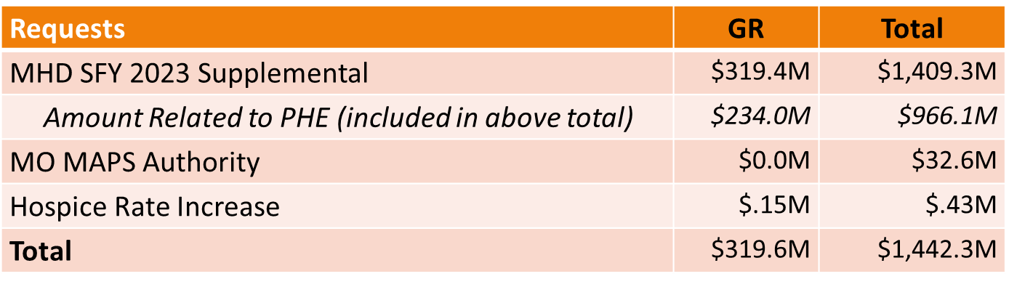
MO HealthNet (MHD) Supplemental Requests
State Fiscal Year (SFY) 2023
Source: https://oa.mo.gov/budget-planning

Slide 32
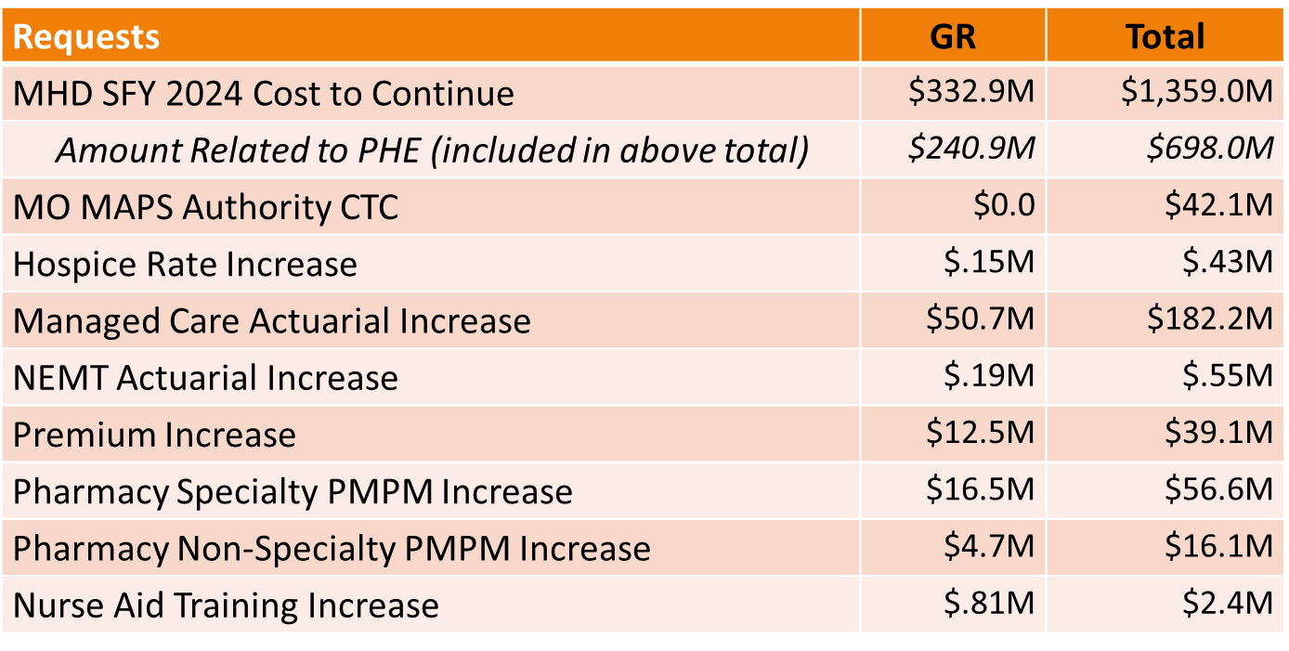
MO HealthNet (MHD) NDI Requests
State Fiscal Year (SFY) 2024
Source: https://oa.mo.gov/budget-planning

Slide 33
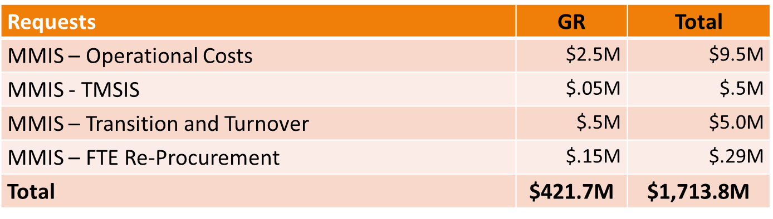
MO HealthNet (MHD) NDI Requests
State Fiscal Year (SFY) 2024
Source: https://oa.mo.gov/budget-planning

Slide 34
legislative update

Slide 35
Public comment

Slide 36
Next meeting
May 25, 2023

