Slide 1


MO HealthNet Oversight Committee Meeting
August 9, 2023

Slide 2
Agenda
August 9, 2023
1:00–1:15 | Welcome/Introductions/Minutes Approval of February meeting minutes | Dr. Nick Pfannenstiel, Chairman
1:15–1:45 | Director’s Update | Todd Richardson
1:45–2:00 | Chief Operations Officer Update | Jessie Dresner
2:00–2:45 | Family Support Division Update | Kim Evans, FSD Director
2:45–3:00 | Chief Transformation Officer Update | Kirk Mathews
3:00–3:15 | Managed Care Update | Alex Daskalakis
3:15–3:30 | Pharmacy Clinical Update | Josh Moore
3:30–3:45 | Legislative Update | Ryan Conway
3:45–4:00 | Public Comment
Next Meeting
November 7, 2023

Slide 3
Director’s Update
Todd Richardson

Slide 4
Overview of Program of All-Inclusive Care (PACE) Rate Development
AWOP -Defined as the amount that would otherwise have been paid (AWOP) under the State plan if participants had not been enrolled in the PACE program (42 CFR 2460.182)
The State and its Actuary utilize Medicaid experience within the PACE defined regions to develop the amount of the AWOP
The AWOP is developed as a monthly capitated per member per month payment.
Two AWOPs for each of the three anticipated PACE regions, one for Dual members and one for Non-Dual members
Final rates are based on a discount off the AWOP rate, currently the discount is 5%.
The AWOP is updated annually and approved by CMS on a calendar year.

Slide 5
Future Value Based Components for PACE
In State Fiscal Year (SFY) 2024, PACE organizations (POs) will begin to monitor baseline quality measures which will be utilized to incorporate a value based payment approach in PACE.
In Calendar Year 2025, the State anticipates implementing the value based quality measures for POs exceeding 36 months of operation in the form of a percentage return of the discount applied to the AWOP PMPM.
Potential quality measures will include two phases:
  Phase One: Voluntary disenrollment's (%), ER visits, number of falls resulting in hospitalization or death, flu immunizations (%), and pneumococcal immunizations (%)
  Phase Two: A1C test recipients (%), acute inpatient days, days sent in a nursing facility over 89 days, days spent in a nursing facility less than 90 days, number of prescription drugs filled (monthly)

Slide 6
FY24

Slide 7

Chief Operating Officer Update
Jessie Dresner

Slide 8
Update: Medically Complex Children’s
Health Home
Ace Kids Act:
Public Law No. 116-16 signed in 2018
State option to begin as of 2022
Voluntary for children and families
Eligible children
Qualifying providers
States must develop plans to educate providers and families

Slide 9
Update: Medically Complex Children’s
Health Home
MHD:
Hired a dedicated full-time employee
Has been in contact with CMS
Has established a time-line
Is beginning stakeholder outreach

Slide 10
Update: 12-month Post-Partum Coverage
MHD will submit to CMS by September 7:
Eligibility State Plan Amendment (SPA)
CHIP SPA
F-MAP SPA addendum

Slide 11
Update: Education and Training
MO HealthNet provider manuals
Maternal Health efforts
Provider forms
All-inclusive Provider Enrollment Guide

Slide 12
Family Support Division Update
Kim Evans

Slide 13







Empower Missourians to live safe, healthy, and productive lives.
August 9, 2023

Slide 14
FSD Charts

Slide 15
FSD Charts

Slide 16
FSD Charts

Slide 17
Update on Technology Projects
Centralized Mail – Implemented
New Citizen Portal
Appointment Scheduler
Insights Engine (Electronic Data Services)
Document Recognition

Slide 18
PHE Unwind
April 1, 2023, Missouri started the unwind process
Currently FSD is in the process of mailing annual renewals forms for reviews due in September and processing annual renewals for August
Information on the unwind process https://mydss.mo.gov/renew
New Annual Renewal Monthly Metrics published at https://dss.mo.gov/mis/clcounter/

Slide 19
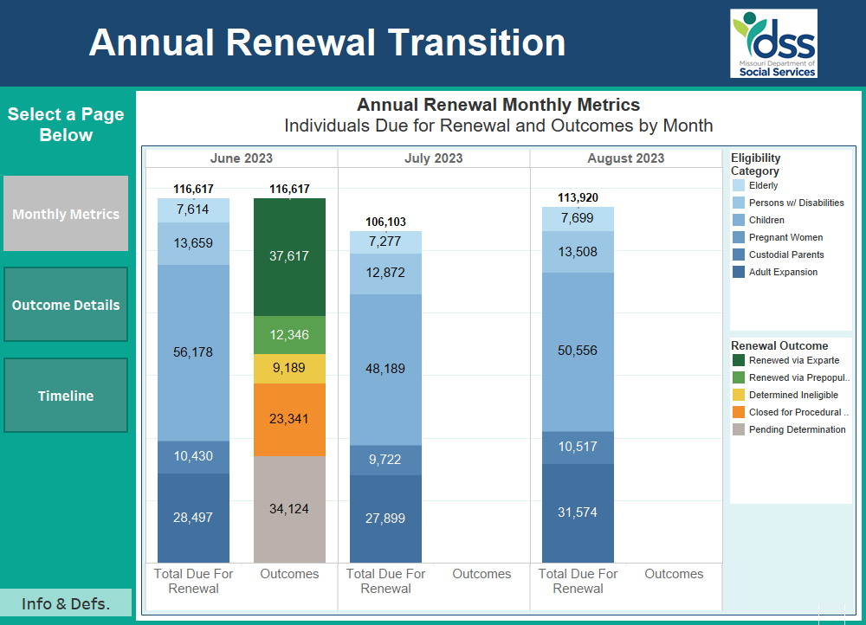

Slide 20
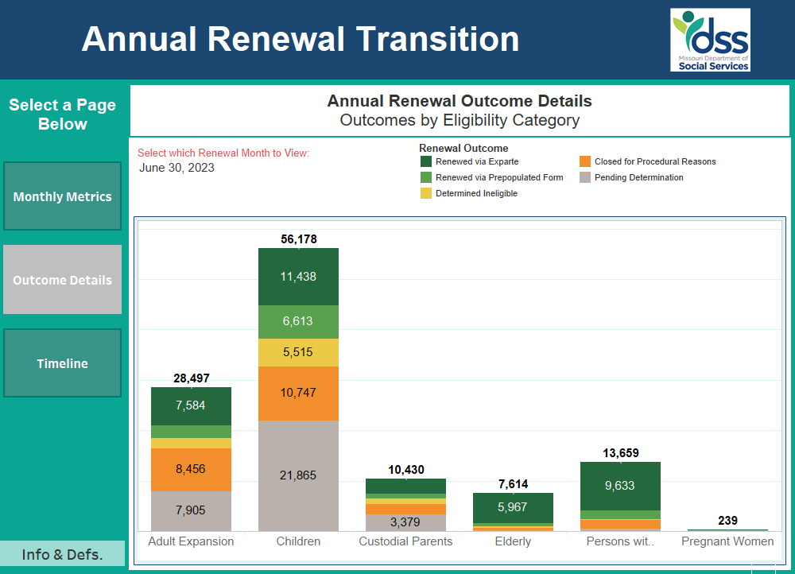
PHE Unwind

Slide 21
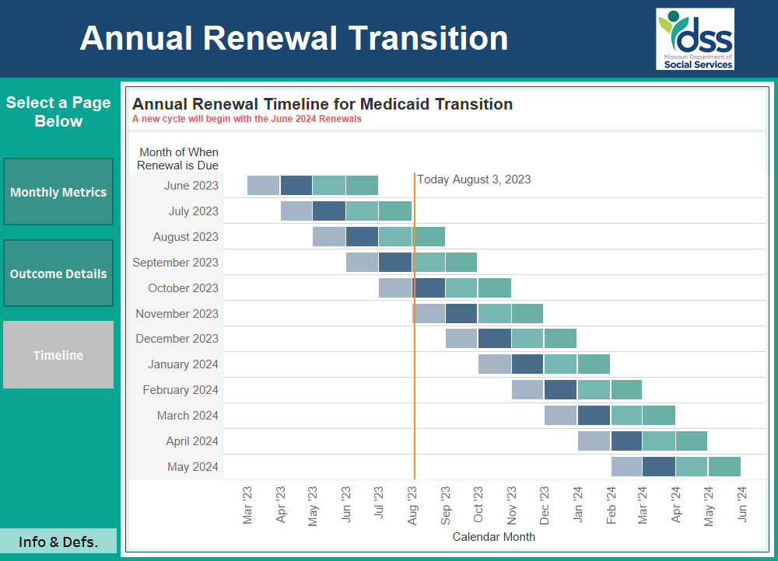
PHE Unwind

Slide 22
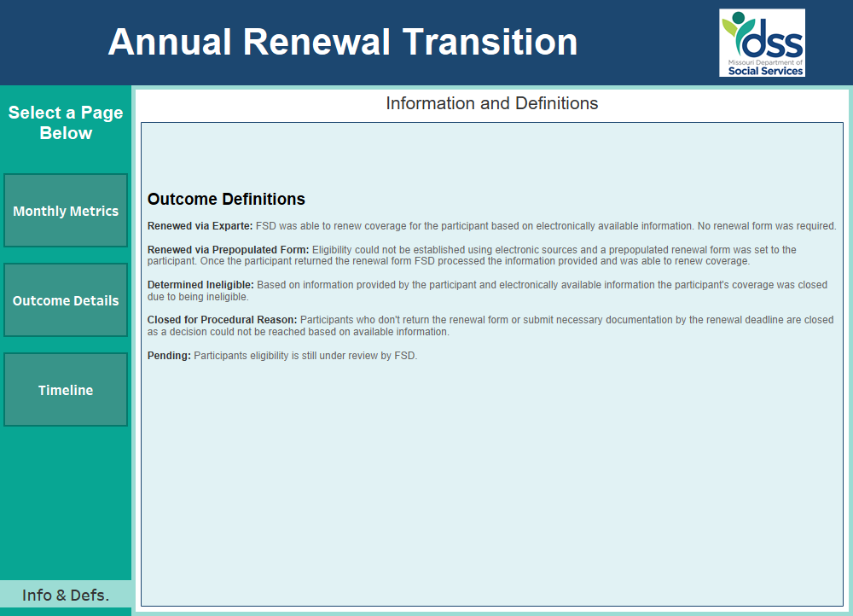
PHE Unwind

Slide 23
Transformation Office Update
Kirk Mathews
Overview of ToRCH Pilot Program
2. Brief update on Hospital Reimbursement Transformation

Slide 24

Three Primary Goals
Improve Population Health in Rural counties by addressing “upstream” causes of poor health related to social factors (such as no transportation, poor nutrition, etc.) These improvements will, over time…
Reduce the cost of care when better population health results in fewer hospital admissions and avoidable ER visits. The resulting savings will then be shared with the hospital in order to…
Help make rural hospitals more viable and sustainable

Slide 25
Basic Construct of the Program
To qualify, hospital must be sole hospital provider in its home county
Selected hospitals will serve as a health hub, establish a leadership board and develop a Community Care Management program that coordinates social care for Medicaid participants in their county in conjunction with community based partners
The leadership board will identify its top Population Health priorities along with the Community Based Organizations best suited to assist in improving Population Health outcomes
MHD will “baseline” Medicaid spending in each selected county (regardless of WHERE those services are delivered), provide funds to each hub with which the leadership board can make investments in CBO’s, pay for SDOH screenings and pay for selected SDOH services delivered to MHD participants
Model is dependent on engaging a closed-loop referral platform to make SDOH referrals, track outcomes, authorize billing, etc.
Ongoing Medicaid spending will be monitored and savings shared back to the hub hospital

Slide 26
$15 Million NDI recommended by Governor Parson and approved by the legislature
First “Cohort” target is six rural hospitals with plans to add future cohorts of six more hospitals every two years.
CMS regulatory path is “underway”
Closed-loop SDOH referral platform vendor has been engaged
Initial Cohort sites have been selected

Slide 27
Initial Cohort Sites
Citizens Memorial Hospital, Bolivar, MO
Bothwell Regional Health Center, Sedalia, MO
Golden Valley Memorial Healthcare, Clinton, MO
Phelps Health, Rolla, MO
Salem Memorial District Hospital, Salem, MO
Ray County Memorial Hospital, Richmond, MO

Slide 28
$15 Million NDI recommended by Governor Parson and approved by the legislature
First “Cohort” target is six rural hospitals with plans to add future cohorts of six more hospitals every two years.
CMS regulatory path is “underway”
Closed-loop SDOH referral platform vendor has been engaged
Initial Cohort sites have been selected

Slide 29
Managed care update
Alex Daskalakis

Slide 30
Pharmacy Clinical Update
Josh Moore

Slide 31
General Update
MHD continues to respond to drug shortages.
Flexibilities include changes to preferred drug lists, removing certain quantity limits, and paying for the brand name as needed
Some of the shortages are due to increased demand, decreased supply, and manufacturing issues
Providers should reach out to MHD.PharmacyAdmin@dss.mo.gov if there is a shortage on an outpatient drug. MHD will review the information and may make changes as needed.
High investment cell and gene therapy approvals are accelerating
The FDA approved 9 cell and gene therapies in the last 12 months
List prices: $2 to $4 million range per participant for one time treatments
Requests are currently low but starting to increase

Slide 32
Substance Use Disorder Treatments
MHD has open access for Medication-Assisted Therapy (MAT)
MO HealthNet continues to encourage the use of MAT with no prior authorization required for preferred opioid use disorder medications.
MO HealthNet does not require ongoing counseling to receive MAT for opioid use disorder
MO HealthNet does not have a limit to the duration of MAT or number of attempts
The data contained within is for MO HealthNet participants only, it does not include commercially insured prescriptions (unless MO HealthNet is secondary) or self-pay prescriptions
The paid amount included within is the amount paid to the MO HealthNet provider and does not include any rebates from pharmaceutical manufacturers.

Slide 33
Reimbursed Amount for Select Substance Use Disorder Treatments
SFY | Participant Count | Total Paid Amount
2019 | 6,724 | $16,782,692.42
2020 | 7,006 | $18,546,196.75
2021 | 8,025 | $21,294,980.94
2022 | 10,757 | $24,082,333.40
2023 | 17,227 | $37,766,698.30
Chart includes unique participants who received at least one claim for one of the following products (or generic) during the state fiscal year (SFY):
  Suboxone (buprenorphine/naloxone sublingual tablets and films)
  Subutex (buprenorphine sublingual tablets)
  Sublocade (buprenorphine long acting injectable)
  Vivitrol (naltrexone long acting injectable)
Data Accessed on 6/21/2023
All data is based on paid MO HealthNet claims through 6/7/2023

Slide 34
Substance Use Disorder Treatments
Specialized treatment and rehabilitation services for substance use disorders (SUD) are provided through Comprehensive Substance Treatment and Rehabilitation (CSTAR) programs. The state match for these services is in the Department of Mental Health budget.
MO HealthNet covered services for SUD in addition to those provided through CSTAR programs include all of the following:
Detoxification services provided in hospitals
Screening, brief intervention, and referral to treatment provided by primary care health homes
Diagnostic assessment and individual, family, or group counseling/psychotherapy provided by licensed behavioral health professionals (i.e., psychologists, social workers, professional counselors, marital & family therapists)
Physician/psychiatrist and advanced practice nurse services to assess/diagnose SUD and prescribe and manage medications – office based MAT
Managed care members also receive care coordination and care management services for SUD

Slide 35
Reimbursed Amount for Opioid Rescue Agents
SFY | Participant Count | Total Paid Amount
2019 | 4,385 | $554,465.00
2020 | 4,105 | $542,561.80
2021 | 9,049 | $1,471,902.51
2022 | 15,328 | $2,198,417.28
2023 | 23,436 | $3,384,061.66
In April 2021 MO HealthNet implemented a policy to require participants on an opioid and another agent that places the participant at higher risk of overdose to receive a naloxone rescue agent in the past 2 years to be able to continue to receive the opioid and/or the other high risk agent
Chart includes unique participants who received at least one claim for one opioid rescue agent during the state fiscal year (SFY)
Data Accessed on 6/21/2023
All data is based on paid MO HealthNet claims through 6/7/2023

Slide 36
Reimbursed Amount for Dispose Rx Packets
SFY | Participant Count | Total Paid Amount
2022 | 1,944 | $48,162.18
2023 | 5,558 | $165,935.13
In January 2022 MO HealthNet, Department of Health & Senior Services, and the MO Board of Pharmacy partnered to give access to Dispose Rx packets so that participants could safely dispose of medication at home
Chart includes unique participants who received at least one claim for one Dispose Rx packet during the state fiscal year (SFY)
Data Accessed on 6/21/2023
All data is based on paid MO HealthNet claims through 6/7/2023

Slide 37
Alternatives to Opioids
MO HealthNet increased coverage of non-opioid medications by removing prior authorization requirements from several medications including:
  Lidocaine patches (generic Lidoderm®)
  Diclofenac gel (generic Voltaren Gel®)
  Celecoxib (generic Celebrex®)
The following slides depict the increase in utilization of non-opioid medications after prior authorization requirements were removed
MO HealthNet offers coverage of chiropractic therapy, acupuncture, physical therapy, and cognitive-behavioral therapy for chronic pain.
  https://dss.mo.gov/mhd/providers/pdf/bulletin41-55.pdf

Slide 38
Reimbursed Amount for lidocaine patches
SFY | Participant Count | Total Paid Amount
2019 | 1,138 | $805,738.99
2020 | 940 | $419,778.09
2021 | 1,241 | $233,525.65
2022 | 6,614 | $579,646.18
2023 | 13,725 | $1,349,832.23
MO HealthNet previously required a specific prior authorization for lidocaine patches.
Lidocaine is a non-opioid local anesthetic used to relieve pain.
Chart includes unique participants who received at least one claim for lidocaine patches during the state fiscal year (SFY)
Data Accessed on 6/21/2023
All data is based on paid MO HealthNet claims through 6/7/2023

Slide 39
Reimbursed Amount for celecoxib
SFY | Participant Count | Total Paid Amount
2019 | 3,711 | $698,855.12
2020 | 4,081 | $559,288.25
2021 | 5,416 | $600,094.59
2022 | 7,093 | $518,775.77
2023 | 10,630 | $670,048.71
MO HealthNet previously required a specific prior authorization for celecoxib capsules (Celebrex).
Celecoxib is a non-opioid non-steroidal anti-inflammatory oral medication used to reduce pain and inflammation.
Chart includes unique participants who received at least one claim for celecoxib during the state fiscal year (SFY)
Data Accessed on 6/21/2023
All data is based on paid MO HealthNet claims through 6/7/2023

Slide 40
Reimbursed Amount for diclofenac gel
SFY | Participant Count | Total Paid Amount
2019 | 1,467 | $267,699.89
2020 | 3,128 | $411,924.63
2021 | 6,097 | $626,670.00
2022 | 6,642 | $502,343.19
2023 | 11,451 | $760,615.22
MO HealthNet previously required a specific prior authorization for lidocaine patches.
Diclofenac gel is a non-opioid local non-steroidal anti-inflammatory drug (NSAID) used to relieve pain and reduce local inflammation.
Chart includes unique participants who received at least one claim for diclofenac gel during the state fiscal year (SFY)
Data Accessed on 6/21/2023
All data is based on paid MO HealthNet claims through 6/7/2023

Slide 41
Current Opioid Policies
MO HealthNet established the daily morphine milligram equivalent (MME) limits based on the elevated risk of overdose at certain doses:
  50+ MME per day: risk of overdose is 2 to 5 times the risk at 0 – 19 MME per day
  100+ MME per day: risk of overdose is up to 9 times the risk at 0 – 19 MME per day
Limit of no more than 7 days on initial prescriptions for opioids
Prior authorization requirement for opioid regimens over 50 morphine milligram equivalents per day
Prior authorization requirement and in-depth clinical review of opioid regimens over 90 MME per day
  Subsequent prior authorization requirements for any additional increases over 90 MME per day (i.e. an increase from 95 to 130 MME per day requires prior authorization.)
  No review is required when opioid regimens decrease daily MME (i.e. a decrease from 130 MME to 95 MME per day)
In-depth clinical review prior to approval of any participants newly starting methadone
https://www.cdc.gov/opioids/providers/prescribing/faq.html

Slide 42
Number of Participants by Daily MME Level per Month
(Participants over 50 MME per day only)
Data Accessed on 6/6/2023
All data is based on paid MO HealthNet claims through 5/26/2023

Slide 43
Additional Links for More Information
https://dss.mo.gov/mhd/cs/pharmacy/pdf/mhd-opioid-policy-update.pdf
https://dss.mo.gov/mhd/cs/pharmacy/pdf/select-oral-benzodiazepines-clinical-edit.pdf
https://dss.mo.gov/mhd/cs/pharmacy/pdf/opioid-select-alcohol-dependence-agents.pdf
https://dss.mo.gov/mhd/cs/pharmacy/pdf/high-risk-therapies-clinical.pdf
https://www.disposerx.com/

Slide 44
legislative update
Ryan Conway

Slide 45
Public comment

Slide 46
Next meeting
November 7, 2023

