Slide 1


MO HealthNet Oversight Committee Meeting May 25, 2023

Slide 2
Agenda May 25, 2023
1:00–1:15 | Welcome/Introductions/Minutes Approval of February meeting minutes | Dr. Nick Pfannenstiel, Chairman
1:15–1:30 | Director’s Update | Jessie Dresner
1:30–1:45 | Chief Operations Officer Update | Jessie Dresner
1:45–2:30 | Family Support Division Update | Kim Evans, FSD Director
2:30–2:45 | Chief Transformation Officer Update | Justin Clutter
2:45–3:00 | Managed Care Update | Alex Daskalakis
3:00–3:15 | Budget Update | Tony Brite
3:15–3:30 | Legislative Update | Ryan Conway
3:30–3:45 | Public Comment
Next Meeting
August 9, 2023

Slide 3
Director/deputy director Update
jessie dresner

Slide 4
Director/Deputy Director Update
12-month post-partum State Plan Opportunity update
Other legislation
Health Home for Medically Complex Children
Building update
MHD CIO
Maternal Health efforts status update
Dashboard

Slide 5
FAMILY SUPPORT DIVISION UPDATE

Slide 6







Empower Missourians to live safe, healthy, and productive lives.
May 25th, 2023

Slide 8
FSD Charts

Slide 9
Update on Technology Projects
Technology Centralized Mail
New Citizen Portal
Appointment Scheduler
Insights Engine (Electronic Data Services)
Document Recognition

Slide 10
PHE Unwind
April 1, 2023, Missouri started the exparte process for individuals with an annual renewal date of June
5-6-2023 pre-populated MAGI and annual renewal forms for Non-MAGI were mailed to individuals.
Annual renewals will be completed as they are returned
Adverse Actions will be sent 10 days before the end of June to individuals who have not returned the annual renewal form or requested information
Individuals will close in the batch process on Friday June 30th if the annual renewal form or requested information has not been returned
Individuals closing for failure to return the annual renewal form or requested information will have 90 days to return the form for consideration without having to re-apply. After 90 days a new application is required

Slide 11
CHIEF TRANSFORMATION OFFICER UPDATE

Slide 12
Transformation of Rural Community Health (ToRCH) a pilot project under development pending CMS approval

Slide 13
ToRCH
New Decision Item was approved for the SFY 2024 budget
14 rural hospitals submitted a Letter of Intent (11 remain interested)
All have received 1-on-1 technical assistance from MO HealthNet
Community Information Exchange – procurement pending
Applications due May 31

Slide 14
NICU Payment Restructure

Slide 15

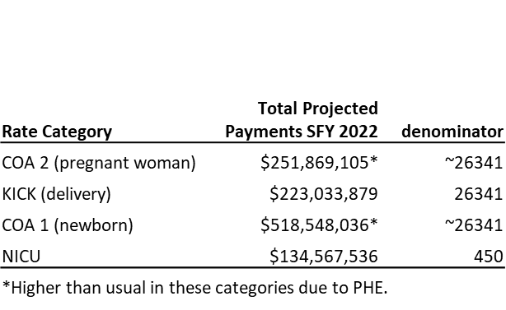
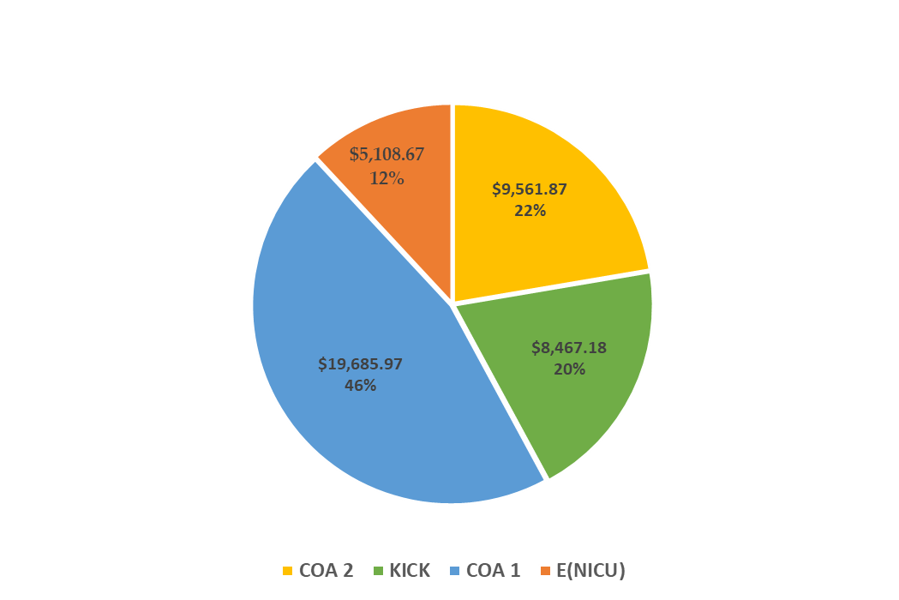

NICU payments increased in May 2017 (statewide managed care)
$187K (Pre 2017) to $300K per NICU
Notes:
We have found no other state paying NICU in this manner
Collapse back into the COA 2 rate allows financial ability to address upstream causes of poor outcomes
This is a prime example of how MO HealthNet is approaching our initiatives to improve M/I outcomes.

Slide 16
Managed care update

Slide 17


MO HealthNet Budget Request State Fiscal Year (SFY) 2024 May 25, 2023

Slide 18
MO HealthNet (MHD) Supplemental
Truly Agreed and Finally Passed (TAFP)
State Fiscal Year (SFY) 2023
Comparison to Governor’s Recommended Budget
MHD Supplemental reduced by $48.5 million state share funds related to more current projections.
MO MAPS increased authority fully funded.

Slide 19
MO HealthNet (MHD) Budget
Truly Agreed and Finally Passed (TAFP)
State Fiscal Year (SFY) 2024
Comparison to Governor’s Recommended Budget
MHD Cost to Continue reduced by $81.2 million state share funds equivalent to 75% of the CTC after adjustments related to more current projections.
Pharmacy Specialty PMPM reduction of $3.2M GR
MMIS Provider Enrollment System reduction of $7M total ($1.75M GR)
All other Governor’s Recommended items fully funded.

Slide 20
MO HealthNet (MHD) Budget
Truly Agreed and Finally Passed (TAFP)
State Fiscal Year (SFY) 2024
New Items added by the General Assembly:
FQHC Women & Minority Health Increase $3M total ($1.5M GR)
QRTP rates increase added an additional $11M total ($6.5M GR)
Nursing Facility Rate increase of $86.2M total ($26.5M GR)
Hospice Rate increase of $6.4M total ($2.2M GR)
FQHC Substance Abuse Prevention Network for $4.5M total ($2M GR)
Inpatient Psych Facility payments of $25M total ($8M GR)
Non-Medicaid related infrastructure payments for 10 healthcare facilities totaling $21.4M GR

Slide 21
legislative update

Slide 22
Public comment

Slide 23
Next meeting August 9, 2023

