Slide 1
Private Duty Nursing 2021

Slide 2
Private Duty Nursing Overview

Slide 3
Private Duty Nursing
Private Duty Nursing (PDN) is the provision of individual and continuous care provided under the direction of the participant’s physician.
Services within the MO HealthNet PDN Program include shift care by a registered nurse (RN) or licensed practical nurse (LPN).
Source: Section 13.1.A in Private Duty Nursing Provider Manual

Slide 4
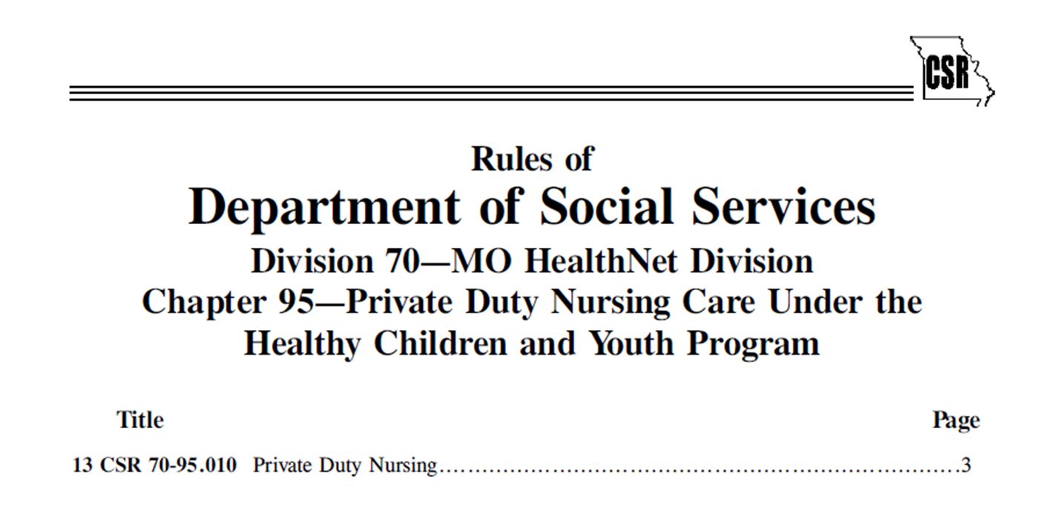
Private Duty Nursing
Source: www.sos.mo.gov/cmsimages/adrules/csr/current/13csr/13c70-95.pdf

Slide 5
Participant Eligibility

Slide 6
Participant Eligibility
To meet PDN eligibility requirements, a participant must:
Be under the age of 21.
Be MO HealthNet eligible on date of service.
Source: Section 13.1.A in Private Duty Nursing Provider Manual

Slide 7
Primary Caregiver Information

Slide 8
Primary Caregiver Responsibilities
PDN services are not a substitution for the responsibilities of primary caregivers.
PDN services do not include custodial, child care, respite or transportation services.

Slide 9
Primary Caregiver Responsibilities
Primary caregivers must appoint a designated individual to provide direct care and make medical care decisions in the extended absence of the parent(s) or responsible party(ies).
The designated individual shall not be an employee of the provider agency nor a Bureau of Special Health Care Needs (BSHCN) employee.

Slide 10
Provider Services Information

Slide 11
Place of Service
PDN services can be administered:
Inside the home.
Outside the home for normal life activities, including daycare.
A nurse may accompany, but cannot drive or provide transportation for the participant.

Slide 12
Plan of Care (POC)
Plan of Care (POC) refers to the medical treatment plan established by the treating physician with the assistance of the home health care nurse or medical home health professional.
Providers can use the CMS-485, CMS-486 and CMS-487 submission forms to document the POC.
A provider developed form is also acceptable but must include all of the elements of the CMS forms above.

Slide 13
Prior Authorization Information

Slide 14
Prior Authorization
All fee-for-service PDN services must be authorized by the BSHCN nursing staff before services are initiated.
For participants enrolled in a MO HealthNet Managed Care Plan contact the specific plan for prior authorization guidance.
Source: Sections 13.10 & 14.1 in Private Duty Nursing Provider Manual

Slide 15
Prior Authorization
It is the policy of MO HealthNet and the BSHCN that 64 units (16 hours) per day is the maximum amount of PDN services that may be authorized.
The BSHCN nursing staff complete the prior authorization (PA) request form for PDN services based on their assessment of the participant.
The frequency, amount, and duration of services are based on the information obtained during the assessment of the participant.
The BSHCN staff will only prior authorize services where there is a need for at least a 4 hour shift of PDN care per day.
Source: Sections 13.10 & 14.1 PDN Provider Manual

Slide 16
Prior Authorization
Exceptions to the 64 unit per day policy can be made:
On a short term basis, not to exceed 21 consecutive days; or
With the notification of the BSHCN Regional Office Coordinator; and
Approval of the HCY Program Manager when there is documentation to support this need.
The BSHCN only prior authorizes services that:
Provide the needed care to stabilize/maintain the participant’s condition.
Educate the parent(s)/responsible party(ies) about the medically necessary care of the participant.
Source: Sections 13.10 & 14.1 PDN Provider Manual

Slide 17
Prior Authorization Process
To obtain a PA for PDN services, the provider must:
Discuss the requested services with BSHCN staff.
Obtain the signed plan of care (practitioner signed/dated or verbal orders).
Send the signed plan of care to the BSHCN.
The BSHCN sends the PA to WIPRO. The provider will receive a letter of PA determination by mail. BSHCN may authorize services for up to 6 months at a time but the POC/485 must be updated at least every 60 days.
Source: Sections 13.10 & 14.1 PDN Provider Manual

Slide 18
Provider Participation

Slide 19
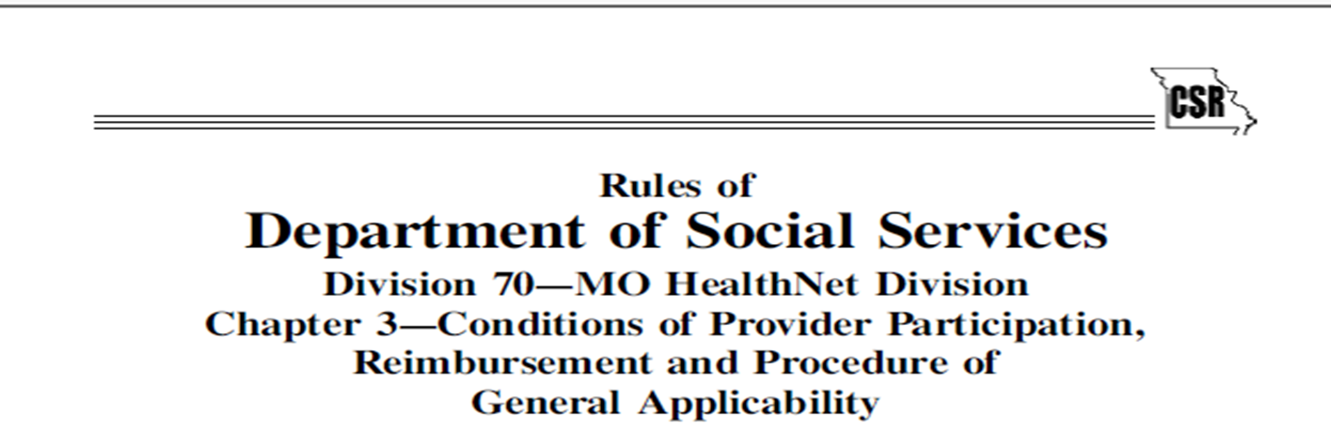
Provider Participation
Source: www.sos.mo.gov/cmsimages/adrules/csr/previous/13csr/13csr1110/13c70-3.pdf

Slide 20
Provider Participation
To offer PDN services, a provider must:
Be a Medicare certified and MO HealthNet Program enrolled home health agency provider; or
Be accredited by the Joint Commission for Accreditation of Health Organization (JCAHO) or the Community Health Accreditation Program (CHAPS); or
Submit a Private Duty Nursing (PDN) Provider Agreement Addendum to MMAC/Provider Enrollment. This addendum is required only if one of the above criteria is NOT met.
http://mmac.mo.gov/providers/providerenrollment/new-providers/provider-enrollment-forms/

Slide 21
Provider Participation
To offer PDN services, a provider must:
Notify Missouri Medicaid Audit and Compliance (MMAC) of changes in address, phone number, or ownership.
Maintain bonding, personal and property liability insurance.
Maintain medical malpractice insurance on nurses delivering care.
Have capability to provide nursing staff outside regular business hours.
Comply with all the requirements of the Code of State Regulations and the Private Duty Nursing Provider Manual.

Slide 22
Provider Enrollment
Agencies interested in enrolling as a MO HealthNet provider should contact Missouri Medicaid Audit and Compliance.
Email: mmac.providerenrollment@dss.mo.gov
Agencies interested in enrolling as a Managed Care provider must complete the credentialing and contracting process with the respective MCO.
https://dss.mo.gov/business-processes/managed-care-2017/bidder-vendor-documents/MO%20HealthNet%20Managed%20Care%20Policy%20Statements.pdf

Slide 23
PDN Personnel Qualifications

Slide 24
Personnel Qualifications
Personnel providing PDN services must:
Be a licensed RN or LPN.
Have four hours orientation training.
Demonstrate competency in POC tasks.
Be certified in Cardiopulmonary Resuscitation (CPR) or Basic Cardiac Life Support (BCLS).
Have documentation of two employment references.
Follow CDC guidelines for Tuberculosis (TB) testing for health care workers.

Slide 25
Personnel Qualifications
Missouri is a participating state in the Nurse Licensure Compact (NLC).
The NLC enables nurses to practice across the country without having to obtain additional licenses.
The NLC has uniform licensure requirements so that all participating states can be confident the nurses practicing within the NLC have met a set of minimum requirements regardless of the home state in which they are licensed.
https://www.ncsbn.org/nurse-licensure-compact.htm

Slide 26
Personnel Qualifications
A nurse who meets all criteria required for participation in the NLC is eligible to provide PDN services in the MHD PDN Program without obtaining a Missouri license.
All states currently participating in the NLC can be found on the National Council of State Boards of Nursing webpage.
https://www.ncsbn.org/nurse-licensure-compact.htm

Slide 27
Personnel Qualifications
Family members and legal guardians may provide PDN services when the following criteria are met:
Be a licensed RN or LPN.
Be employed by a PDN agency.
A Family member is defined as a parent; sibling; child by blood, adoption, or marriage; spouse; grandparent or grandchild.
Note: Family Caregivers shall not provide more than 12 hours of service per day for a maximum of 40 hours per week, regardless of the number of children receiving services.

Slide 28
Supervision Responsibilities

Slide 29
Supervision Responsibilities
Each agency shall employ a RN with at least three years nursing experience (RN and/or LPN) to act as supervisor to all other nursing staff.
Must have one year of experience in a supervisory position or in the field of pediatric nursing.

Slide 30
Supervision Responsibilities
A RN supervisor responsibilities:
Case conferences
Competency of staff
Training and orientation
Staff evaluations

Slide 31
Supervision Responsibilities
A LPN with three years experience may act as the assistant supervisor under the RN supervisor.
Must have one year of experience in high acuity pediatric nursing care in a hospital, home care agency, or residential setting.

Slide 32
Multiple PDN Providers
Participants have Right of Choice in PDN providers.
In the event one provider agency is unable to staff all authorized PDN services, multiple PDN provider agencies may be used.
A specific number of hours must be prior authorized to each agency.
Authorized hours can be readjusted as needed between providers based on staffing abilities.
Providers are encouraged to work together to best meet care plan needs.

Slide 33
Emergency, Urgent, or Unforeseen Circumstances

Slide 34
Emergency, Urgent, or Unforeseen Circumstances
The provider must have a policy for responding to emergency situations.
Reimbursement is not made for services in excess of the prior authorized amount; therefore, any emergency situation resulting in service delivery beyond the limits of the prior authorization must be reported to the BSHCN within 72 hours.

Slide 35
Emergency, Urgent, or Unforeseen Circumstances
Additional units of service are approved or denied based on medical necessity so the prior authorization can be adjusted.
Contact the appropriate Regional Office for the Bureau of Special Health Care Needs to adjust the authorization.
https://health.mo.gov/living/families/shcn/pdf/SHCNRegionMap.pdf
For participants enrolled in a MO HealthNet Managed Care Plan contact the specific health plan.

Slide 36
Reporting Abuse and Neglect
All PDN staff are mandated reporters.
Refusal to provide adequate medical care for a participant must be reported to the Child Abuse/Neglect Hotline.
Phone: 1-800-392-3738
Online: Online System for Reporting Child Abuse & Neglect
https://dss.mo.gov/cd/keeping-kids-safe/can.htm

Slide 37
Discontinuation of PDN

Slide 38
Discontinuation of PDN
PDN services may be discontinued due to:
Provider decision to discontinue services.
Participant decision to discontinue services.
Death of the participant.
Participant is admitted to a health care facility.
Participant is no longer in need of care.

Slide 39
Discontinuation of PDN
To discontinue PDN services, providers must:
Provide 21 day notice of discontinuation of services to the participant; and
Notify BSHCN within 72 hours of initiation of discontinuation.

Slide 40
Medical Record Documentation

Slide 41
Medical Record Documentation
Required medical record documentation includes:
Participant identifying information.
All correspondence with BSHCN.
Signed orders with required original signature.
Parent or legal custodian consent.
Participant POC.

Slide 42
Medical Record Documentation
Required medical record documentation includes:
Daily documentation of services provided.
Documentation of supervisory visits.
LPN competency demonstration.
Documentation the Participant Bill of Rights was provided.

Slide 43
School Based Individualized Education Plan (IEP) PDN
PDN services included in an IEP are the school district’s responsibility.
The school district may contract with a PDN provider to provide IEP PDN.
IEP services are billed by the school district.
IEP services are always Fee-For-Service.
IEP PDN services do not require a PA and do not go through the BSHCN. The IEP is considered authorization.

Slide 44
Provider Resources

Slide 45
Provider Resources
Private Duty Nursing Provider Manual
MO HealthNet Division
Fee For Service Provider Information
MMAC Provider Enrollment
Bureau of Special Health Care Needs Regional Map
Constituent Education contact: MHD.PROVTRAIN@dss.mo.gov or 573-751-6683

Slide 46
Managed Care Guidance

Slide 47
PDN and Managed Care Billing
MHD Managed Care providers:
Managed Care enrolled providers should contact their Managed Care Organization with questions regarding the PDN services billing and reimbursement.
MCO contact information is located on the following slides.

Slide 48
Healthy Blue Contact
Mika Fue, Manager Provider Experience
Phone: (816) 541-6131
Email: Tamika.Fue@healthybluemo.com
James Blackburn, Director Network Management
Phone: (573) 355-3909
Email: James.Blackburn@HealthyBlueMO.com

Slide 49
United HealthCare Contact
Katherine M. Whitaker (JD, CHC), Associate Director of Compliance – Missouri
Phone: (314) 592-3684
Email: Katherine_Whitaker@uhc.com

Slide 50
Home State Contact
Bob Lampe, Compliance Officer
Phone: (314) 369-2018
Email: Robert.A.Lampe@homestatehealth.com
Jennifer West, Manager Care Management
Phone: (636) 735-4566
Email: Jennifer.L.West@homestatehealth.com

Slide 51
Thank you!
Please submit your questions in the Q&A or chat box and we will compile all questions. The responses to the questions will be posted after completion.

