Slide 1

ICD-10
MO HealthNet
Provider Resources
MO HealthNet Division (MHD)
Sara Davenport, MS and Kim Morgan, CPC
October 2015

Slide 2
What is ICD?
International Classification of Diseases (ICD)
A set of codes to record and identify health conditions.
Use the recording of ICD codes to see trends in health, track morbidity, and mortality.
Insurers use ICD codes to classify conditions and determine reimbursement.

Slide 3
What is ICD-10?
In 1990, the World Health Organization (WHO) recommended the ICD 10th edition diagnostic and procedure coding system.
The diagnosis classification system was developed by the Centers for Disease Control (CDC) and Prevention for use in all United States of America health care treatment settings.
WHO owns and publishes the classification.
WHO: http://www.who.int/classifications/icd/en/.
CDC: http://www.cdc.gov/nchs/icd/icd10cm.htm.

Slide 4
Two Components ICD-10
ICD-10 CM ~ (Clinical Modification)
  Used for diagnosis coding.
  Replaces ICD-9 Vol. 1 & 2
ICD-10 PCS ~ (Procedure Coding System)
  Used in hospital inpatient settings for inpatient procedure coding ONLY.
  Replaces ICD-9 CM Vol. 3

Slide 5
Transition to ICD-10
ICD-9 has limited information about participants’ medical conditions and hospital inpatient procedures.
ICD-9 > 30 years old, contains outdated terms, and is inconsistent with current medical practice.
ICD-9 structure limits the number of new codes that can be created, and many ICD-9 categories cannot be expanded.

Slide 6
ICD-10 for Everyone
Diagnosis and inpatient procedure coding for everyone covered by the Health Insurance Portability and Accountability Act (HIPAA)
  Not just those who submit Medicare or Medicaid claims!!
Providers and billing services must comply with ICD-10:
  All electronic transactions must use Version 5010 standards, which accommodates ICD-10 codes.
  ICD-10 diagnosis codes must be used for all health care services provided in the U.S. ICD-10 procedure codes must be used for all hospital inpatient procedures.

Slide 7

Remember
  Claims with ICD-9 codes for services provided on or after 10/1/15, cannot be paid!

Slide 8

Use the Wrong Code Get…

Slide 9

A Few Things to Remember
No changes
  Current Procedural Terminology (CPT)
  Health Care Procedure Coding System (HCPCS)
  Current Dental Terminology (CDT)

Slide 10
ICD-9 State
ICD-9 lacks the specificity & granularity needed to accurately reflect care provided
Technology & practice patterns have changed dramatically in 30 years
ICD-9 has run out of codes to accurately capture current medical practice

Slide 11
ICD-10 State
Updates terminology & disease classification consistent with current practice
Enhances: research, outcomes data captured, reporting
Expands flexibility for future updates based on technical advances

Slide 12
ICD-9 vs. ICD-10 Diagnosis Codes
ICD-9 Diagnosis Codes – 14,000 + | ICD-10 Diagnosis Codes – 75,000 +
3-5 Characters | 3-7 Characters
Character 1 is numeric or alpha (E or V) | Character 1 is alpha Character 2 is numeric
Use of decimal after 3rd character | Use of decimal after 3rd character
Characters 2-5 are numeric | Characters 3-7 can be alpha or numeric Letter U is not used
 | Use of dummy placeholder “X” for future code expansion
E codes reference External Causes of Injury & Poisoning in ICD-9.
E references the Endocrine system in ICD-10.
V codes reference Health Status & Contact with Health Services in ICD-9.
V – Y codes reference External Causes of Morbidity in ICD-10.

Slide 13
ICD-10 Diagnosis Code Structure
S 8 0 2 1 1 A
Category:
Superficial injury of knee and lower leg
Sub-categories:
Other superficial injuries of knee
Valid code:
Abrasion of the right knee, initial encounter

Slide 14
ICD-9 vs. ICD-10 Procedure Codes
ICD-9 Procedure Codes – 4,000 + | ICD-10 Procedure Codes – 87,000 +
3-4 Characters | 7 Characters
All characters are numeric | Alpha or numeric
All codes have at least 3 characters | Numbers 0 -9 Letters A-H, J-N, P-Z Letters O & I are omitted
Example: Angioplasty has 3 codes | Example: Angioplasty – 1298 coding combinations
The increase in the number of procedure codes is driven by the increased specificity, granularity & laterality contained within the ICD-10 codes.

Slide 15
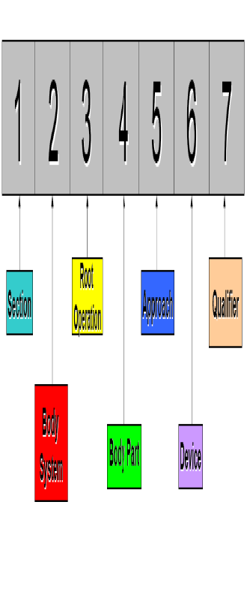
ICD-10 Procedure Code Structure

Slide 16
When to Use ICD-10
Claims should not span months. Bill September 2015, on one claim, and bill October 2015, on a separate claim.
  Not just separate lines, but separate claims.
The date of service (DOS) determines the code, not filing date.
Due to Timely Filing requirements, MHD system allows ICD-9 and ICD-10 claims based off the DOS.

Slide 17
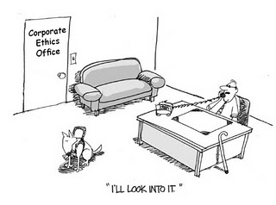
ICD-9 or ICD-10?
ICD-9 and ICD-10 codes may not be billed on same claim
DOS prior to 10/1/15, use ICD-9 code
  On or before 9/30/15
DOS on or after 10/1/15, use ICD-10 code

Slide 18
Date Span on Claims
Medical, Outpatient, Home Health, Dental, and Professional Crossover claim types:
(Start Date, From Date, Through Date)
From and Through Date of Service will be used to determine whether the diagnosis code set value must be ICD-9 or ICD-10.
  ICD-9 Codes: From Date of Service and Through Date of Service are prior to October 1, 2015. (September 30, 2015, and prior)
  ICD-10 Codes: On and after October 1, 2015.

Slide 19
Date Span on Claims
Medical and for Professional Crossover claim types for Durable Medical Equipment (DME):
(Start Date, From Date)
  From Date of Service will be used to determine whether the diagnosis code set value must be ICD-9 or ICD-10.
  ICD-9 Codes: From Date of Service are prior to October 1, 2015. (September 30, 2015, and prior)
  ICD-10 Codes: On and after October 1, 2015.

Slide 20
Date Span on Claims
Inpatient, Nursing Home, or Institutional Crossover claim types:
(Discharge Date, End Date, Through Date)
Through Date of Service will be used to determine whether the diagnosis code set value must be ICD-9 or ICD-10.
  ICD-9 Codes: Through Date of Service or Discharge Date is prior to October 1, 2015. (September 30, 2015, and prior)
  ICD-10 Codes: Through Date of Service or Discharge Date is On and after October 1, 2015.

Slide 21
MHD Outreach
Provider outreach in various areas of the state.
Publish bulletins, hot tips, and other outreach of the ICD-10 transition.
Calls to providers to determine their ICD-10 readiness.
Hosting a test region for the submission of ICD-10 claims.
Ready to accept ICD-10 compliant claims in 837 batches.
Free, online, ICD-10 compliant claims billing software through the www.eMOMED.com.
REMINDER: ICD-10 is effective October 1, 2015.

Slide 22
ICD Resources
  www.CMS.gov/ICD10
  www.roadto10.org
  www.CDC.gov
  www.AHIMA.org
  www.ICD10watch.com
  www.AAPC.com
  http://www.wedi.org/
  www.wedi.org/topics/icd-10
  www.Healthcareitnews.com
  www.ICD10Monitor.com
  https://www.aapc.com/icd-10/codes/

Slide 23
National Resources for ICD-10
ICD-10 is a national initiative and has been supported by CMS and many associations
  www.cms.gov/medicare/coding/icd10
Translation websites and CMS code lists/GEMS
  https://www.aapc.com/icd-10/codes/
  https://www.cms.gov/Medicare/Coding/ICD10/2016-ICD-10-CM-and-GEMs.html

Slide 24
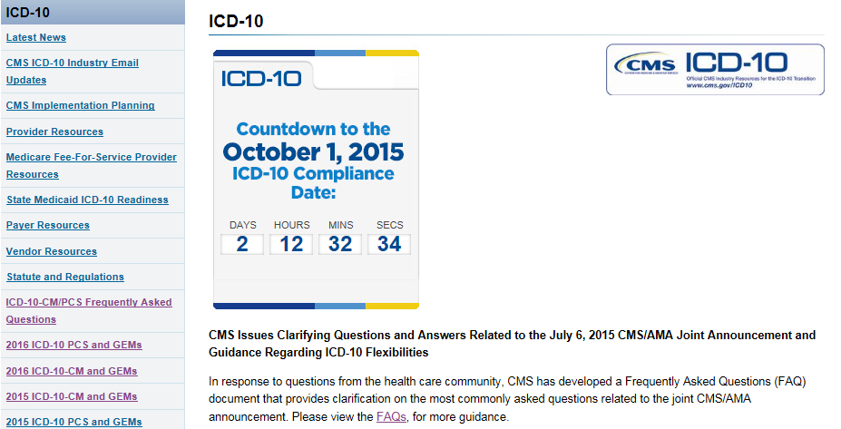
FREE List ICD-10 CM/PCS Codes and FAQs
https://www.cms.gov/Medicare/Coding/ICD10/index.html

Slide 25
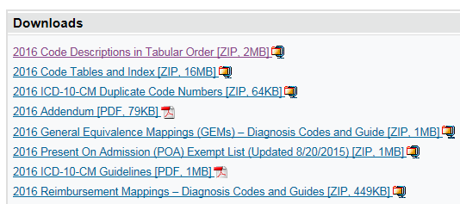
Verify the ICD-10 Code is a Valid, Billable Code
  https://www.cms.gov/Medicare/Coding/ICD10/2016-ICD-10-CM-and-GEMs.html

Slide 26
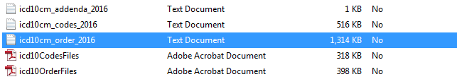
Verify the ICD-10 Code is a Valid, Billable Code

Slide 27
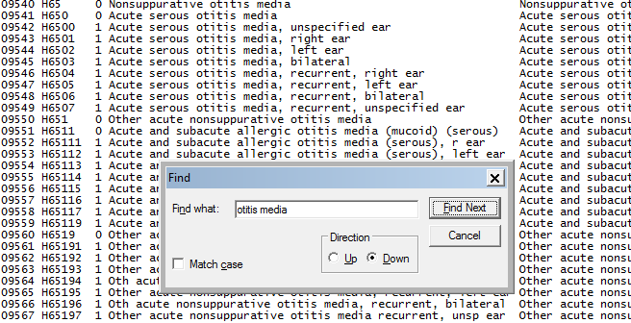
Verify the ICD-10 Code is a Valid, Billable Code

Slide 28
Ongoing Updates for ICD-10
CMS
  Sign up for CMS email updates: https://subscriptions.cms.hhs.gov/accounts/USCMS/subscriber/new?topic_id=USCMS_608
MHD
  Sign up for MHD email updates: https://public.govdelivery.com/accounts/MODSS/subscriber/new

Slide 29
Guidance
CMS Code list and Guidelines:
https://www.cms.gov/Medicare/Coding/ICD10/2016-ICD-10-CM-and-GEMs.html
American Medical Association (AMA) Guidance:
http://www.ama-assn.org/ama
CDC:
http://www.cdc.gov/nchs/icd/icd10cm.htm
AAPC:
https://www.aapc.com/icd-10/

Slide 30
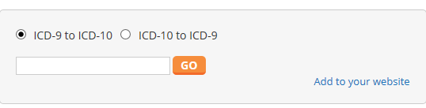
ICD-10 Translation Sites
Translation websites may assist in narrowing down the potential ICD-10 codes. The provider should still verify the selected code reflects the condition of the participant.
  https://www.aapc.com/icd-10/codes/
Be aware of the disclaimers on the site.

Slide 31
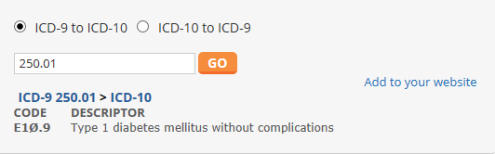
Example ICD-10 Translation
Type 1 Diabetes Mellitus without complications
  ICD-9: 250.1
  ICD-10: E10.9 (E109)

Slide 32
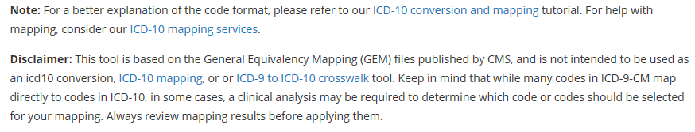

AAPC Disclaimer

Slide 33
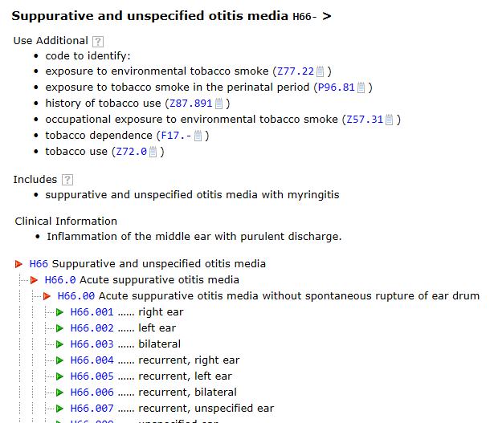
Google ICD-10 code
Many may have multiple ICD-10 code choices, so choose the most appropriate code

Slide 34

Web Based Translations
ICD-9 to 10 Bidirectional Crosswalk Tool
  2016 ICD-10 CM Codes
http://icd10cmcode.com/icd9to10conversion.php
Caution and Disclaimers!

Slide 35
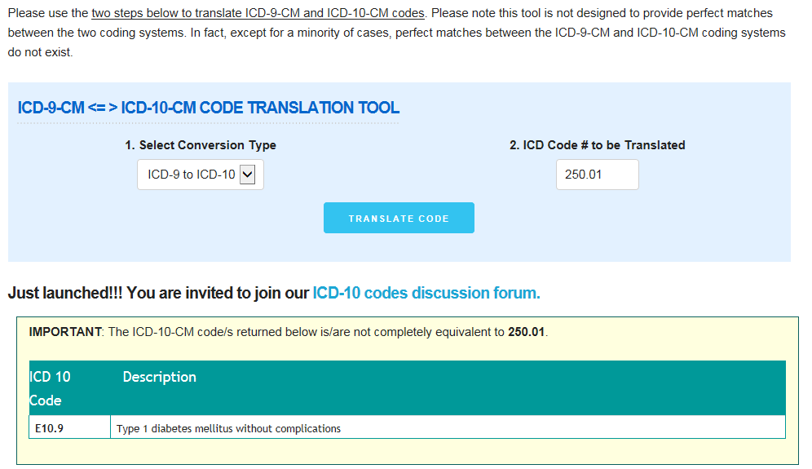

Slide 36
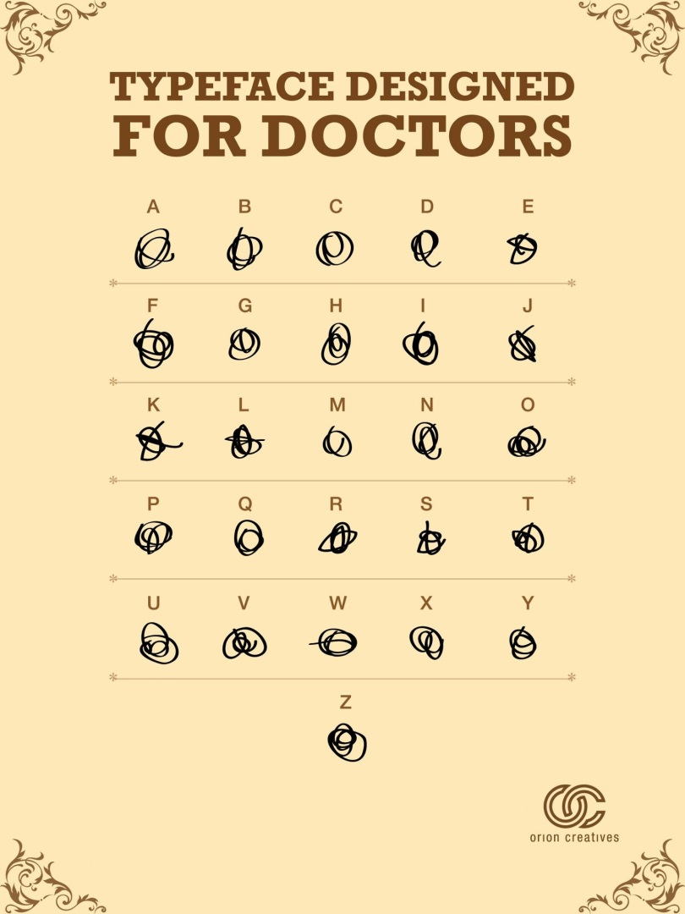
Clinician should have Legible and Detailed Documentation to chose the Appropriate Code

Slide 37
What codes should the Provider Use?
Access Translation Sites to crosswalk the ICD-9 code to ICD-10 Code. Take the ICD-10 code to the CMS mapping, AAPC coding books, and ALL resources to determine the family code ranges. Find the code that demonstrations the clinician’s documentation of the service rendered.
To determine the appropriate and valid code, follow CMS and coding guidelines, and the clinician’s documentation from the services rendered.
Sign up for CMS and MHD email notifications to receive updates.
  Reference MHD Provider Manuals, Bulletins, and Hot Tips.
  Remember these are suggested codes, and the provider needs to ensure they represent the condition/services rendered to the participant.

Slide 38

MHD Provider Participant Page
Access Provider and Participant webpage: http://dss.mo.gov/mhd/providers/.
This page provides links and resources. Access the provider manuals, hot tips, bulletins, and all program provisions from this page.

Slide 39
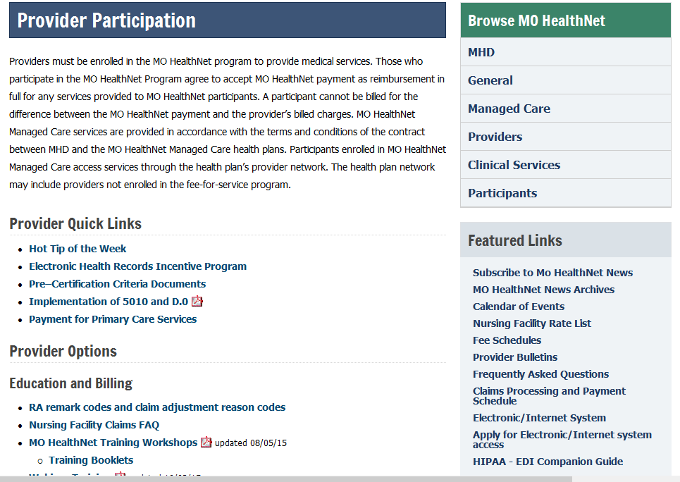

Slide 40
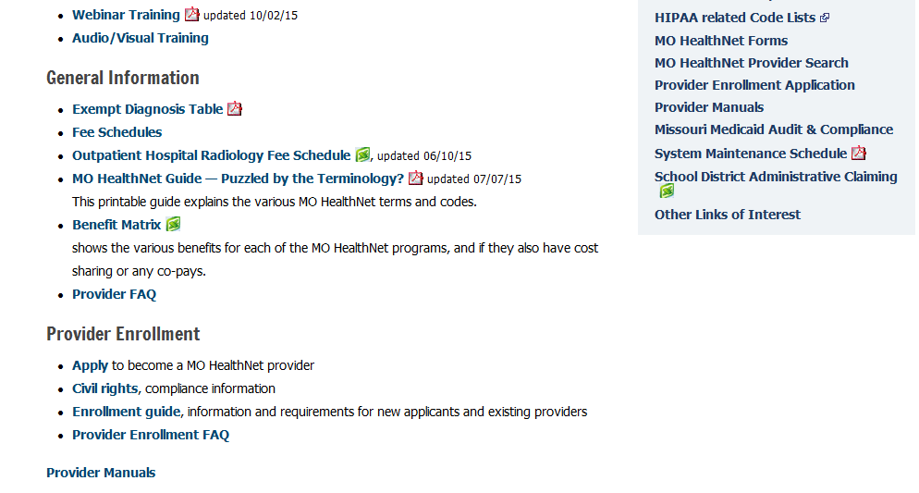

Slide 41

Provider Bulletins and Hot Tips
Provider Bulletin Webpage:
http://dss.mo.gov/mhd/providers/pages/bulletins.htm.
Hot Tips Webpage:
http://dss.mo.gov/mhd/providers/pages/provtips.htm.

Slide 42
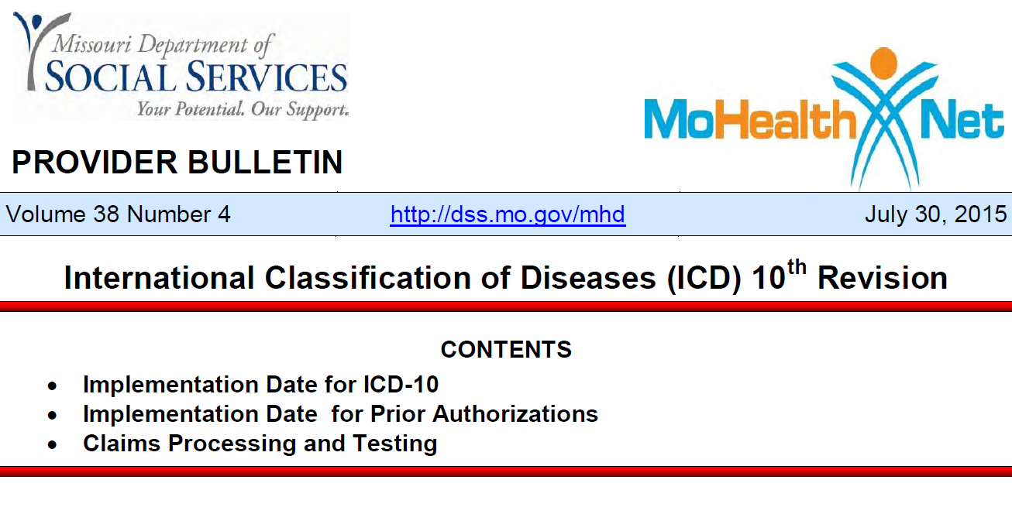
Access this Provider Bulletin for ICD-10 Information

Slide 43
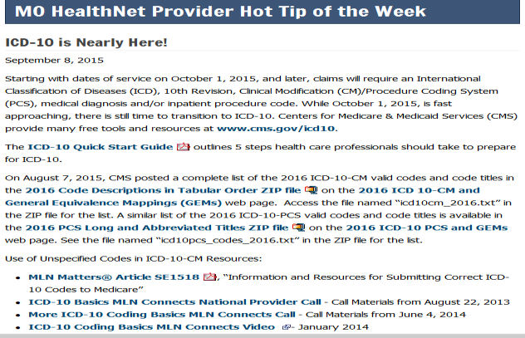
Access this Hot Tip for Helpful Links and Resources

Slide 44
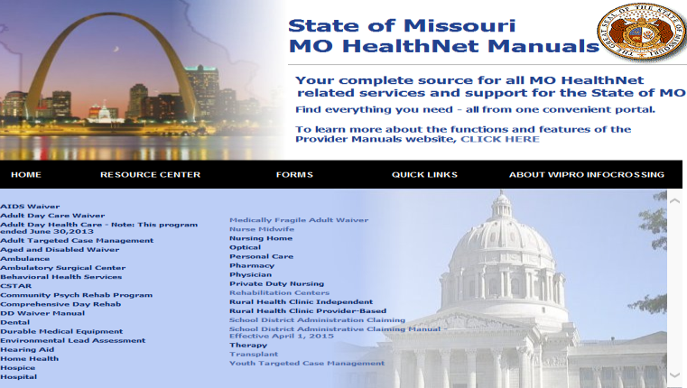
Updated Provider Manuals
http://manuals.momed.com/manuals/.

Slide 45

MHD Changes
Processing of Part A/C Institutional Crossover Claims will now use the Medicare covered days multiplied by the Medicaid per diem from the pricing file to determine payment.

Slide 46
Prior Authorizations
The provider should not have obtain another Prior Authorization

Slide 47

Reminders
No Special Checks for providers documenting the incorrect ICD code on the claims.
Provider must identify the correct ICD Code

Slide 48
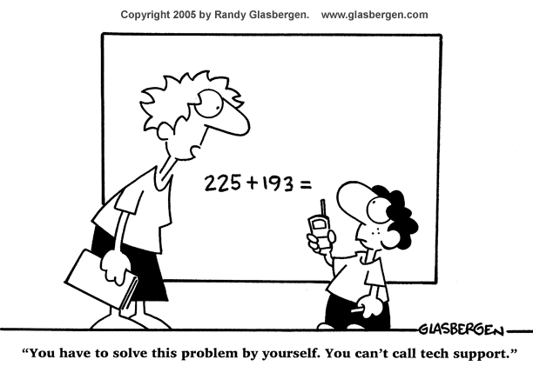

Slide 49

Resources and
Contact Information

Slide 50
Technical Help Desk
MHD Help Desk, (573) 635-3559
Email: internethelpdesk@momed.com
Technical support and assistance for issues with www.emomed.com.
Establish required electronic claims and RA formats, network communication, HIPAA trading partner agreements

Slide 51
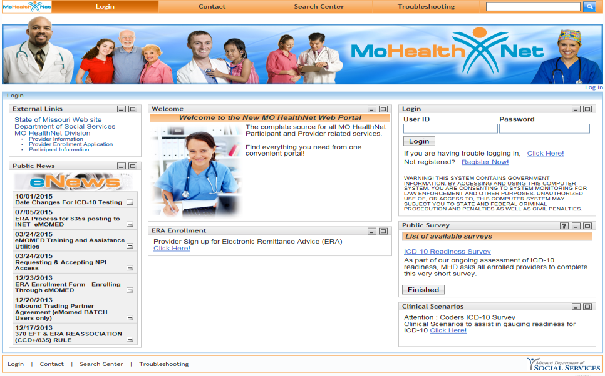
MHD Electronic Billing www.emomed.com.

Slide 52
Provider Communications Unit
(573) 751-2896
Email through the MHD web portal: www.emomed.com.
Contact with inquiries, concerns or questions regarding proper claim filing, claims resolution and disposition, and participant eligibility questions and verification.

Slide 53
Provider Education
(573) 751-6683
Email: MHD.provtrain@dss.mo.gov.
Inquiries regarding education, training assistance and scheduling
Register for Training Today!
http://dss.mo.gov/mhd/providers/education/.

Slide 54
Pharmacy & Clinical Services
(573) 751-6963
Email: clinical.services@dss.mo.gov.
Policy development, benefit design, coverage decisions, provider and program policy inquiries
Pharmacy & Medical Pre-Certification Help Desk
(800) 392-8030
Pharmacy Clinical Authorizations, Edit Overrides, Medical Pre-Certifications.

Slide 55
CyberAccess
Account setup or technical questions
  (888) 581-9797 or (573) 632-9797
  Email: cyberaccesshelpdesk@xerox.com
CyberAccess web address: https://www.cyberaccessonline.net/cyberaccess/.
CyberAccess helpful Tips:
http://dss.mo.gov/cd/info/forms/reference/cyberaccess-helpful-tips.pdf.

Slide 56
Missouri Medicaid Audit and
Compliance (MMAC)
(573) 751-3399
Email: http://mmac.mo.gov/
Conducts investigations into allegations of fraud, waste and abuse by providers and participants
PO Box 6500
Jefferson City, MO 65102-6500

Slide 57
Provider Enrollment Unit
Email: mmac.providerenrollment@dss.mo.gov.
Located within MMAC Division
Inquiries regarding enrollment applications, changes to Provider Master File (addresses, tax identification, ownership, individual's name, practice name, National Provider Identification (NPI) number)

Slide 58


ICD-10 Diagnosis Codes
Z56.6 – Other physical & mental strain related to work (ICD-10 CM)

Slide 59
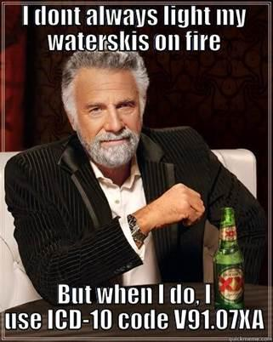
ICD-10 Diagnosis Codes

Slide 60
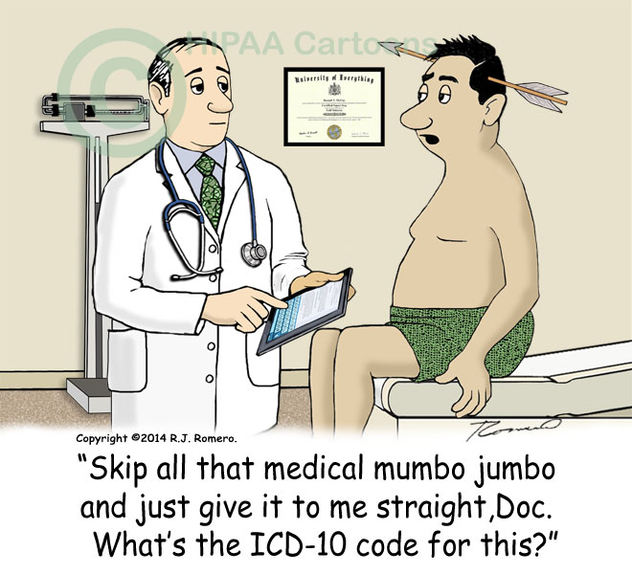
ICD-10 Diagnosis Codes

