Slide 1

Missouri DSS EVV Aggregator Solution (EAS) Personal Care Service (PCS) Provider Stakeholder Kickoff
July 26, 2021

Slide 2
Agenda
Agenda Item | Lead | Description
Introductions | Ruth Sewell | State and Sandata introductions
EVV Background | John Kalivas | 21st Century Cures Act, EVV Systems must verify, Services subject to EVV
EAS Implementation Goals and Scope | John Kalivas | Review program goals and scope
Data Flow: EVV Aggregator Solution (EAS) | John Kalivas / Clella Newcomb | Review data sources, data flow and review of Sandata EAS, Missouri specifics
Demo of EVV Aggregator Solution (EAS) | John Kalivas | Demonstration of the EAS
EAS Implementation Timeline & Activities | Ruth Sewell / Amanda Scanlan | Review high-level timeline
EAS Training | Chad Carr / Angie Lowry | Review training registration
Next Steps | All | Review next steps
Questions | All | Q&A

Slide 3
Missouri State Team Introductions
Team Member | Role
Terri Woodward | DSS/MHD
Dale Carr | DSS/MMAC
Linda Nilges | DSS/MMAC
Travis West | DHSS/DSDS
Leslie Woods | DHSS/BSHCN
Kaitlin Taube | DHSS/DCPH
Shelly Summers | DMH/DD

Slide 4
Sandata Team Introductions
Team Member | Role
Ruth Sewell | Lead Implementation Director
Carlos Rojas | Project Manager
John Kalivas | Technical Manager
Amanda Scanlan | Outreach Lead
Chad Carr | Training Lead

Slide 5
EVV Background

Slide 6

21st Century Cures Act
The 21st Century Cures Act, passed in late 2016, directs States to require the use of an Electronic Visit Verification (“EVV”) system for Medicaid-provided personal care services (PCS) and home health services.
The Cures Act requires that EVV capture six data elements about each visit:
WHO: Member receiving the services
WHO: Caregiver providing the service
WHAT: Type of Service
WHERE: Location of the service delivery
WHEN: Date & time the service begins
WHEN: Date & time the service ends

Slide 7
EVV Related Services
The following PCS services authorized by the Department of Health and Senior Services (DHSS) and/or the Department of Mental Health (DMH) must be verified through use of an EVV system in order to comply with the Cures Act and to comply with State regulations:
Advanced Personal Care
Chore
Consumer-Directed Personal Care
Homemaker
In-Home Respite authorized by the Division of Senior and Disability Services (DSDS)
Personal Care
Any of the above services reimbursed by a Managed Care Organization (MCO)

Slide 8
EAS Implementation Goals & Scope

Slide 9
EAS Implementation Goals
CMS, Cures Act, and State regulation compliance
Vendor-neutral EVV Aggregator
Improve services to participants through increased ability to monitor and deliver care
Data aggregation and program oversight
Target and reduce Fraud, Waste, and Abuse (FWA) through identification of duplicated or unauthorized services
Enhance program integrity and efficient data exchange

Slide 10
EAS Solution
EAS Portal
Oversight and Analytics
Gathers and standardizes all PCS provider visit data against MO-DSS business rules, regardless of the EVV vendor
Presents the data for reporting and analysis, providing full transparency into the care of members

Slide 11
EAS Scope
EAS Implementation
PCS Provider EAS Training
PCS Provider EAS Support
EVV Vendor Interface
EVV Vendor Support
Testing Environment

Slide 12
Data Flow: EVV Aggregator Solution (EAS)

Slide 13
EVV Vendor Interface
The EVV vendor interface is the mechanism by which Sandata will consume EVV visit information from EVV vendors. The data will be stored in EAS, applying the state’s consistent business rules and policy guidelines to every visit performed, regardless of source.
EVV Aggregator Solution (EAS)
PCS Provider Agencies
EVV Vendors
Data Warehouse
EVV Data
State
Program Rules
Store EVV Record Information
EVV Activity
Reporting
Vendor Created Process
Program Rule Exceptions

Slide 14
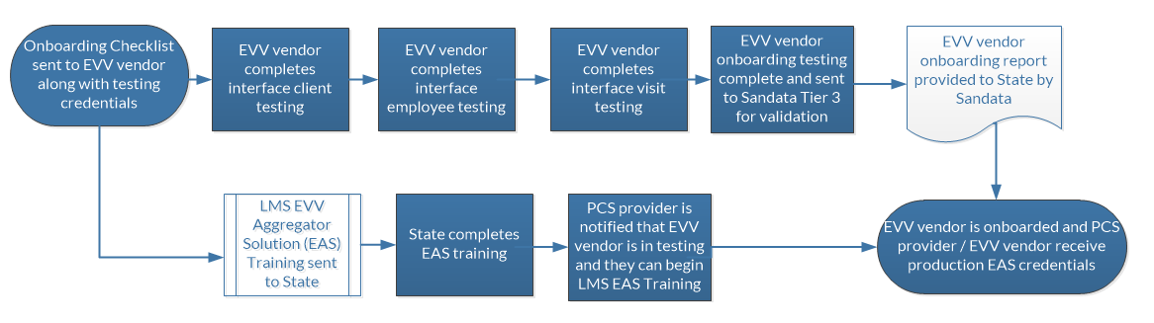
Workflow for EVV Vendor Onboarding Process

Slide 15
MO Specific Data Requirements
PCS Provider Agencies will be required to provide three data transaction sets through their EVV Vendor to support EAS implementation.
Transactions Sets:
Client (Member) Data
Client DCN (Departmental Client Number) - Required
Client Address - Required
Client Phone Number - Optional but recommended
Employee (Caregivers)
Family Care Safety Register (FCSR) number - Required
Visit Data (Schedules)
Matching Client DCN
Matching Employee Identifier
Tasks completed at time of visit (if applicable)
Visit Change – only required when updating/changing existing record

Slide 16
EAS Demonstration

Slide 17
EAS Implementation Timeline & Activities

Slide 18
EAS Work Plan
Project
Milestones
Kick-Off
Approved BRD & Interface Specs
System Ready (8.1.44)
Full Program Go-Live
EVV Vendor
Milestones
Review Specs & Policies
PCS provider
registration opens
EVV Testing (for Go-Live)
Ongoing EVV Testing
(Post Go-Live)
June
July
Aug
Sep
Oct
Nov
Dec
Jan

Slide 19
Key Dates for PCS Providers and EVV Vendors:
Date | PCS Providers | EVV Vendors
07/19 | EAS communication to PCS providers including: Link to provider’s online EVV vendor registration
07/23 |  | EAS communication including: Notice that EVV vendor technical Town Hall is upcoming on 08/05
07/26 | Missouri DSS EVV Aggregator Solution (EAS) Personal Care Service (PCS) Provider Stakeholder Kickoff
08/05 | Implementation Update Inform Stakeholders of upcoming requirements (i.e., technology interfaces to existing EVV), training requirements or other project updates. | MO State EVV vendor interface published. EVV Vendor Town Hall with focus on testing Development approach / examples Testing overview, support channels Common issues / solutions
09/07 | Notice on what comes next as EVV vendors complete testing LMS Training (with dates) How PCS providers become aware their EVV vendor is ready | Notification to EVV Vendor that testing access will be available Testing access opens 9/13 Reminder on access, support, next steps
09/13 | PCS Provider Training LMS becomes available for use. | EVV Vendor receives: Testing credentials Testing checklist
10/26 | Notification of upcoming program launch | EVV Vendors notified of Town Hall with focus on production readiness
11/16 |  | EVV Vendor Town Hall for production readiness Live readiness notice Issue responses and support issues Review of production credential delivery

Slide 20
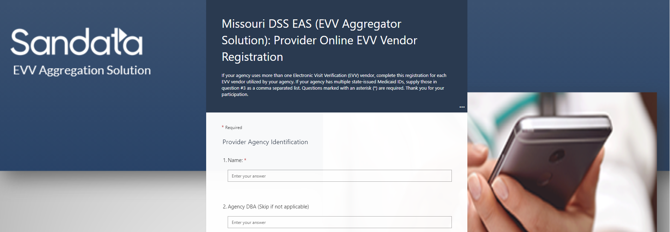
Please complete
PCS Provider Online EVV Registration
Completing registration starts the process for Sandata and your EVV Vendor to develop a data interface to EAS.
Completion Due Date: July 30, 2021

Slide 21
EVV Aggregator Solution (EAS) Training

Slide 22
PCS Provider EVV Aggregator Solution (EAS) Training
Self-Paced Online Webinar hosted via Sandata’s Learning Management System (LMS)
Duration: 30 minutes
Training Registration Process Opens: 9/13/21
Self-Paced Learning Registration Quick Reference Guide
https://www.sandatalearn.com?KeyName=MOaltevv

Slide 23
Next Steps

Slide 24
Next Steps
PCS Providers and EVV Vendors attend EVV Vendor Town Hall with focus on testing – August 5th
Review the published MO State EVV vendor interface
Development approach / example
Testing overview, support channels
Common issues / solutions
Test credentials received – September 13th
EVV vendors who have been registered by their PCS Provider
EVV Vendors attend Town Hall for production readiness – November 8th
Refresh of previous Town Hall
Best practices
Push for compliance

Slide 25
Questions

