Slide 1

HHCS EVV Town Hall
Wednesday, May 17, 2023
9:30a – 10:30a CST

Slide 2
Discussion Topics
Welcome and Town Hall Guidelines
Integration Testing Process
EVV Vendor Specification and JSON
Issuance of Production Credentials
Unsuccessful Testing, Common EVV Vendor Support Issues (Errors and troubleshooting steps)
Overview of the Quick Reference Guide
EVV Vendor and Provider Agency Resources
State Expectations
Thank You

Slide 3
Welcome and Town Hall Guidelines

Slide 4
Welcome and Town Hall Guidelines
Purpose:
This town hall is a follow-up to the February 21, 2023, town hall that addressed the registration of EVV vendors and the posting of EVV vendor specifications and to the March 6, 2023 town hall that addressed the Electronic Visit Verification Aggregator Solution (EAS) vendor testing process. The focus of this town hall is to announce the EAS go-live and the delivery of production credentials, along with detailing the process required for successful completion.
Guidelines:
All participants have been placed on mute.
Post presentation specific questions using the Q&A feature. Questions will be answered during the presentation as time permits.
This presentation and recording will be shared with MO DSS to be published to the MO DSS EVV website.
Sandata will be distributing a survey to collect feedback. Participation is encouraged.
Notes:
If we don’t get through the questions during the town hall, we can state we will address them via another form of communication.
This presentation and recording will be shared (added bullet)

Slide 5
Integration Testing Process

Slide 6
EVV Vendor Specification and JSON

Slide 7
Understanding the EVV Vendor Specification
  The EVV vendor specification is housed on the Missouri EVV website.
    EVV vendor specification: https://dss.mo.gov/mhd/providers/pdf/evv-vendor-specification.pdf
  The EVV vendor specification contains three sections:
    Client
    Employee
    Visit

Slide 8
Client Overview
  Three Segments for client records:
    Client General – Required
    Client Address – Required
    Client Phone – Recommended
      Client payer segments are not required and should not be sent.
  Identifiers are used for matching logic:
    ProviderID value: 9-Digits Medicaid ID
    ClientBirthDate: YYYY-MM-DD (Required)
    ClientIdentifier: 8-Digits exactly including leading zeros Departmental Client Number (DCN)
      Error Message: “Client_ID Not Found” will post if an initial match with the MMIS ClientIdentifier loaded to Sandata is not made.
      EVV vendors may need to resubmit after 24 hours to obtain ClientIdentifier match.
  Client Validation:
    ClientIdentifier and ClientBirthDate match to State MMIS data.
    ClientAddress segment is required
    ClientPhone segment is recommended

Slide 9
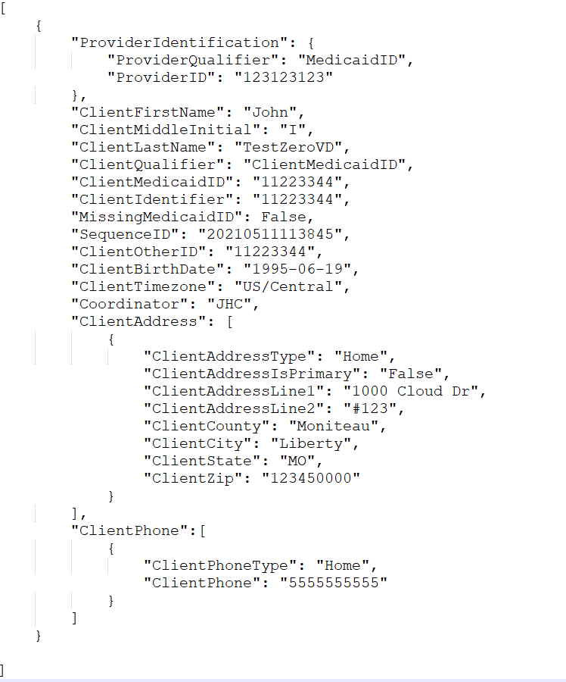
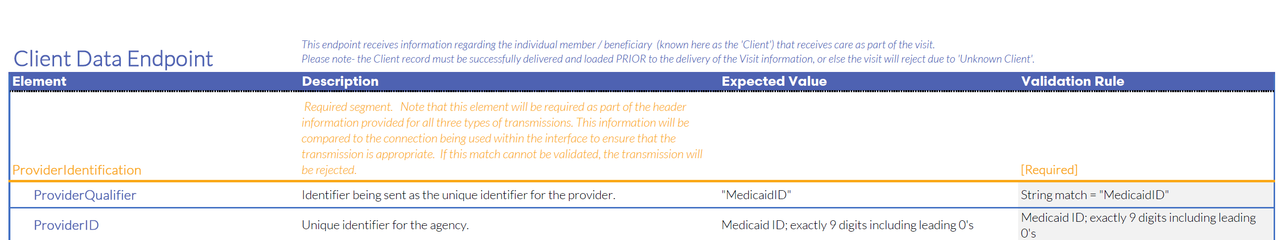
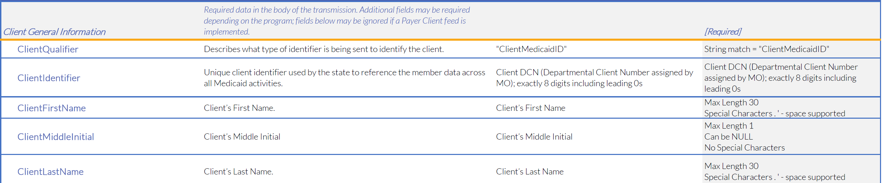
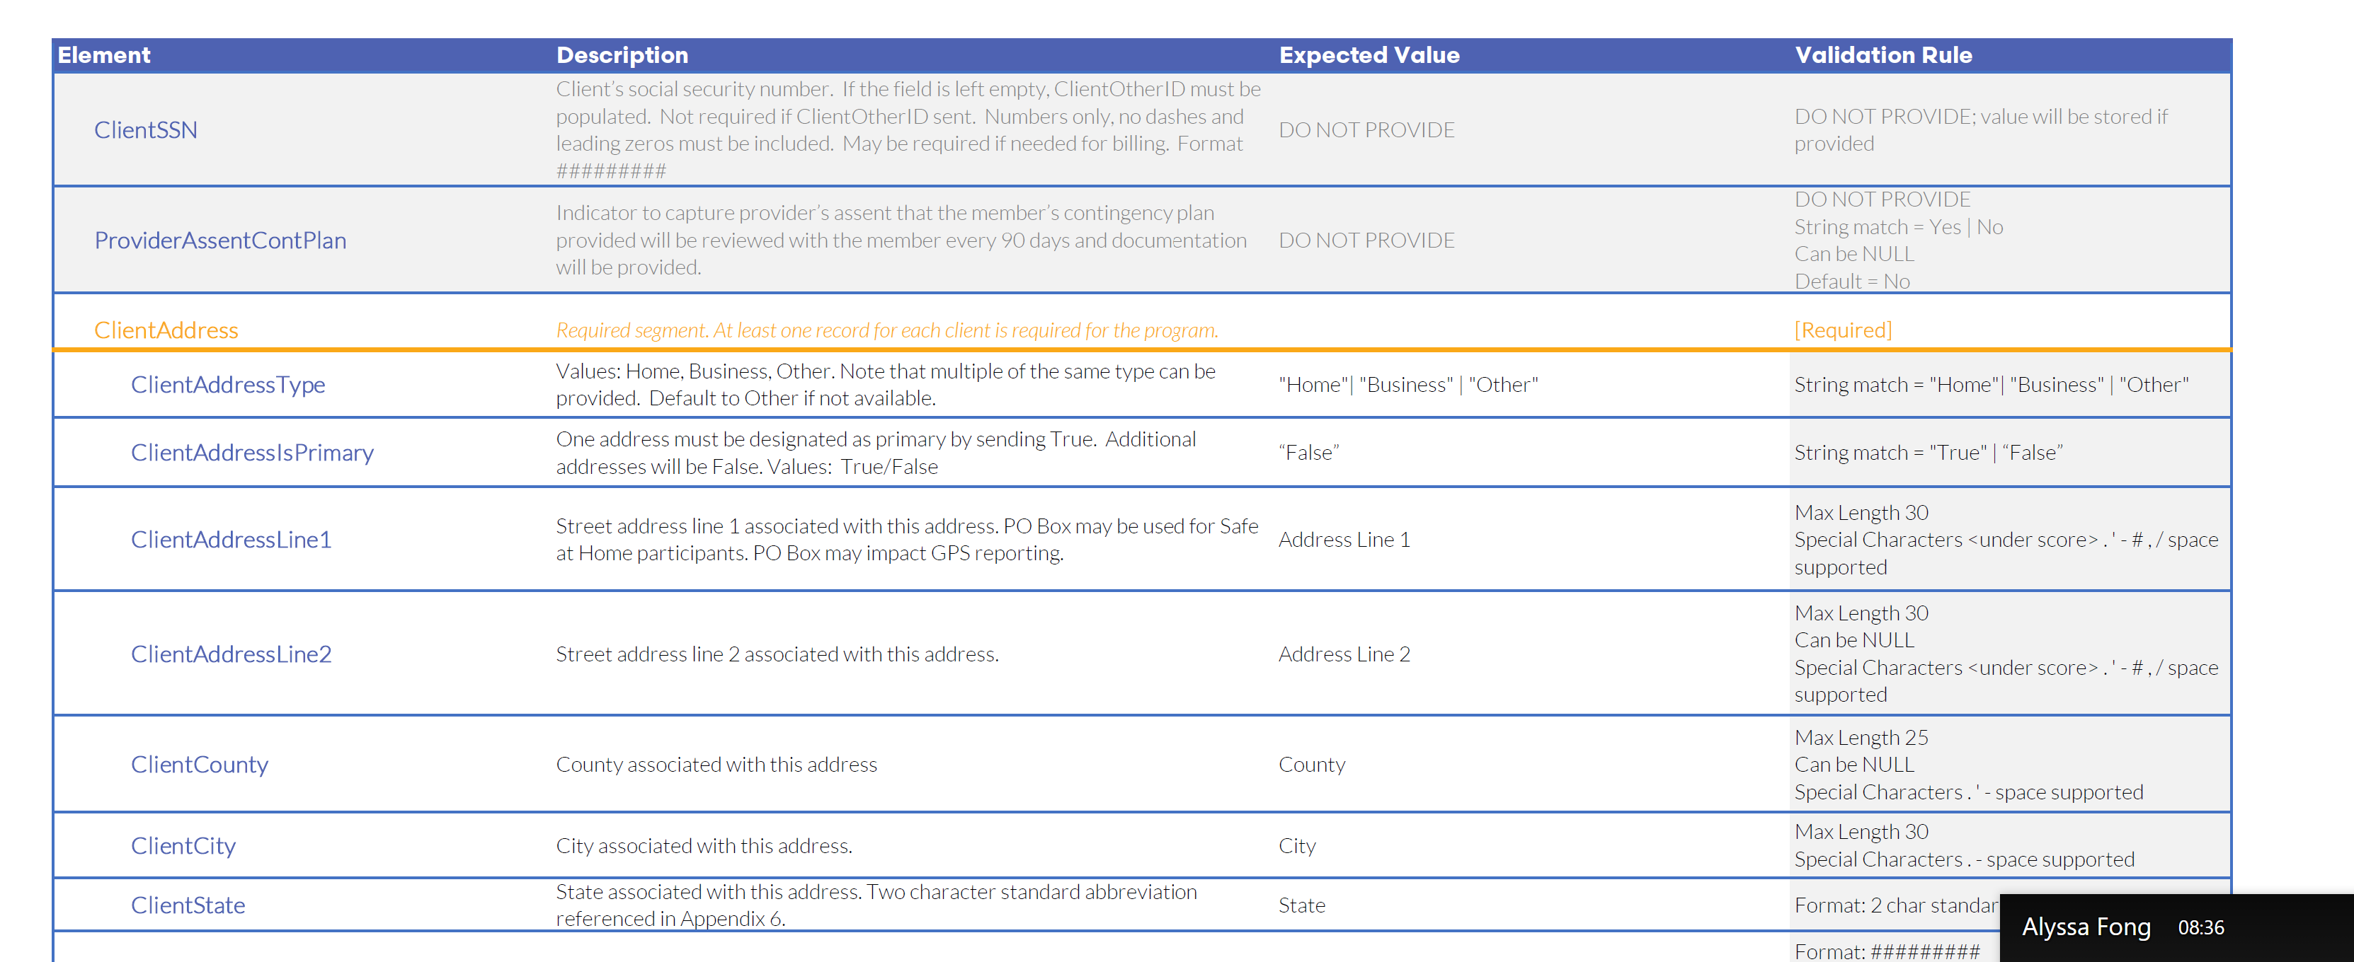
Client Overview: JSON
EVV vendor data is sent via RESTful API / JSON transmissions
  Example: Missouri Client API

Slide 10
Employee Overview
  One required segment for Employee (Person providing service in the home):
    Employee General
  Identifiers used for matching logic:
    ProviderID value: 9-Digits Medicaid ID
    EmployeeIdentifier: 8-Digits exactly including leading zeros Family Care Safety Registry (FCSR) Number
  Employee Validation:
    EmployeeIdentifier length check
    EmployeeIdentifier will be matched to existing records:
      No Match = Insert new record
      Yes Match = Update existing

Slide 11
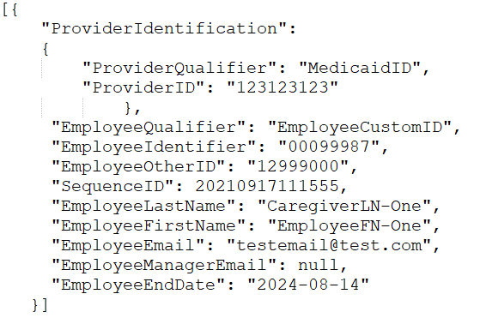
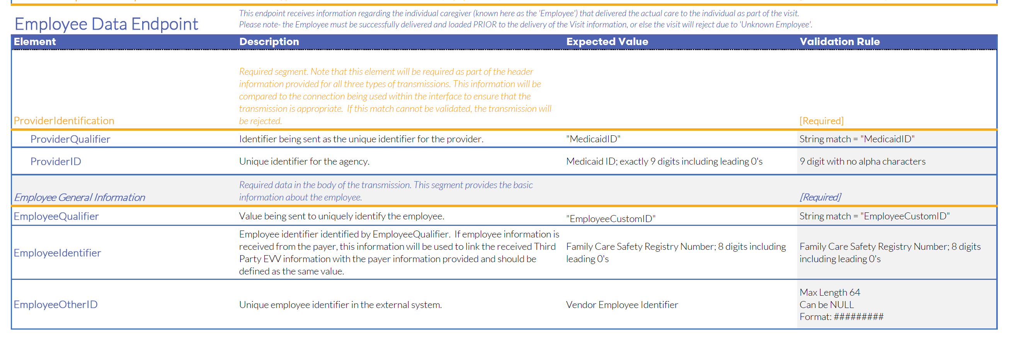
Employee Overview: JSON
EVV vendor data is sent via RESTful API / JSON transmissions
  Example: Missouri Employee API

Slide 12
Visit Overview
  One required segment for Visit Records:
      Visit General
  Three conditional segments for Visit Records:
      Calls
      Visit Changes
      Visit Tasks
  Identifiers used for matching logic:
      ProviderID value: 9-Digits Medicaid ID
      VisitOtherID value: ID from EVV vendor system
      ClientIdentifier: 8-Digits Departmental Client Number (DCN)
      EmployeeIdentifier: 8-Digits Family Care Safety Registry (FCSR) Number

Slide 13

Visit Overview
  Procedure code validation.
    PayerID, PayerProgram, & ProcedureCode must match to a valid record as listed in the specification.
  ClientIdentifier must match to existing client record.
      Error Message: “Client_ID Not Found” will post if an initial match with the MMIS ClientIdentifier loaded to Sandata is not made.
      EVV vendors may need to resubmit after 24 hours to obtain ClientIdentifier match.
  EmployeeIdentifier must match to existing employee record.
  Optional segments are required based on the condition for the segment.
    Example: When a change is required for a visit previously sent to the EAS, the updated visit will require the VisitChange Segment.
  Visits performed without electronic call data (manual calls) will require the ‘VisitChanges’ segment to be included in the ‘Visit’ transmission.

Slide 14
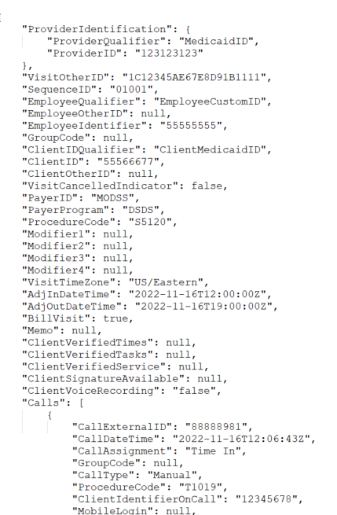
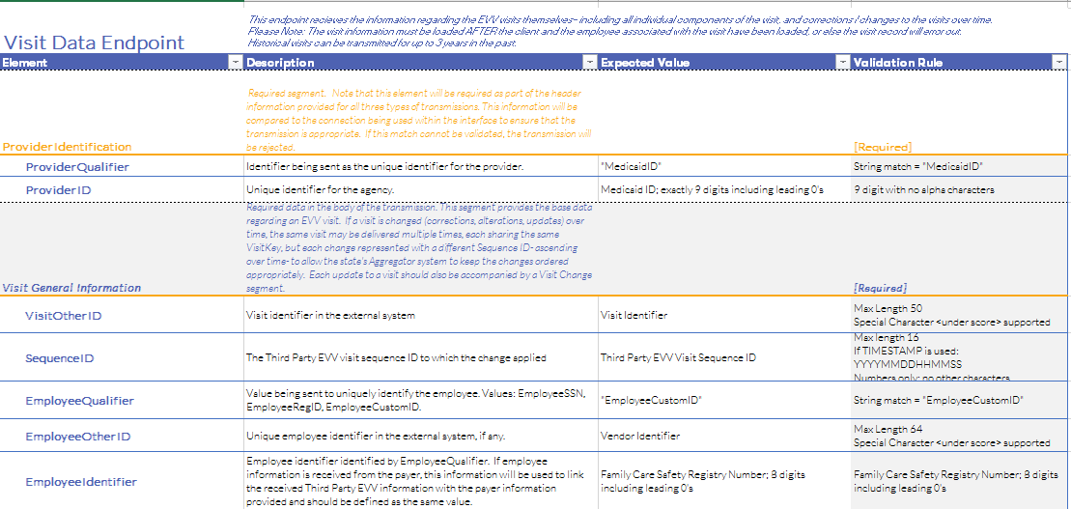
Visit Overview: JSON
EVV vendor data is sent via RESTful API / JSON transmissions
  Example: Missouri Visit API

Slide 15
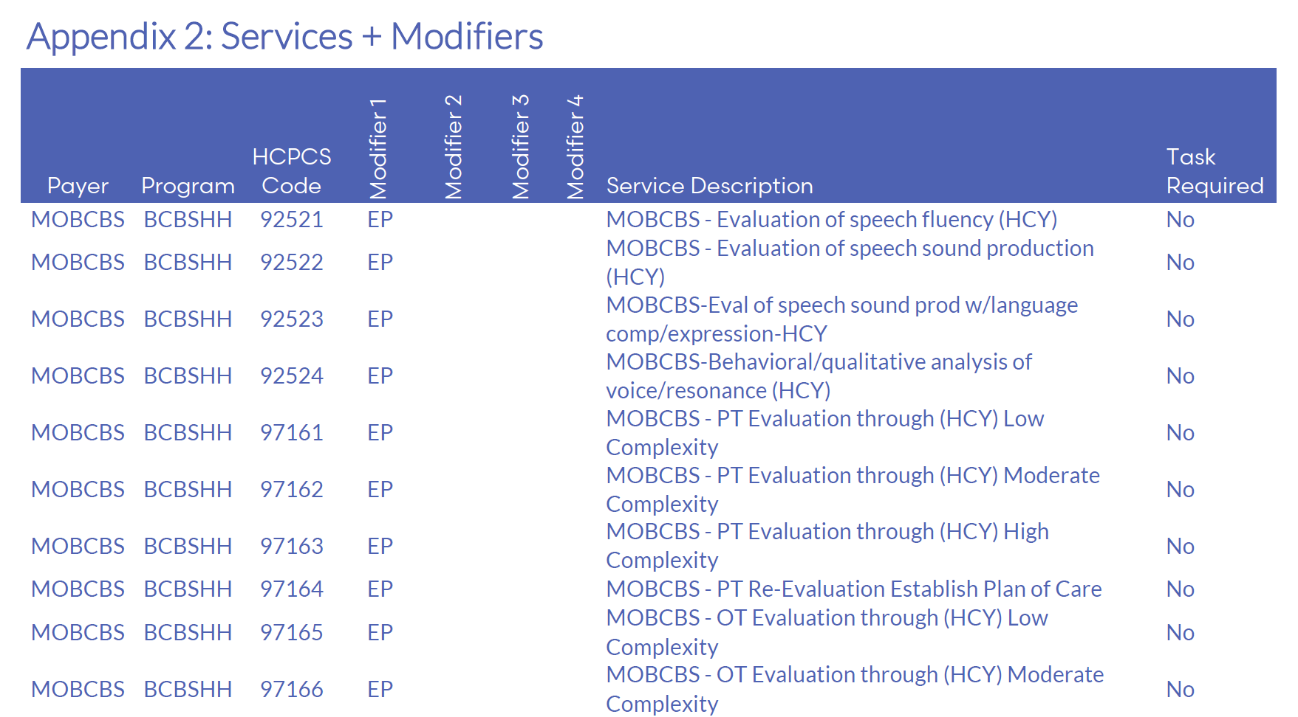
Services and Modifiers – Sample of Appendix 2

Slide 16
Visit Exceptions
  Exceptions ensure data aligns to program definition for the Missouri EAS program.
  The Missouri exceptions will cause incomplete visit status; and therefore, are not acknowledgeable via the API.
  On error, correct the missing or incorrect data and resubmit the transaction.
  For Missing Task Exception, Exception Code 10, tasks are required for some services and if the visit does not include a task, the visit will be set to incomplete. (This exception only applies to personal care services.)
Exception Code | Exception Name
0 | Unknown Clients
1 | Unknown Employees
2 | Visits Without Any Calls
3 | Visits Without In-Calls
4 | Visits Without Out-Calls
10 | Missing Task Exception *
23 | Missing Service

Slide 17
Issuance of Production Credentials

Slide 18
Distribution of Production Credentials
  Testing Complete?
    Submit completed checklist to Sandata at moaltevv@sandata.com.
    Sandata will validate the testing checklist.
    Upon successful testing and validated testing checklist, provider agencies will need to complete LMS training for production credentials to be issued.
    Sandata Support will send encrypted email to the provider and vendor with a link to the production credentials which will be used to transmit visit data to the EVV Aggregator.

Slide 19
Unsuccessful Testing - Common EVV Vendor Support
Issues

Slide 20
Common EVV Vendor Support Issues
Invalid Credentials
  Error Message: Error Message: “Request contains the following providers that are not authorized for the given Account & Credentials: [ProviderID]”.
  Root Cause:
    Provider does not have valid credentials.
  What can we do to troubleshoot?
    Contact Sandata Support

Slide 21
Common EVV Vendor Support Issues
Client Not Found – Error Code -1021 (Visit Record)
  Error Message: “Client Not Found” (Client Record)
  Root Cause 1:
    Client does not exist in State-provided client/member file feed.
      Error Message: “Client Not Found. Clients must have been previously received from Payer to be updated via Alt-EVV” will post if an initial match with the MMIS ClientIdentifier and ClientBirthDate loaded to Sandata is not made.
      EVV vendors may need to resubmit after 24 hours to obtain ClientIdentifier match.
  What can we do to troubleshoot?
    Check EAS to ensure Client record was successfully added to the provider account.
    Access the eMOMED portal (eligibility and billing) to check member dates of birth.
    If failed on 24 hour resubmit, contact Sandata for support.

Slide 22
Common EVV Vendor Support Issues
Client Not Found – Error Code -1021 (Visit Record)
  Error Message: “Client Not Found” (Visit Record)
  Root Cause 2:
    Client does not exist in provider account.
      Client JSON failed to be created.
      Transmission of visit with incorrectly formatted ClientIdentifier – format requires leading 0s and must be exactly 8 digits.
  What can we do to troubleshoot?
    Check EAS to ensure Client record was successfully added to the provider account.
    Check the EVV vendor specification for the format and ensure the correct value is in the correct field.
    Ensure Visit Client Identifier matches Client Identifier on Client record.
    Contact Sandata for support.

Slide 23
Common EVV Vendor Support Issues
Worker Not Found – Error Code -1031 (Visit Record)
  Error Message: “Worker Not Found”
  Root Cause:
    Employee not properly specified.
      Employee Identifier is not correctly formatted. For example: the Payer program may require an ID that is padded with leading zeroes.
      Improper transmission format where a valid Employee Identifier is in the wrong JSON field.
  What can we do to troubleshoot?
    Check the EVV vendor specification for the format and ensure the correct value in the correct field.
    Possible Next Steps:
      May need to involve Sandata EVV vendor support for additional troubleshooting.
      Retransmit Employee data to EAS.

Slide 24
Common EVV Vendor Support Issues
Service ID – Error Code -553 (Visit Record)
  Error Message: “Error during retrieving service service_id entered”.
  Root Cause 1:
    Missing service in visit.
      All visits must include the service provided to the member to be verified.
  What can we do to troubleshoot?
    Check the EVV vendor specification for the valid service, if applicable, modifier field combinations and order to ensure the provider has the correctly formatted value in the correct field.
    Possible Next Steps:
      May require investigation of service code and visit processing with Sandata’s Engineering team.
      Retransmit with corrected visit data to EAS.

Slide 25
Common EVV Vendor Support Issues
Service ID – Error Code -553 (Visit Record)
  Error Message: “Error during retrieving service service_id entered”
  Root Cause 2:
    Incorrectly formatted service in visit.
      All services and modifiers are case sensitive and must use capital letters.
        For example: g0153 ep is a valid service code with modifiers but will fail due to the lower-case letters.
  What can we do to troubleshoot?
    Check the EVV vendor specification for the valid service, if applicable, modifier field combinations and order to ensure the provider has the correctly formatted value in the correct field.
    Possible Next Steps:
      May require additional investigation of service code and visit processing with Sandata’s Engineering team
      Retransmit with corrected visit data to EAS.

Slide 26
Auto Verified Visit Requirements
Auto Verified Visit Requirements:
All visits must have a Call In and Call Out time that originates in the field.
All visits must include data verifying the location of service delivery.
All visits with adjustments are considered manual regardless of when the adjustment is made.
CMS and the state require a high auto verification rate for visits in EAS.

Slide 27
Integration Best Practices
  Send Client (Member) Records First.
    Send all Clients as soon as possible.
    Check status to ensure Client loaded successfully.
  Send Employee (Caregiver) Records Second.
    Send all Caregivers as soon as possible.
    Check status to ensure Employee loaded successfully.
  Send Visits after verifying that Clients and Employees have loaded successfully.
  Continue to send visits at a minimum, once daily in alignment to the Missouri DSS requirement.
  Send new clients as they are identified, or an existing record is updated.
  Send new employees as they are identified, or an existing record is updated.
  Send data elements in alignment with the MO DSS vendor specifications. If it states, “Do Not Send”, don’t send the data.

Slide 28
Overview of the Quick Reference Guide

Slide 29
Quick Reference Guide
  The EAS Interface Process Quick Reference Guide describes the process for interfacing with EVV Aggregator Solution (EAS) and covers the following steps:
    Registration
    Testing Process
    Provider Training
    Data Validation
Notes:
The EAS integration process begins with the provider and completing the EVV vendor registration form. The secured email has an expiration date to open. The testing credentials do not expire.

Slide 30
EVV Vendor And Provider Agency Resources

Slide 31
Working with Sandata Customer Support
The following information will be collected by our support team to help expedite resolution of your case:
Provider name
EAS account number (referred to as your STX #)
Provider contact name
EVV vendor contact information
  Vendor contact email address
  Vendor contact direct phone
Description of issue
  Please provide a brief description of the issue and when it started.
Please include:
  Screenshots
  JSON files
  UUIDs
IMPORTANT: JSONs and screenshots should be sent securely and are required to investigate any errors received during transmission (e.g., Client Not Found).

Slide 32
EVV Support Resources
  Sandata MO DSS EVV Vendor Support:
    Email: moaltevv@sandata.com
    Phone: 1-833-350-5844
  Sandata Resource Website Sandata-On-Demand (SOD):
    Link: https://sandata.zendesk.com/hc/en-us
  Missouri EVV Website:
    Resources for the EVV vendors
      Link for EVV vendors: https://dss.mo.gov/mhd/providers/electronic-visit-verification.htm

Slide 33
EVV Support Resources
  The EVV vendor specification is housed on the Missouri EVV website.
    EVV vendor specification: https://dss.mo.gov/mhd/providers/pdf/evv-vendor-specification.pdf
  Provider Vendor Interface Quick Reference Guide
    Link: https://dss.mo.gov/mhd/providers/pdf/eas-interface-process-quick-reference-guide.pdf

Slide 34
State Expectations

Slide 35
Provider Responsibilities
Complete an online EVV vendor registration form.
Complete EAS training prior to the release of EAS credentials.
Log in to the Aggregator to verify that data has been transmitted and is accurate.
Communicate frequently with your EVV vendor and check the MO DSS website for updates.
Notes:
Complete an online EVV vendor registration form.
Confirmation of receipt is provided by Sandata.
Sandata reviews registration responses.
Communicate with the EVV vendor about the requirements to interface with EAS and to the MO DSS website for implementation updates.
Complete EAS training prior to the release of EAS credentials.

Slide 36
Online EVV Vendor Registration Form
    Who Needs to Register?
    Home Health Care Service (HHCS) providers who have not registered their EVV vendor with Sandata
    A PCS and HHCS provider that has already registered their EVV vendor for PCS services, must complete this form to register their EVV vendor for HHCS services
    If provider has multiple state issued provider Medicaid ID’s, provider must complete this form for each state issued provider Medicaid ID
Refer to the Registration section of the Quick Reference Guide for instructions on how to register.
Notes:
Who needs to complete the online vendor registration form?
Home Health Care Service (HHCS) providers who have not registered their EVV vendor with Sandata.
A PCS and HHCS provider that has already registered their EVV vendor for PCS services, must complete this form to register their EVV vendor for HHCS services.
If provider has multiple state issued provider Medicaid ID’s, provider must complete this form for each state issued provider Medicaid ID.

Slide 37
Provider Training
At least one individual from the provider agency must complete the free self-paced EAS Learning Management System (LMS) Training.
Training is available to all applicable staff.
Training can be taken as often as needed.
Refer to the Provider Training section of the Quick Reference Guide for instructions on how to access EAS training.
Notes:
Who needs to complete the online vendor registration form?
Home Health Care Service (HHCS) providers who have not registered their EVV vendor with Sandata.
A PCS and HHCS provider that has already registered their EVV vendor for PCS services, must complete this form to register their EVV vendor for HHCS services.
If provider has multiple state issued provider Medicaid ID’s, provider must complete this form for each state issued provider Medicaid ID.

Slide 38
Provider Responsibilities Post Go Live
Log in to EAS a minimum of once a week to verify visit data is being transmitted successfully to EAS.
Communicate often with EVV vendor.
Providers visit data must be submitted to the EVV vendor at a minimum of once daily.
Notes:
Who needs to complete the online vendor registration form?
Home Health Care Service (HHCS) providers who have not registered their EVV vendor with Sandata.
A PCS and HHCS provider that has already registered their EVV vendor for PCS services, must complete this form to register their EVV vendor for HHCS services.
If provider has multiple state issued provider Medicaid ID’s, provider must complete this form for each state issued provider Medicaid ID.

Slide 39
Thank You!

