Slide 1


Partnering for Impact: Gainwell Technologies
and MO HealthNet
Chris Brown, RPh - Clinical Program Director
October 7, 2026

Slide 2
Agenda
01
Where Are We?
04
Questions?
Review project status
Raise questions, resolve and/or table
02
What Is Next?
Discuss upcoming activities
03
What Is Needed?
Identify resources/engagement needed for next steps

Slide 3
Where Are
We?
3

Slide 4
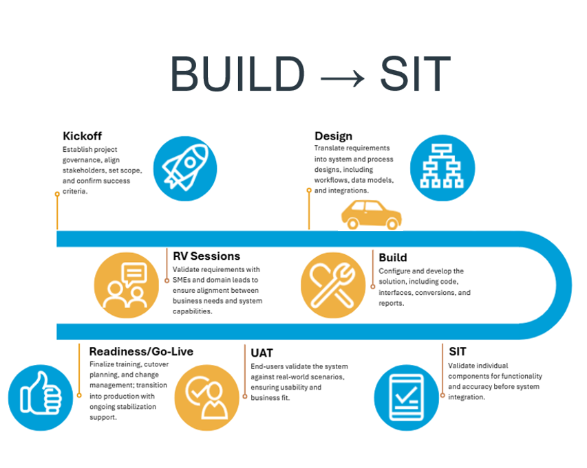
Project Life Cycle Update
With the Design Phase nearing completion, we are ready to transition to the Build Phase of the project.
Purpose:
Turn approved designs into configured, developed, and test-ready solution components.

Slide 5
What Is
Next?
5

Slide 6
PBA BUILD PHASE
Turning approved design into a working, test-ready solution
What happens during Build
PBA teams configure, develop, connect, and validate the solution so it is ready to enter formal testing.
01
02
03
04
Configure the PBA Solution
Develop Interfaces & Data
Complete Outputs & Workflows
Prepare for SIT
Apply approved business rules, workflows, security, and operational settings.
Build integrations, conversions, and data components needed for end-to-end processing.
Develop reporting, notices, and supporting workflows defined in the approved design.
Complete unit testing, address defects, and confirm environments and test data are ready.
What helps Build stay on track?:
Timely decisions
SME validation
Clear ownership
Fast blocker resolution
This keeps configuration and development aligned to approved design and supports a smoother transition into SIT.
Notes:
[Sources]
- MHD Power Point for July - Build.pptx, slides 4, 6, 7, and 9. User-provided presentation used for visual style and Build-phase messaging.
[/Sources]

Slide 7
Build Readiness Checkpoint
Build work is IN PROGRESS
Configuration, development, interfaces, conversions, and reports are ready for validation.
Scope is CLEAR
Components included in the Build/SIT path are clearly defined
Design direction is being APPROVED
Open design questions, decisions, and assumptions are resolved or tracked.
Testing preparation is in PLACE
Unit testing, test data, defect tracking, and environment readiness are aligned.

Slide 8
What Is
Needed?
8

Slide 9
Clear Blockers
Keep Build Moving Towards SIT
As Build progresses, timely partnership helps reduce rework, clear blockers, and support readiness for formal testing.
Confirm Direction
Validate Outputs

Slide 10
Questions

