Slide 1

Vocational Rehabilitation
Missouri Department of Elementary and Secondary Education
August 2019
Notes:
Type comments here.

Slide 2
VR Mission
Our mission is to support individuals with disabilities in achieving successful employment outcomes.
Work hard to ensure that everyone has a great VR experience

Slide 3
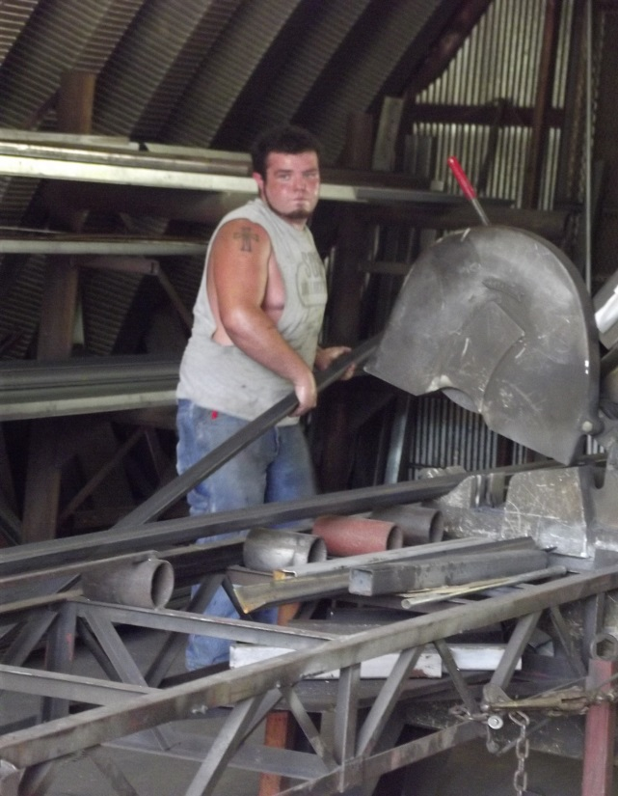
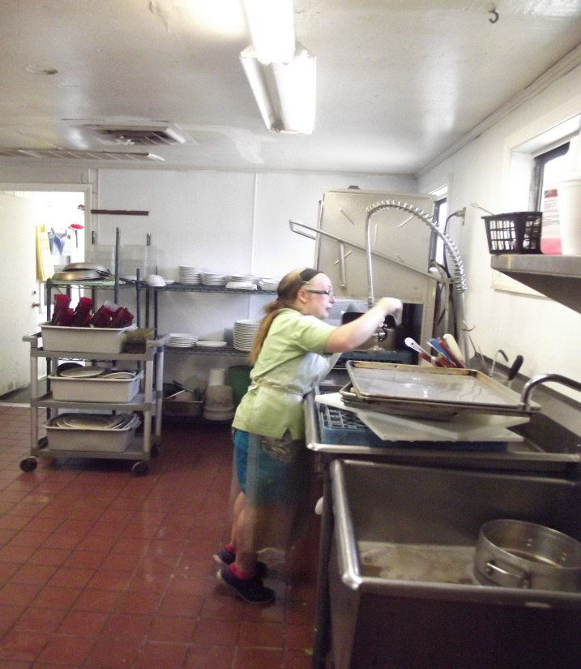
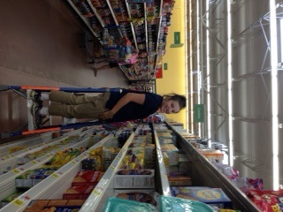
What is Vocational Rehabilitation?
A program designed to help individuals with physical or mental impairment(s) prepare for, engage in and retain competitive integrated employment

Slide 4
Services Offered
Pre-Employment Transition Services
Summer Work Experience
Vocational Guidance and Counseling
Supported Employment
Employment Services
Employment Services Plus for Autism, DHH, TBI
Training/College
Rehabilitation Technology
Individual Placement Supports (IPS)

Slide 5
Pre-Employment Transition Services
With the changes to WIOA in 2014, VR was charged with serving students who are potentially eligible and at a younger age
VR partnered with University of Missouri (MU) to provide Pre-ETS services to students who are potentially eligible
Pre-Employment services are provided in the following areas:
Job Exploration Counseling
Work-based Learning Experiences
Workplace Readiness Training
Instruction in Self-Advocacy
Counseling on Post-Secondary Enrollment

Slide 6
Summer Work Experience
VR also developed a summer work experience to provide Work-based learning for students the summer before their last year in school
This is a 6 week program and includes a Job Readiness Training component.
Students are paid minimum wage for their experiences and are provided a job coach in a 1:6 ratio
https://youtu.be/WEmm1Xb0qX4

Slide 7
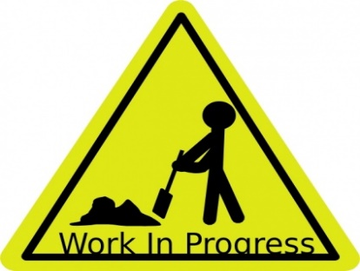
Employment Services
This service is funded by VR and provided by a CRP.
For individuals that do not need long-term coaching or long-term follow along services.
Limited coaching available.
Retention Services for a minimum of 90 days.
Includes Job Development with resume building, interview prep, filling out applications, etc.

Slide 8
Supported Employment
This service is funded by VR and provided by a Community Rehabilitation Provider (CRP) and is for those individuals needing coaching and long-term supports on the job-must be Most Significantly Disabled.
Includes:
Discovery and Exploration: community assessments, informational interviews, job shadowing, interest assessments to determine appropriate job;
Job Development: resume building, interview skills, completing job applications;
Coaching: Onsite supports to learn the job; and
Long-Term Follow Along Services: monthly check- ins for the life of the job.

Slide 9
Employment Services Plus
ESP for Autism, Head Injury or Deaf and Hard of Hearing (D/HH)
Autism Services-includes Career Exploration, social skills groups, Job Development, coaching, follow along at least 90 days
Head Injury-Can include return to work, Job Development, 90 day follow along
D/HH-includes D/HH case management, interpreting, Job Development, coaching, 90 day follow along services
**These services are not available in all areas**

Slide 10
Individual Placement and Support (IPS)
IPS is a collaborative service with the Department of Mental Health (DMH) for individuals with a serious mental illness in order to help them obtain and maintain employment.
The IPS approach is to place an individual into employment as soon as possible, placing less emphasis on the traditional concept of employment “readiness”.
Principles of IPS:
Focus on Competitive Employment
Eligibility is Based on Client Choice
Integration of Rehabilitation and Mental Health Services
Attention to Worker Preferences
Personalized Benefits Counseling
Rapid Job Search
Systematic Job Development
Time-Unlimited and Individual Job Support.

Slide 11
College/Training Assistance
Financial Assistance based on financial need of individual/family.
Assistance connecting with disability support services.
Vocational Guidance and Counseling throughout training or college and on to Employment-assistance with resume building, interview skills.
Follow-along assistance after graduation until the individual is employed.

Slide 12
Rehabilitation Technology
VR can assist with technology necessary for an individual to obtain, maintain or regain employment, such as:
Hearing aids
Wheelchairs
Vehicle modifications
Home modifications

Slide 13
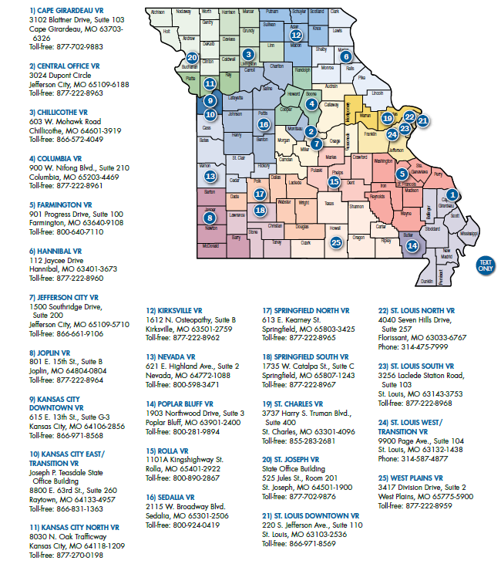
Missouri VR Offices
Notes:
MAP of VR offices and what counties are served per office – located on our webpage

Slide 14
VR Business Team
VR business team focuses on the following 3 areas:
Employer Engagement-a connection to employment opportunities, opening the door for a job seeker. Strategic access to the employer.
Community Partnership-ensuring that VR is at the table and included. Creating and accessing braiding opportunities. Knowledge and sharing of resources.
VRC and Agency Support-necessary steps to connect job ready candidates to opportunities. Opportunities include apprenticeship, OJT and other training options by vetting these opportunities before we provide the information to staff.
Notes:
There are 7 business specialists located regionally across the state

Slide 15

2018 Successful Outcomes
5010 consumers with successful employment outcomes!!

Slide 16

For more information
http://dese.mo.gov/adult-learning-rehabilitation-services/vocational-rehabilitation
Elizabeth Perkins: elizabeth.perkins@vr.dese.mo.gov
Rebecca Maynard: rebecca.maynard@vr.dese.mo.gov
Notes:
For additional information, please click on the above link to learn more about Vocational Rehabilitation.

